Slide 1
Black Friday & Cyber Monday 2024
JCDecaux UK Programmatic DOOH Auction Packages

Slide 2
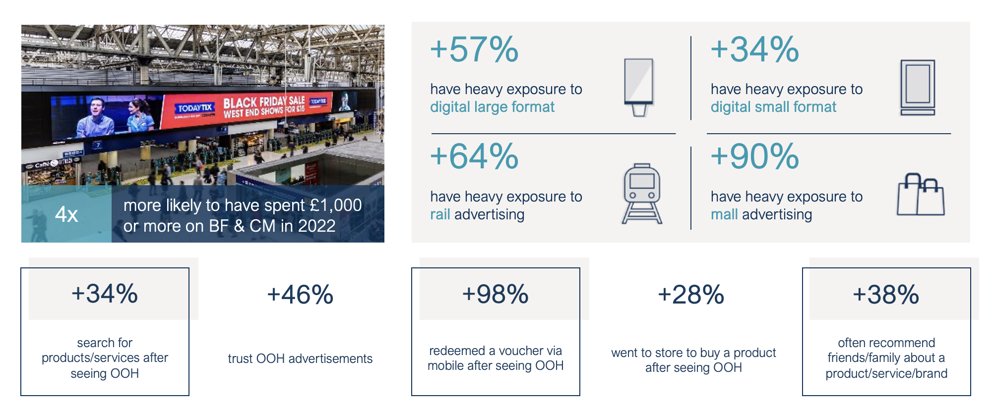
Black Friday & Cyber Monday: 29th November – 2nd December 2024
Source: YouGov Profiles 2024: Audience defined as those who have participated in Black Friday/Cyber Monday in the last 12 months vs Nat Rep *BF = Black Friday CM = Cyber Monday

Slide 3
Ready, set, shop!
£8.74 bn ​
Retail expenditure on Black Friday in 2023 ​
​
4 in 10 ​
Brits are planning to make a purchase on Black Friday​
​​
#1 ​
Biggest retail event​
​
Source: Statista, 2023; YouGov, 2019, Crimtan, ​

Slide 4
Customer motivations
Christmas shopping is a huge driver during Black Friday, with the majority of consumers focused on buying gifts for loved ones.
This creates a prime opportunity to target an audience that's actively searching for holiday deals.
With 54% of respondents prioritising Christmas presents and 34% taking advantage of spontaneous bargains, the holiday season is clearly the perfect time to capture shoppers. ​
By aligning campaigns with these motivations, brands can tap into highly engaged, deal-hungry audiences, ensuring messaging is tailored to holiday shoppers looking for the perfect gifts.​
*Statista 2024 ; Leading consumer reasons for planned shopping during the Black Friday period in the United Kingdom (UK) in 2023​

Slide 5
The audience
By leveraging the JCDecaux Data Management Platform, we can identify regions across the UK that have a higher concentration of discount shoppers and those interested in Black Friday deals.
Even with a limited budget, this allows us to make our audience targeting as relevant as possible.
Upon request, we can create custom audience segments based on additional factors.
Example audience filters:
Interested in Black Friday / discount shopping​
GenZ discount shoppers
Millennial bargain hunters
Mid-income tech enthusiasts
Source – JCDecaux DMP​

Slide 6
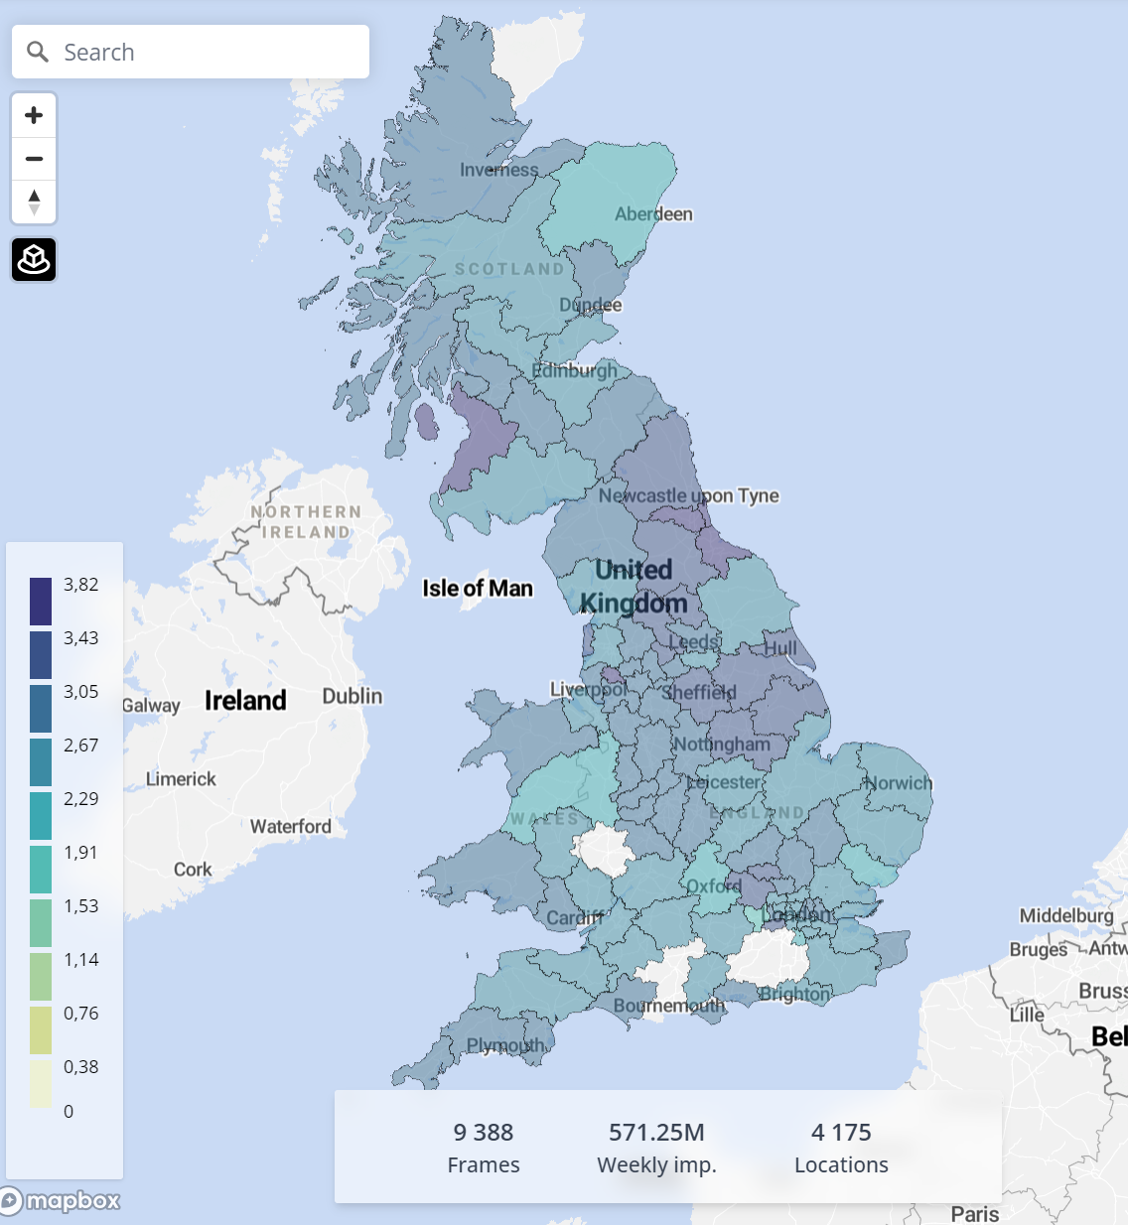
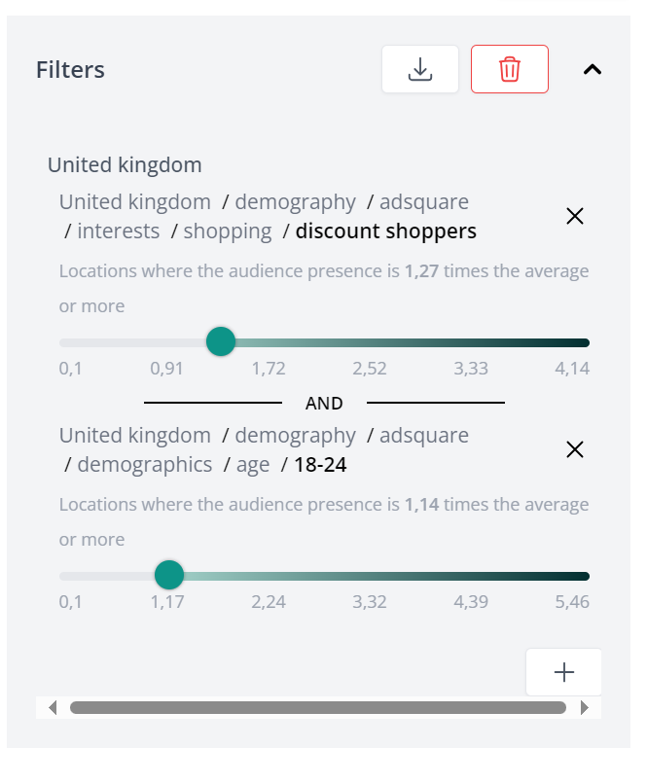
Gen Z discount shoppers
Source: JCDecaux DMP

Slide 7
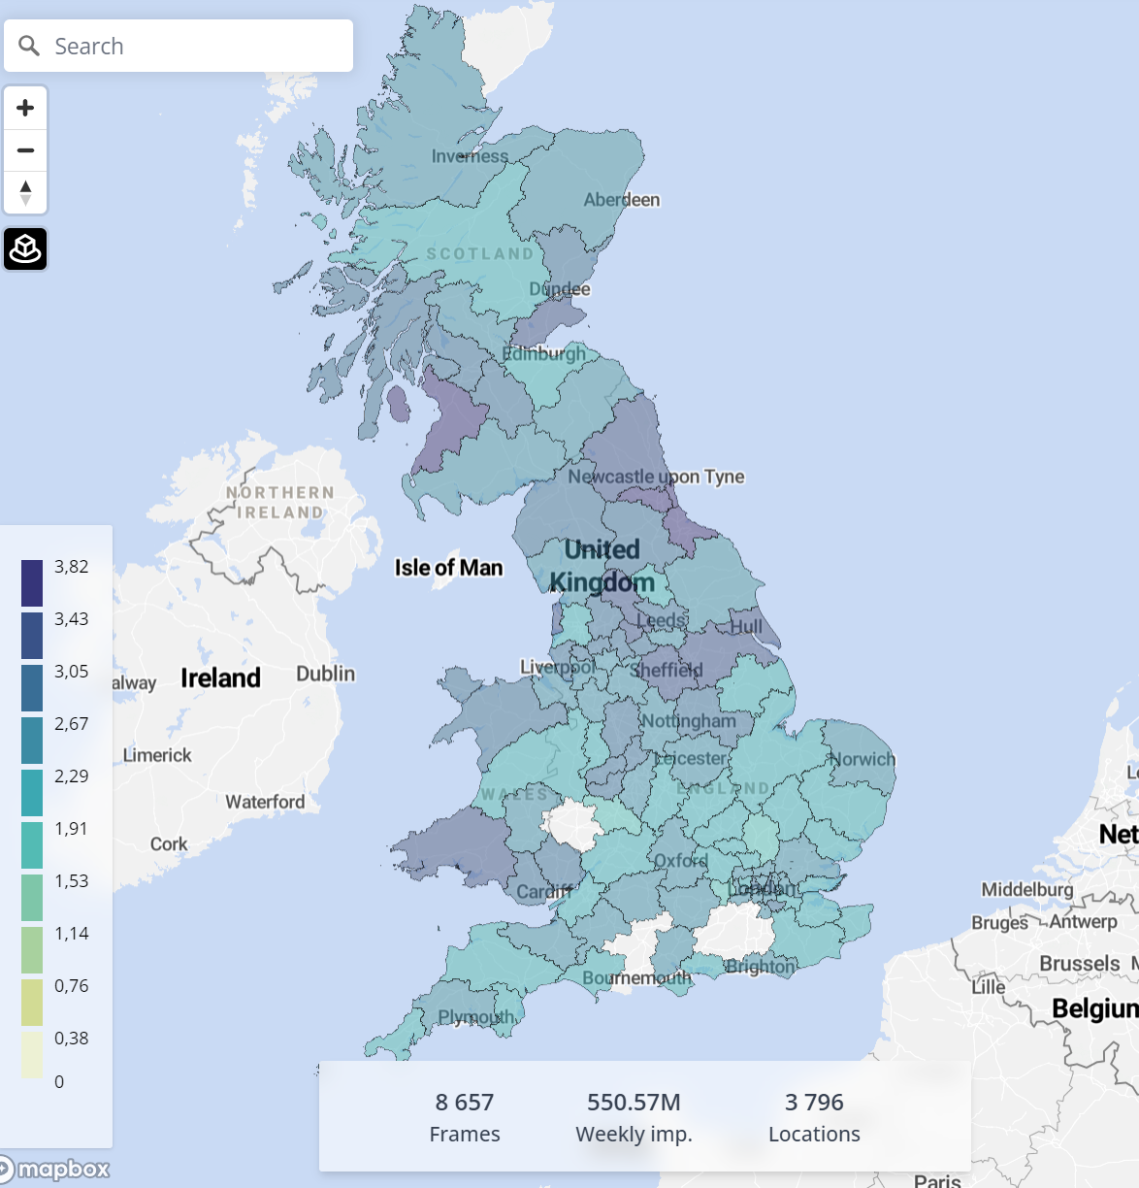
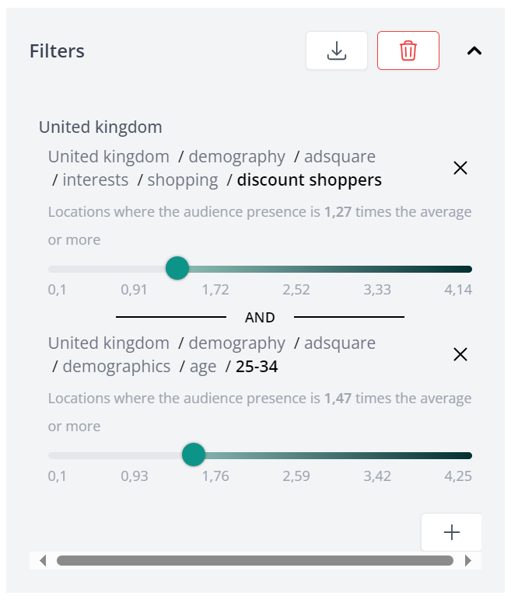
Millennial bargain hunters
Source: JCDecaux DMP

Slide 8
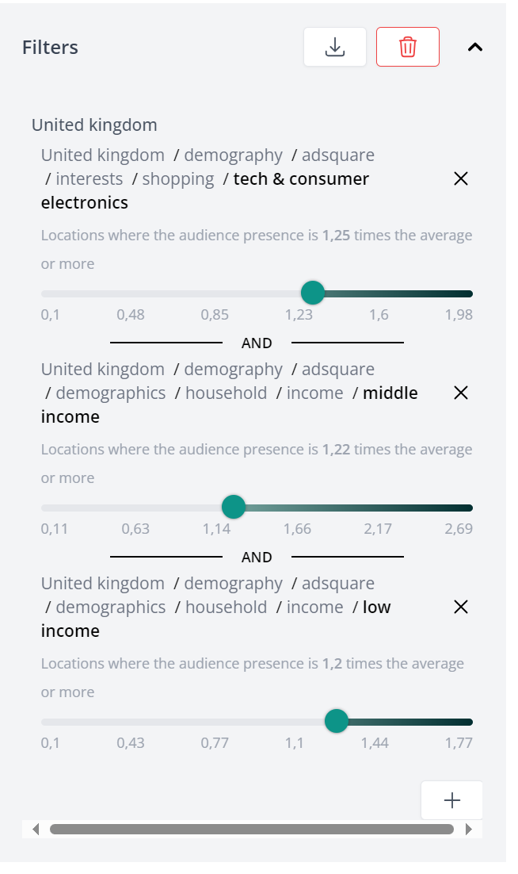
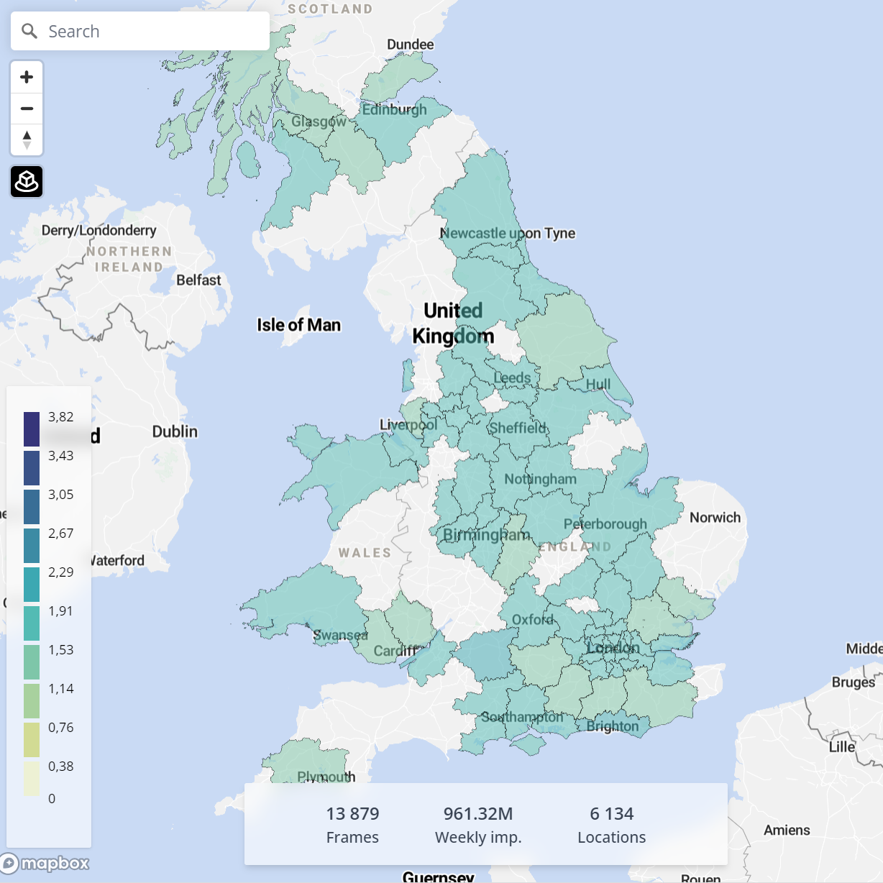
Mid-income tech enthusiasts
Source: JCDecaux DMP

Slide 9
Bronze package: £25,000
25th November – 2nd December 2024
Format | Creative | Specs | CPM
Roadside D6 | Static | 1080x1920 | £15
Rail D6 | Static and motion | 1080x1080​ | £8
Mall D6 | Static and motion | 1080x1080​ | £8
2.4m**
Impressions
£10.30
Average CPM
Please get in touch to discuss personalising this campaign.​
*Sizes Vary​, ** 2,427,184 – impressions generated from VIOOH Automation, subject to change depending on availability when deals are set up​

Slide 10
Silver package: £50,000
25th November – 2nd December 2024
Format | Creative | Specs | CPM
Roadside D6 | Static | 1080x1920 | £15
Rail D6 | Static and motion | 1080x1080​ | £8
Mall D6 | Static and motion | 1080x1080​ | £8
MVision | Static and motion | 720x1280*​ | £15
Large format | Static | 612x306*​ | £15
5.4m**
Impressions
£9.20
Average CPM
Please get in touch to discuss personalising this campaign.​
*Sizes Vary​, ** 2,427,184 – impressions generated from VIOOH Automation, subject to change depending on availability when deals are set up​

Slide 11
Gold package: £100,000
25th November – 2nd December 2024
Format | Creative | Specs | CPM
Roadside D6 | Static | 1080x1920 | £15
Rail D6 | Static and motion | 1080x1080​ | £8
Mall D6 | Static and motion | 1080x1080​ | £8
MVision | Static and motion | 720x1280*​ | £15
Large format | Static | 612x306*​ | £15
Supermarkets | Static | 1080x1920 | £15
7.8m**
Impressions
£13.00
Average CPM
Please get in touch to discuss personalising this campaign.​
*Sizes Vary​, ** 2,427,184 – impressions generated from VIOOH Automation, subject to change depending on availability when deals are set up​

Slide 12
Black Friday & Cyber Monday 2024
If you want to reach Black Friday and Cyber Monday customers, or have any other briefs, please contact your JCDecaux rep, or email:​
uk.programmatic@jcdecaux.com

