Slide 2
OUT-OF-HOME DELIVERS increased BRAND AWARENESS, retailer support and credibility for a challenger drinks brand
Support new retailer listing and price promotions
HumaniTea
BACKGROUND:
HumaniTea is a social enterprise crafting the UK’s 1st chilled ready-to-drink plant-based vegan tea lattes brewed with actual tea leaves, creamy oat milk, and ethically sourced, quality ingredients.
CAMPAIGN OBJECTIVES:
Raise brand awareness
Support price promotions and listings within stockists including the Co-op, Amazon and Ocado.
CAMPAIGN DETAILS:
A two-week campaign on sites near specific Co-op stores, as well as digital street furniture, rail, large format billboards in key cities.
Specifically, Motion@TheCity sites across key commuter stations, including Liverpool Street, Blackfriars, London Bridge and Fenchurch Stations.
RESULTS:
Increase in brand awareness amongst new audiences that aren’t reached through HumaniTea’s social channels.
The Out-Of-Home campaign enhanced HumaniTea’s credibility and stature as a new startup brand.

Slide 3
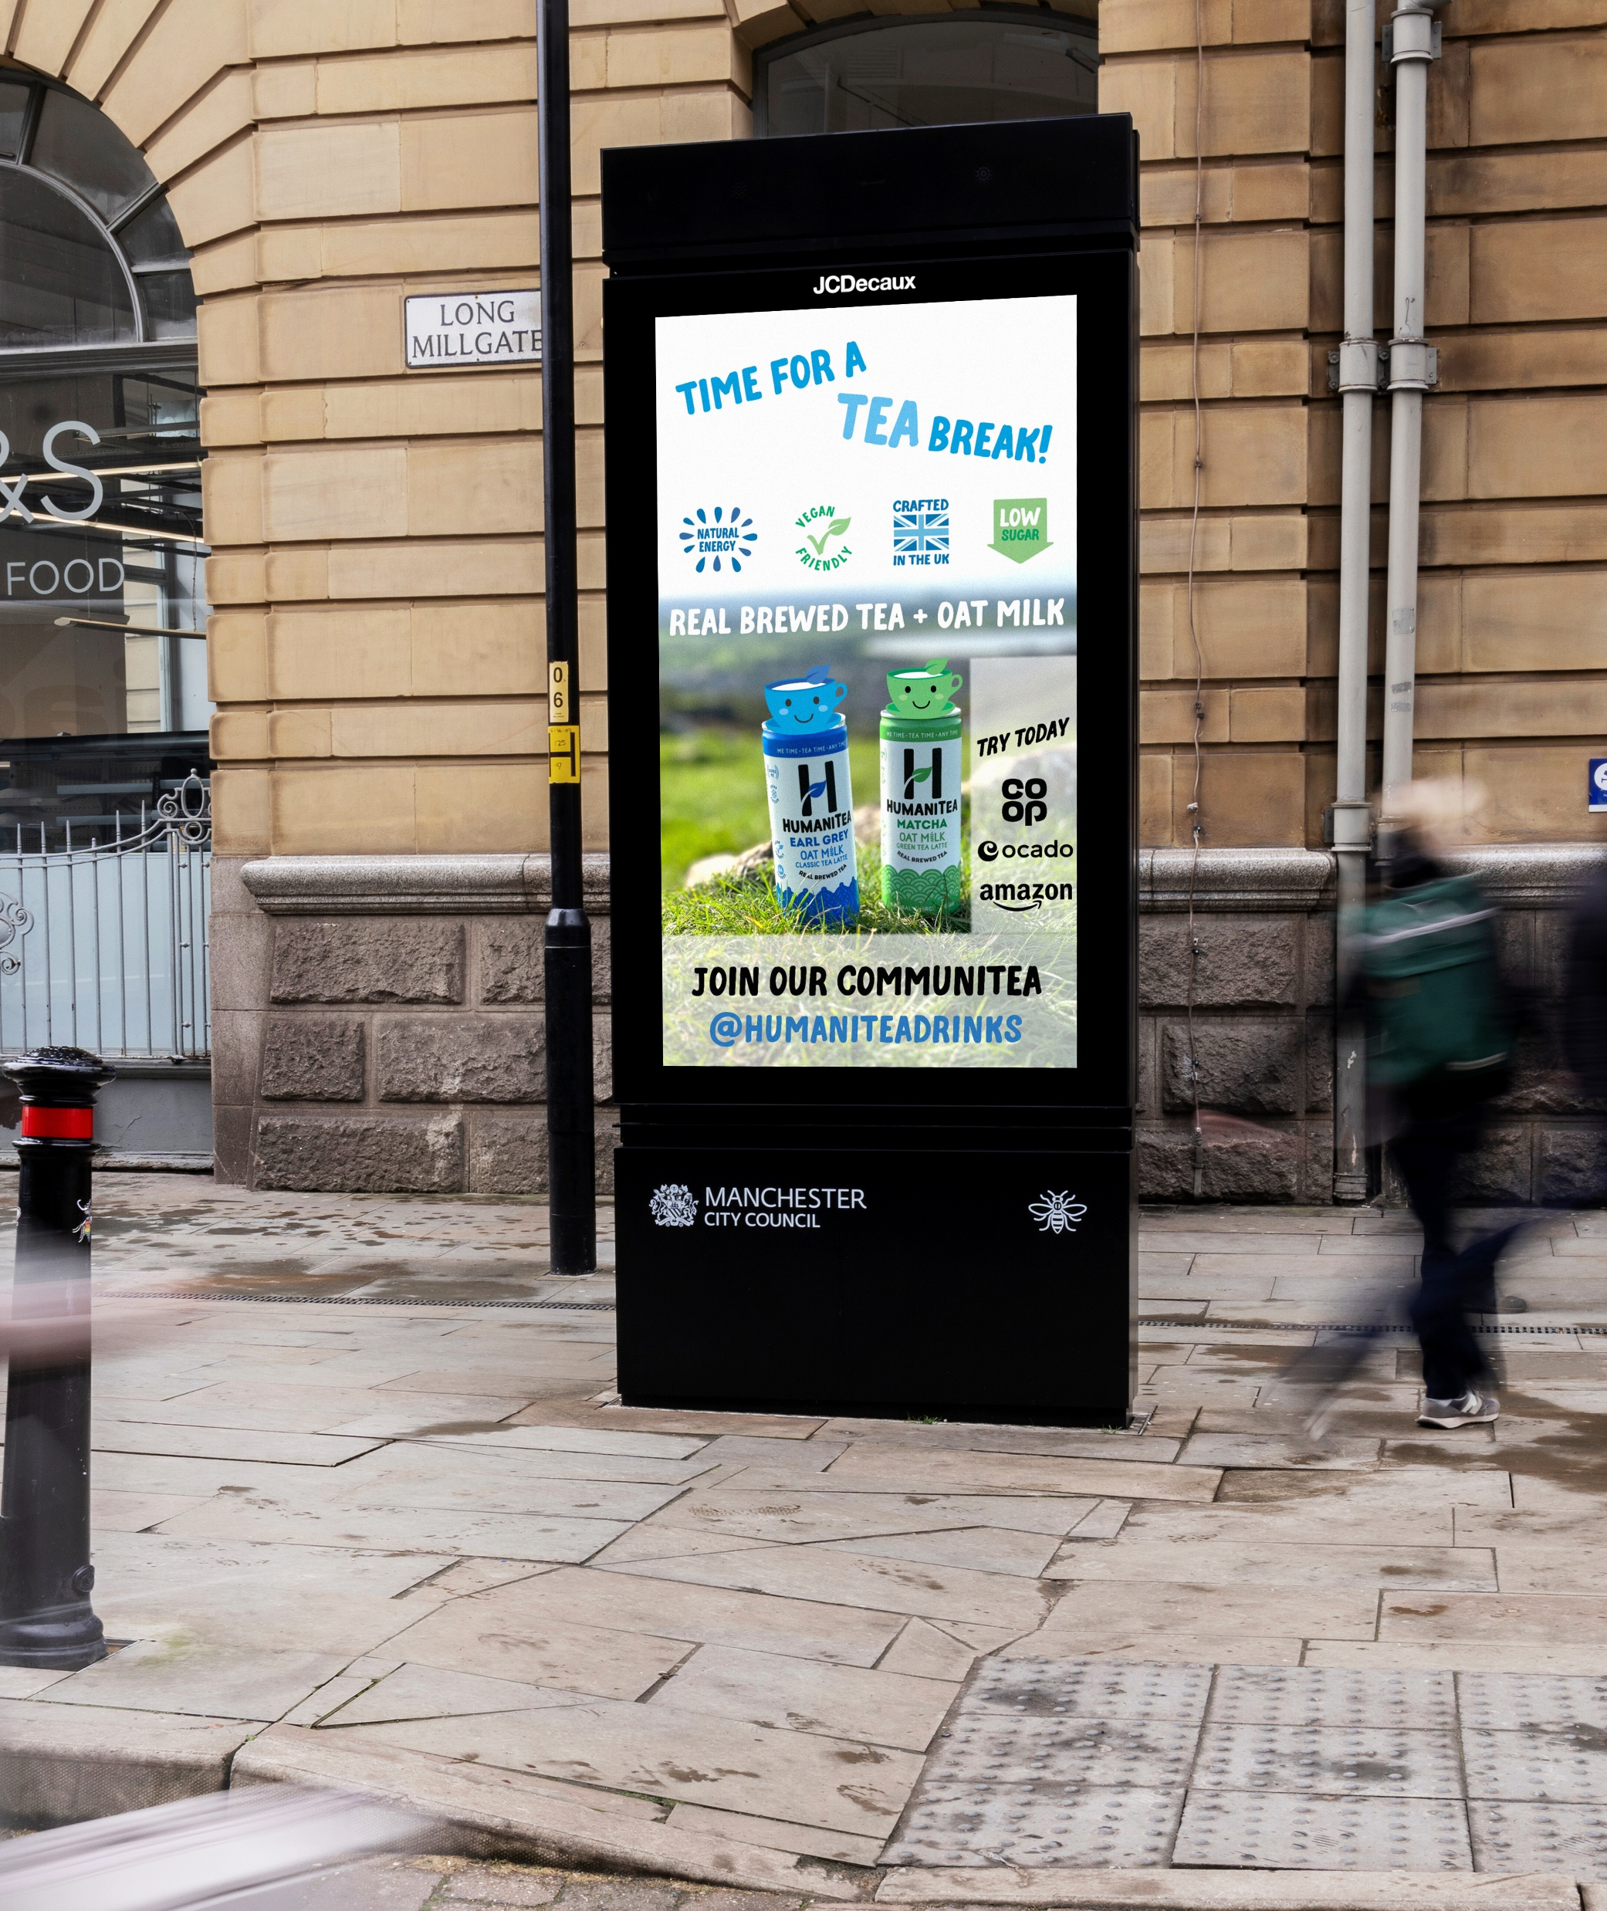
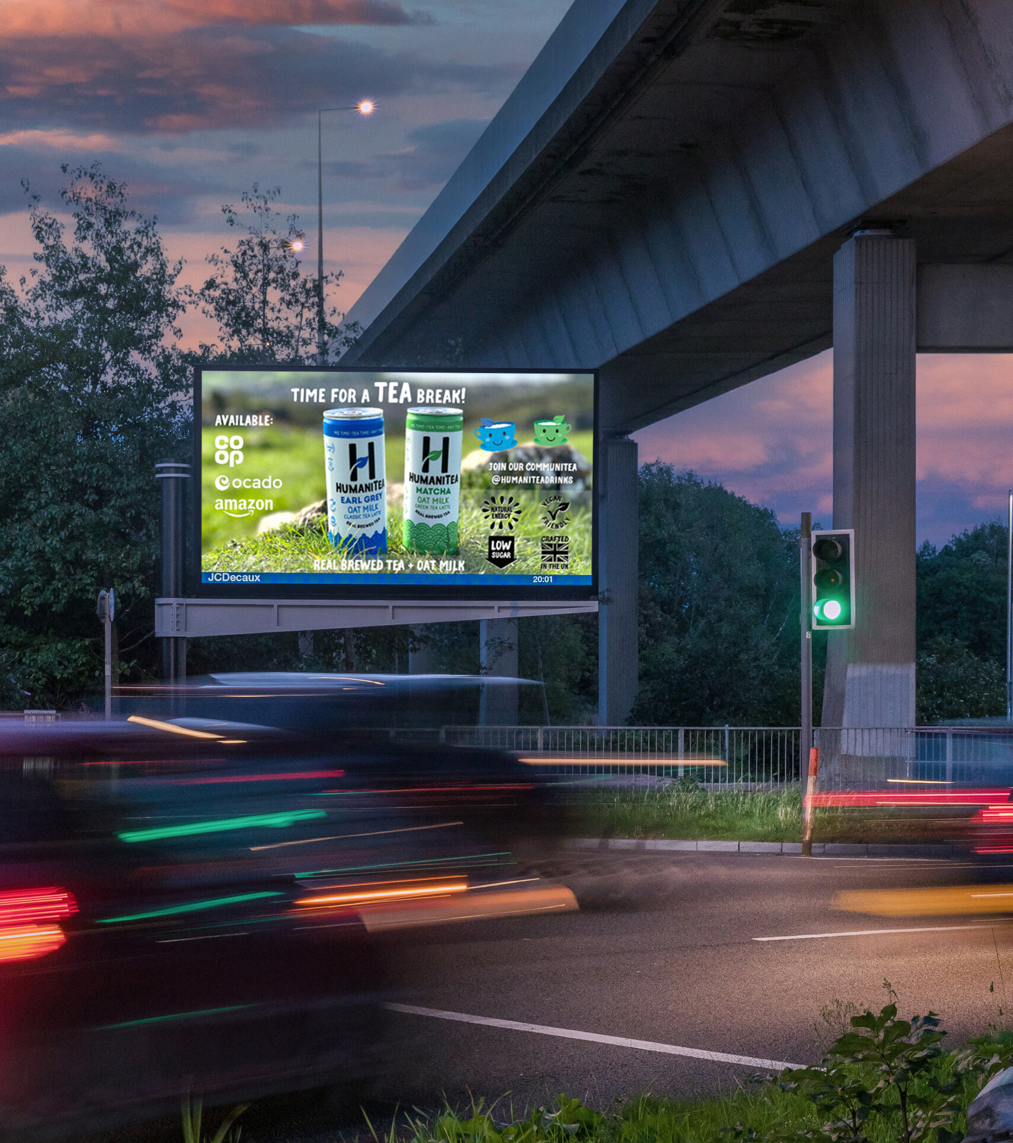
The JCDecaux Reach program has enabled HumaniTea to venture into Out-of-Home advertising successfully. This initiative not only boosted the visibility of our product but also elevated our brand's standing by sharing advertising space with renowned brands like Burberry! It was exhilarating to receive messages from friends and colleagues who spotted our campaign.
Beyond the excitement, this opportunity allowed us to bolster our presence in Co-op stores, amplify in-store promotions, and drive traffic to platforms like Amazon and Ocado. The exposure on digital 6 sheets in Manchester's city centre and dynamic screens in London's bustling train stations provided significant validation for our four-year-old startup.
TINA CHEN
CEO & FOUNDER - HumaniTea

