Slide 1
WOMEN’S EUROS 6TH – 31ST JULY 2022

Slide 2
WOMEN’S EUROS 6TH – 31ST JULY
UK
will host the 16-team final
13th
edition of UEFA Women’s Championship
Source: UEFA.com
Notes:
2022 will see the 13th edition of the UEFA Women’s Championship held in the UK.
The UEFA Women’s Euros final will be held across nine key venues between 6th – 31st July, including:
1. Brighton & Hove (Brighton & Hove Community Stadium) 2. London (Brentford Community Stadium & Wembley Stadium – final only) 3. Manchester (Manchester City Academy Stadium) 4. Milton Keynes (Stadium MK) 5. Rotherham (New York Stadium) 6. Sheffield (Bramall Lane) 7. Southampton (St Mary's Stadium) 8. Trafford (Old Trafford – opening game) 9. Wigan & Leigh (Leigh Sports Village)
More information about the order of events can be found here: https://bit.ly/3NLQ6iK

Slide 3
WOMEN’S EUROS PARTNERS 2022
Source: The FA
Notes:
LinkedIn, the world’s largest professional network will be the latest national sponsor for The Women’s Euros – joining existing partners including; Lego, Pandora and Stirling Bank.
The professional network giant will spotlight the game’s female trailblazer and is committed to ‘make work work for women’ – demonstrating how the platform and community can support women to achieve their goals and drive conversation around female empowerment, leadership, wellbeing and diversity.
Source: https://bit.ly/3JS7LD5

Slide 4
PASSIONATE SUPPORTER
FOOTBALL ATTENDEES
Notes:
The Passionate Supporter are those who wish they could go and see FIFA Women’s World Cup live or agree they are really passionate about women’s football and FIFA Women’s World Cup vs Nat Rep.

Slide 5
A PASSIONATE AUDIENCE
+36%
more likely
to have
£1,750 + in PDI per month*
+42%
more likely
to be
Out-of-Home for 15 hours + per week
+145%
more likely
to have taken
5+ holidays abroad per year
+129%
more likely
to consider themselves
more fashion-able than most
+120%
more likely
to say
‘I can’t resist expensive products’
WOMEN’S WORLD CUP
FANS
Source: YouGov profiles 2022: Target audience are those who wish they could go and see FIFA Women’s World Cup live or agree they are really passionate about women’s football and FIFA Women’s World Cup vs Nat Rep. *more likely to
Notes:
*personal discretionary income

Slide 6
PRIMED BY OUT-OF-HOME
+117%
POSTED/SHARED CONTENT ABOUT A PRODUCT/SERVICE ON SOCIAL
+102%
TRUST OOH
+98%
TALK TO FRIENDS/FAMILY ABOUT A PRODUCT/SERVICE SEEN ON OOH
+69%
SEARCH FOR PRODUCTS/SERVICES VIA MOBILE AFTER SEEING OOH
Source: YouGov profiles 2022: Target audience are those who wish they could go and see FIFA Women’s World Cup live or agree they are really passionate about women’s football and FIFA Women’s World Cup vs Nat Rep. *more likely to
Notes:
The target audience are primed by Out-of-Home – in terms of trust and talking to peers about products/services seen.

Slide 7
BRAND PREFERENCES
+133%
Fortified wine
+31%
Lager
+24%
Cider/micro brew
beer
Favourite alcoholic beverage
+258%
Mobile broadband devices
+220%
Smart wear
+216%
MiFi*
Device purchase intent, next 12 months
+222%
Genesis
+80%
Infiniti
+46%
Tesla
Car brand consideration
41%
PayPal
38%
Visa
28%
Mastercard
Credit card current customer
1 in 4
Tesco
Main supermarket
Source: YouGov profiles 2022: Target audience are those who wish they could go and see FIFA Women’s World Cup live or agree they are really passionate about women’s football and FIFA Women’s World Cup vs Nat Rep
Notes:
*MiFi – A mobile wireless hotspot or router that gives internet access on the move.

Slide 8
PRO SPONSORSHIPS
+194%
+168%
+119%
+63%
63%
‘If you sponsor my team, I will buy your products’
‘I like to support my team by buying products from sponsors’
‘I take notice of who sponsors the sporting events I watch’
‘Sponsorship can help keep companies socially relevant’
Source: YouGov profiles 2022: Target audience are those who wish they could go and see FIFA Women’s World Cup live or agree they are really passionate about women’s football and FIFA Women’s World Cup vs Nat Rep. *more likely to

Slide 9
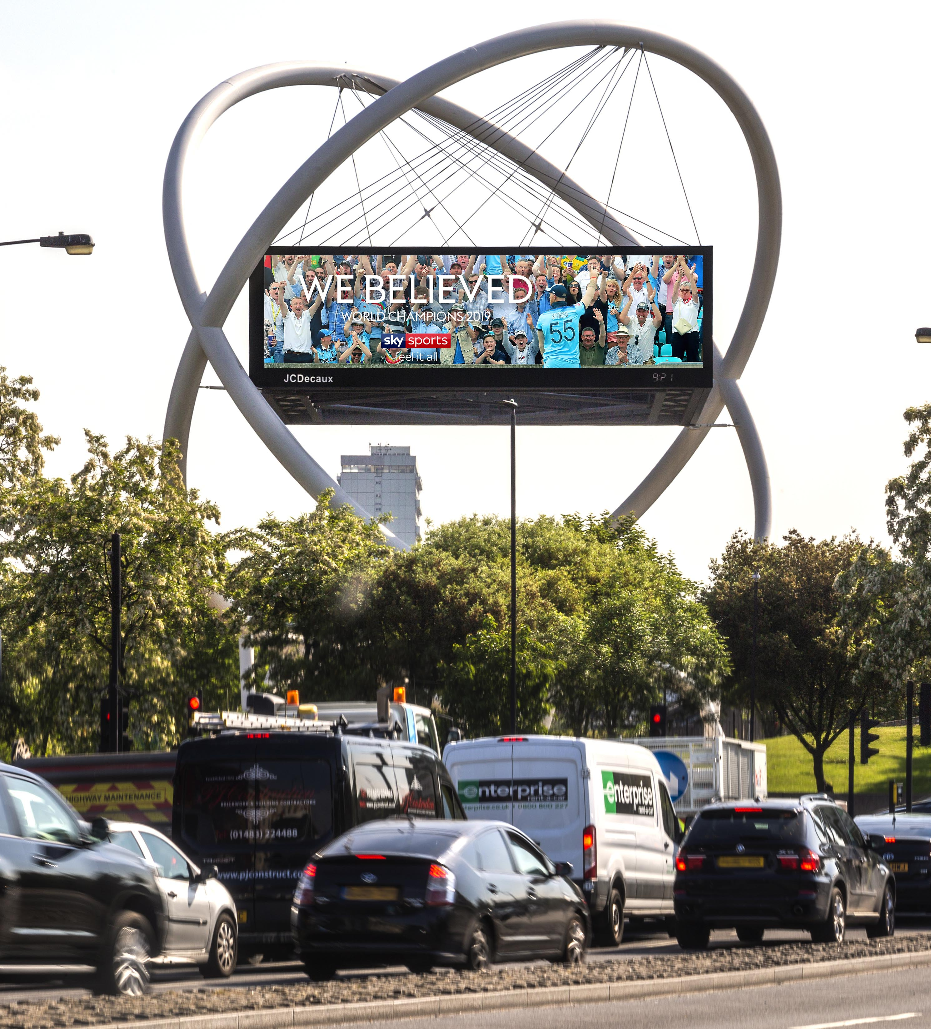
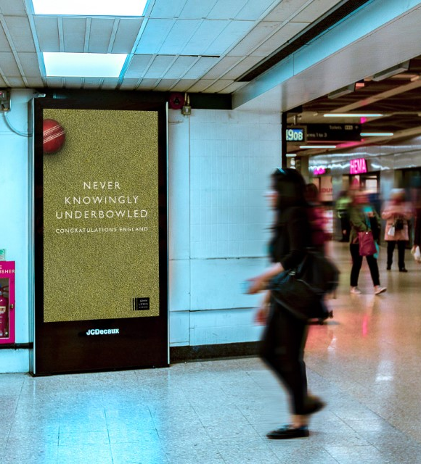
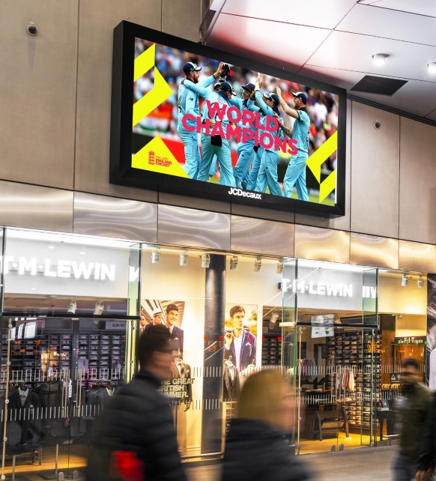
OWN THE MOMENT CONTEXTUAL DOOH: CRICKET WORLD CUP
SKY
John Lewis
England & Wales Cricket Board
Source: The Drum
Notes:
Well, if you work in marketing, there’s a fair chance that you’ve heard of the fabled Rule of Seven. For those who haven’t, the Rule of Seven was formulated by Dr Jeffery Lant who stated that, in order to effectively influence the purchasing decisions of a consumer, a brand needs to be seen by or have contact with the individual at least seven times within an 18-month period.
This is quite simply the idea of targeting people with messaging, at multiple touchpoints, until you win over their loyalty.
However, given that every brand is trying to do the same thing, how do you ensure that you cut through the noise to make sure you are maximising your ROI and driving sales.
You own a moment.
Using contextual lends itself as the perfect way to use DOOH to own a moment, to communicate with people in real time as and when events happen. To cut through the noise and really resonate with that person in that specific moment, creating a long lasting, trusting moment.
Here are examples of how brands have successfully used contextual DOOH to own sporting moments.

Slide 10
TESCO SUMMER BBQ CONTEXUAL DOOH CONSIDERABLE SALES UPLIFT INCREASE WHEN USING CONTEXTUAL
DUR
+4%
POST
+2%
DUR
+6%
POST
+3%
DUR
+9%
POST
+6%
DUR
+13%
POST
+12%
Static vs no advertising
Contextual Static vs no advertising
Motion vs no advertising
Contextual Motion vs no advertising
Source: JCDecaux Tesco EPOS case study 2018
Notes:
As the Tesco case study shows, contextual DOOH can significantly increase sales during and post campaign.

Slide 11
VIRGIN MEDIA CONTEXUAL DOOH INCREASED AD RECALL WHEN USING CONTEXTUAL
98% 99%
79%
69%
+14%
Spontaneous
Prompted
Source: Opinium 2015
Notes:
Contextual DOOH can also increase ad recall, as shown in the Virgin Media case study…

Slide 12
OUT-OF-HOME EXPOSURE
Notes:
The Passionate Supporter are those who wish they could go and see FIFA Women’s World Cup live or agree they are really passionate about women’s football and FIFA Women’s World Cup vs Nat Rep.

Slide 13
HEAVY EXPOSURE TO OUT-OF-HOME
+131%
Rail
+69%
Large Format
+156%
Super-
market
+74%
Street Furniture
+133%
Malls
Notes:
The target audience have heavy exposure to Out-of-Home…

Slide 14
KEY RAIL TERMINI NATIONWIDE & LONDON
UK STATIONS | INDEX
Watford Junction | 235
Bristol Temple Meads | 232
Birmingham Moor Street | 222
Oxford | 157
Nottingham | 148
Glasgow Central | 147
Edinburgh Waverley | 140
Reading | 130
Newcastle | 126
Manchester Piccadilly | 113
LONDON STATIONS | INDEX
London Cannon Street | 235
London Fenchurch Street | 232
Clapham Junction | 166
London Charing Cross | 163
London Blackfriars | 153
London Waterloo (East) | 137
London Liverpool Street | 133
London Waterloo | 129
London Victoria | 127
London Euston | 121
London Bridge | 116
London King’s Cross | 110
Source: YouGov profiles 2022: Target audience are those who wish they could go and see FIFA Women’s World Cup live or agree they are really passionate about women’s football and FIFA Women’s World Cup vs Nat Rep. *more likely to
Notes:
Key rail termini where the target audience indexes highly…

Slide 15
MALL HOTSPOTS
MALL | INDEX
East Kilbride Shopping Centre | 347
Telford Shopping Centre | 263
Metrocentre | 260
Atria Watford | 268
Centre:MK | 265
Braehead Shopping Centre | 204
Liverpool ONE | 209
Victoria Centre | 196
St Enoch (Glasgow) | 181
Bluewater (Kent) | 191
Westfield London | 194
Eldon Square | 177
St David’s Centre | 174
Lakeside Shopping Centre | 177
Westfield Stratford | 154
Source: YouGov profiles 2022: Target audience are those who wish they could go and see FIFA Women’s World Cup live or agree they are really passionate about women’s football and FIFA Women’s World Cup vs Nat Rep. *more likely to
Notes:
Key malls where the target audience indexes highly…

Slide 16
REACH THE FANS
507
over-indexing digital 6-sheets which deliver...
12.7m
fortnightly impressions
Source: Adsquare *Audience are those who are football enthusiasts
Notes:
The audience created on Adsquare are those who are football enthusiasts.

Slide 17
PASSIONATE SUPPORTER
FOOTBALL ATTENDEES
Notes:
Football Attendees are those who are passionate about women’s football AND have attended a live football match in the last 12 months

Slide 18
AFFINITY FOR OUT-OF-HOME
+80%
more likely
to be
Out-of-Home for 20 hours + a week
+51%
more likely
to find
OOH ads to be a good way to reach them with advertising
+83%
more likely
to
often notice ads at train stations
+112%
more likely
to have
previously purchased a product or service after seeing an OOH ad
FOOTBALL ATTENDEES
Source: YouGov Profiles 2022, Target audience: Those who are passionate about women’s football AND have attended a live football match in the last 12 months, Base: National rep.
Notes:
Football Attendees are those who are passionate about women’s football AND have attended a live football match in the last 12 months.

Slide 19
FOOTBALL CRAZY, SPONSOR MAD
+194%
+168%
+119%
+63%
+262%
+251%
+162%
+83%
63%
‘If you sponsor my team, I will buy your products’
‘I like to support my team by buying products from sponsors’
‘I take notice of who sponsors the sporting events I watch’
‘Sponsorship can help keep companies socially relevant’
Source: YouGov Profiles 2022, Target audience: Those who are passionate about women’s football AND have attended a live football match in the last 12 months, Base: National rep.
Notes:
The small stats show how our Passionate Supports audience responded to these statements from an earlier slide, and as we can see, the Football Attendees reacts even more positively to sponsors when compared to the national average

Slide 20
WOMEN’S EUROS 6TH – 31ST JULY 2022

