Slide 1
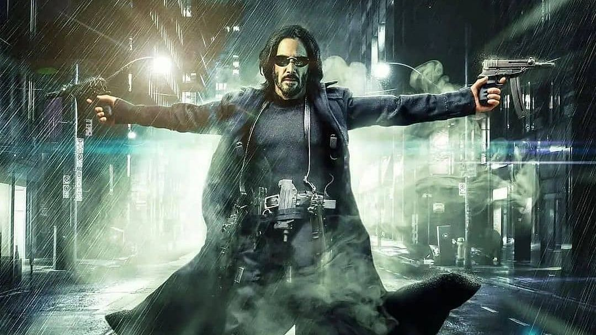
BIG BUDGET BLOCKBUSTERS

Slide 2
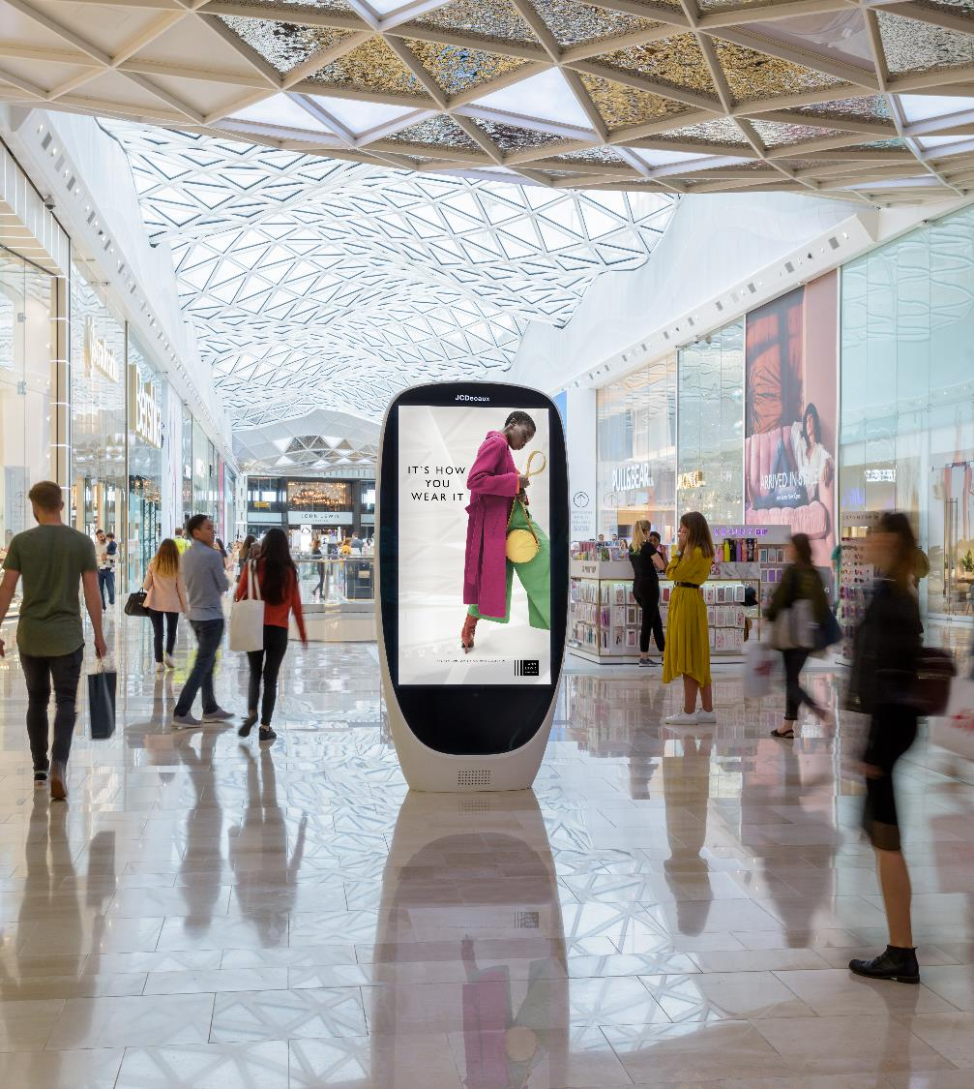
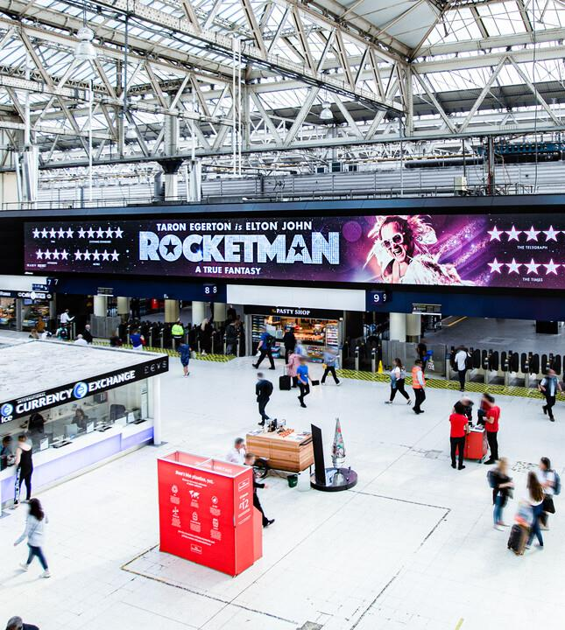
OFF THE SCALE
£250m+
Hollywood marketing
spend planned
160
films been on hold past
18 months
Source: The Guardian
Notes:
Hollywood studios are planning a £250m-plus UK marketing blitz to promote the return of blockbusters to the big screen over the next 18 months, as the much-delayed premiere of the new James Bond film, No Time to Die, gives the industry the confidence to plot a post-pandemic boom in new releases
The public can expect to be bombarded with ads across media spanning TV, billboards and poster sites across the country, as well as blanket web campaigns, for a string of blockbusters finally getting a big-screen release.
Three years worth of Blockbusters in next 18 months

Slide 3
BACK IN THE GAME
A quarter of a billion pounds worth of [promotional] media [spend] will ensure that no one is unaware that video is back in the game.
Kim Bayley
Chief Executive
Entertainment Retailers Association
Notes:
“This level of marketing support is off the scale. After 18 months when the video industry has been starved of releases because of the cinema blackout, this is a dramatic comeback.”

Slide 4
NEW RELEASES

Slide 5
FILM LOVERS RESPOND WELL TO OUT-OF-HOME
+26%
more likely
to
spend between 10-15 hours
OOH commut-ing per week
+58%
more likely
to
often comment on things seen on OOH ads on social media
+54%
more likely
to
trust the ads seen on posters/
billboards
+43%
more likely
to
recommend things seen on posters/
billboards to friends and family
+44%
more likely
to
make a purchase on mobile after seeing OOH ad
Audience
Source: YouGov. More likely than average adult. Those who visit the cinema at least once every 3 months vs nat rep

Slide 6
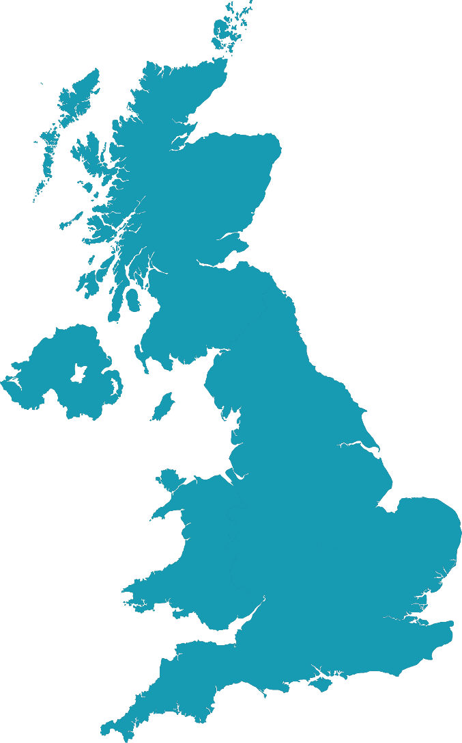
MALLS PLUS CINEMA
Trinity Leeds
The Potteries
Centre
Queensgate
Touchwood
Westfield London
Westfield Stratford
Bluewater
Lakeside

Slide 7
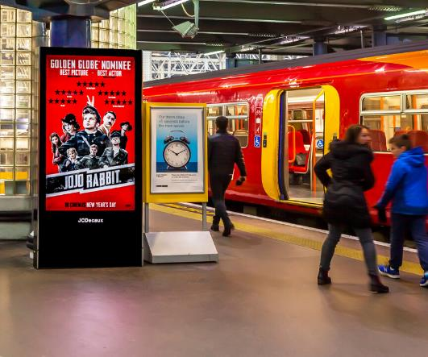
Notes:
Film creative looks great on OOH

Slide 8
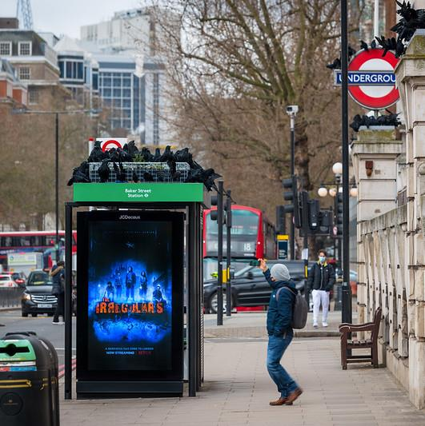

Slide 9
WESTFIELD LONDON ATRIUM DOMINATION
AUDIENCE
#1 shopping mall in the UK
#1 Vue cinema in the UK
82% more likely to agree that OOH main media channel
LOCATION
Atrium
AMBIENT FORMATS
1 x wall wrap
+100% SOT on centre spectacular screen
MEDIA AND PRODUCTION RATES
£65,000 gross media
£66,232 net production
LEAD-TIMES
Ambient: 4 weeks from receipt of artwork
Digital copy: 5 working days

Slide 10
BIG BUDGET BLOCKBUSTERS

