Slide 2
OUT-OF-HOME RAISES AWARENESS OF A DEI FOCUSED EVENT, DRIVES TICKET SALES & HELPS MAKE ESEA AUDIENCES “FEEL SEEN”
Increased awareness, representation, validation & a sold out event
ASIAN LEADERSHIP COLLECTIVE
BACKGROUND:
Asian Leadership Collective is a social enterprise business passionate about increasing and amplifying representation of East and Southeast Asian leaders as part of an overall drive towards inclusive leadership.
They are the official hosts of #ESEAEats, a campaign celebrating East Asian and Southeast Asian (ESEA) culture and heritage storytelling through food.
This year focused on the topics of diverse storytelling and leadership in the media and advertising space
CAMPAIGN OBJECTIVES:
Increase awareness of the Asian Leadership Collective.
Promote Asian Leadership Collective as a Diversity, Equity and Inclusion social enterprise that focuses on the East and Southeast Asian community.
Drive ticket sales the 2023 ESEAEats event.
CAMPAIGN DETAILS:
100 x roadside digital 6 sheets
Motion@TheCity – 9 screens across 5 key railway stations
Digital Large Format
RESULTS:
Sold out event
Out-Of-Home amplified social and PR campaigns
East and South East Asian audiences felt seen and validated

Slide 3
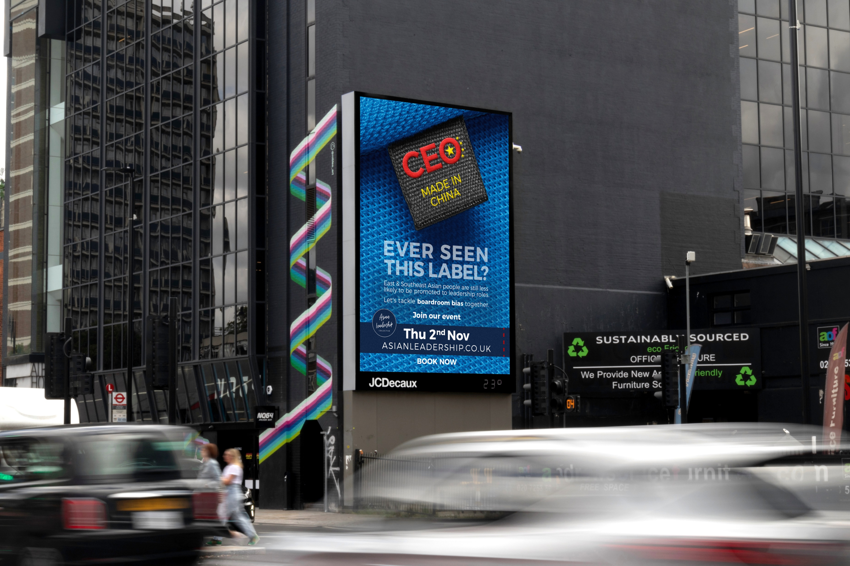
In choosing JCDecaux, a renowned industry leader, we felt confident that our advertising campaign would be in capable hands. Witnessing diverse examples from companies of all sizes served as inspiration, motivating us to create a standout campaign.
We believe in showcasing representation from companies of various sizes, each with distinct messages and goals. Our campaign provided the perfect platform to make a bold statement, allowing us to crystallise the essence of the Asian Leadership Collective.
Strategically placed in prime locations near the event venue, including bus shelters, iconic sites like the M4 torch with high vehicular traffic, and the E8 Showcase, our campaign aimed to be a visual spectacle.
Leveraging our social media channels and PR campaign, we encouraged people to actively look out for and engage with the campaign in London.

Slide 4
Our primary objective was to drive a call to action for the event we were hosting, and I am thrilled to report that the event sold out! The success of the campaign lies in the solidification of our messaging and identity as a social enterprise business. Numerous comments hailed the campaign for "breaking through the bamboo ceiling," bringing joy to individuals of East Asian and Southeast Asian heritage who felt seen and validated.
This impactful campaign was featured as a case study and campaign highlight at a triple-accredited business school in the UK, serving as an inspiration for students pursuing creative and business courses too.
ANNA CHAN
CEO & FOUNDER, ASIAN LEADERSHIP COLLECTIVE

