Slide 1
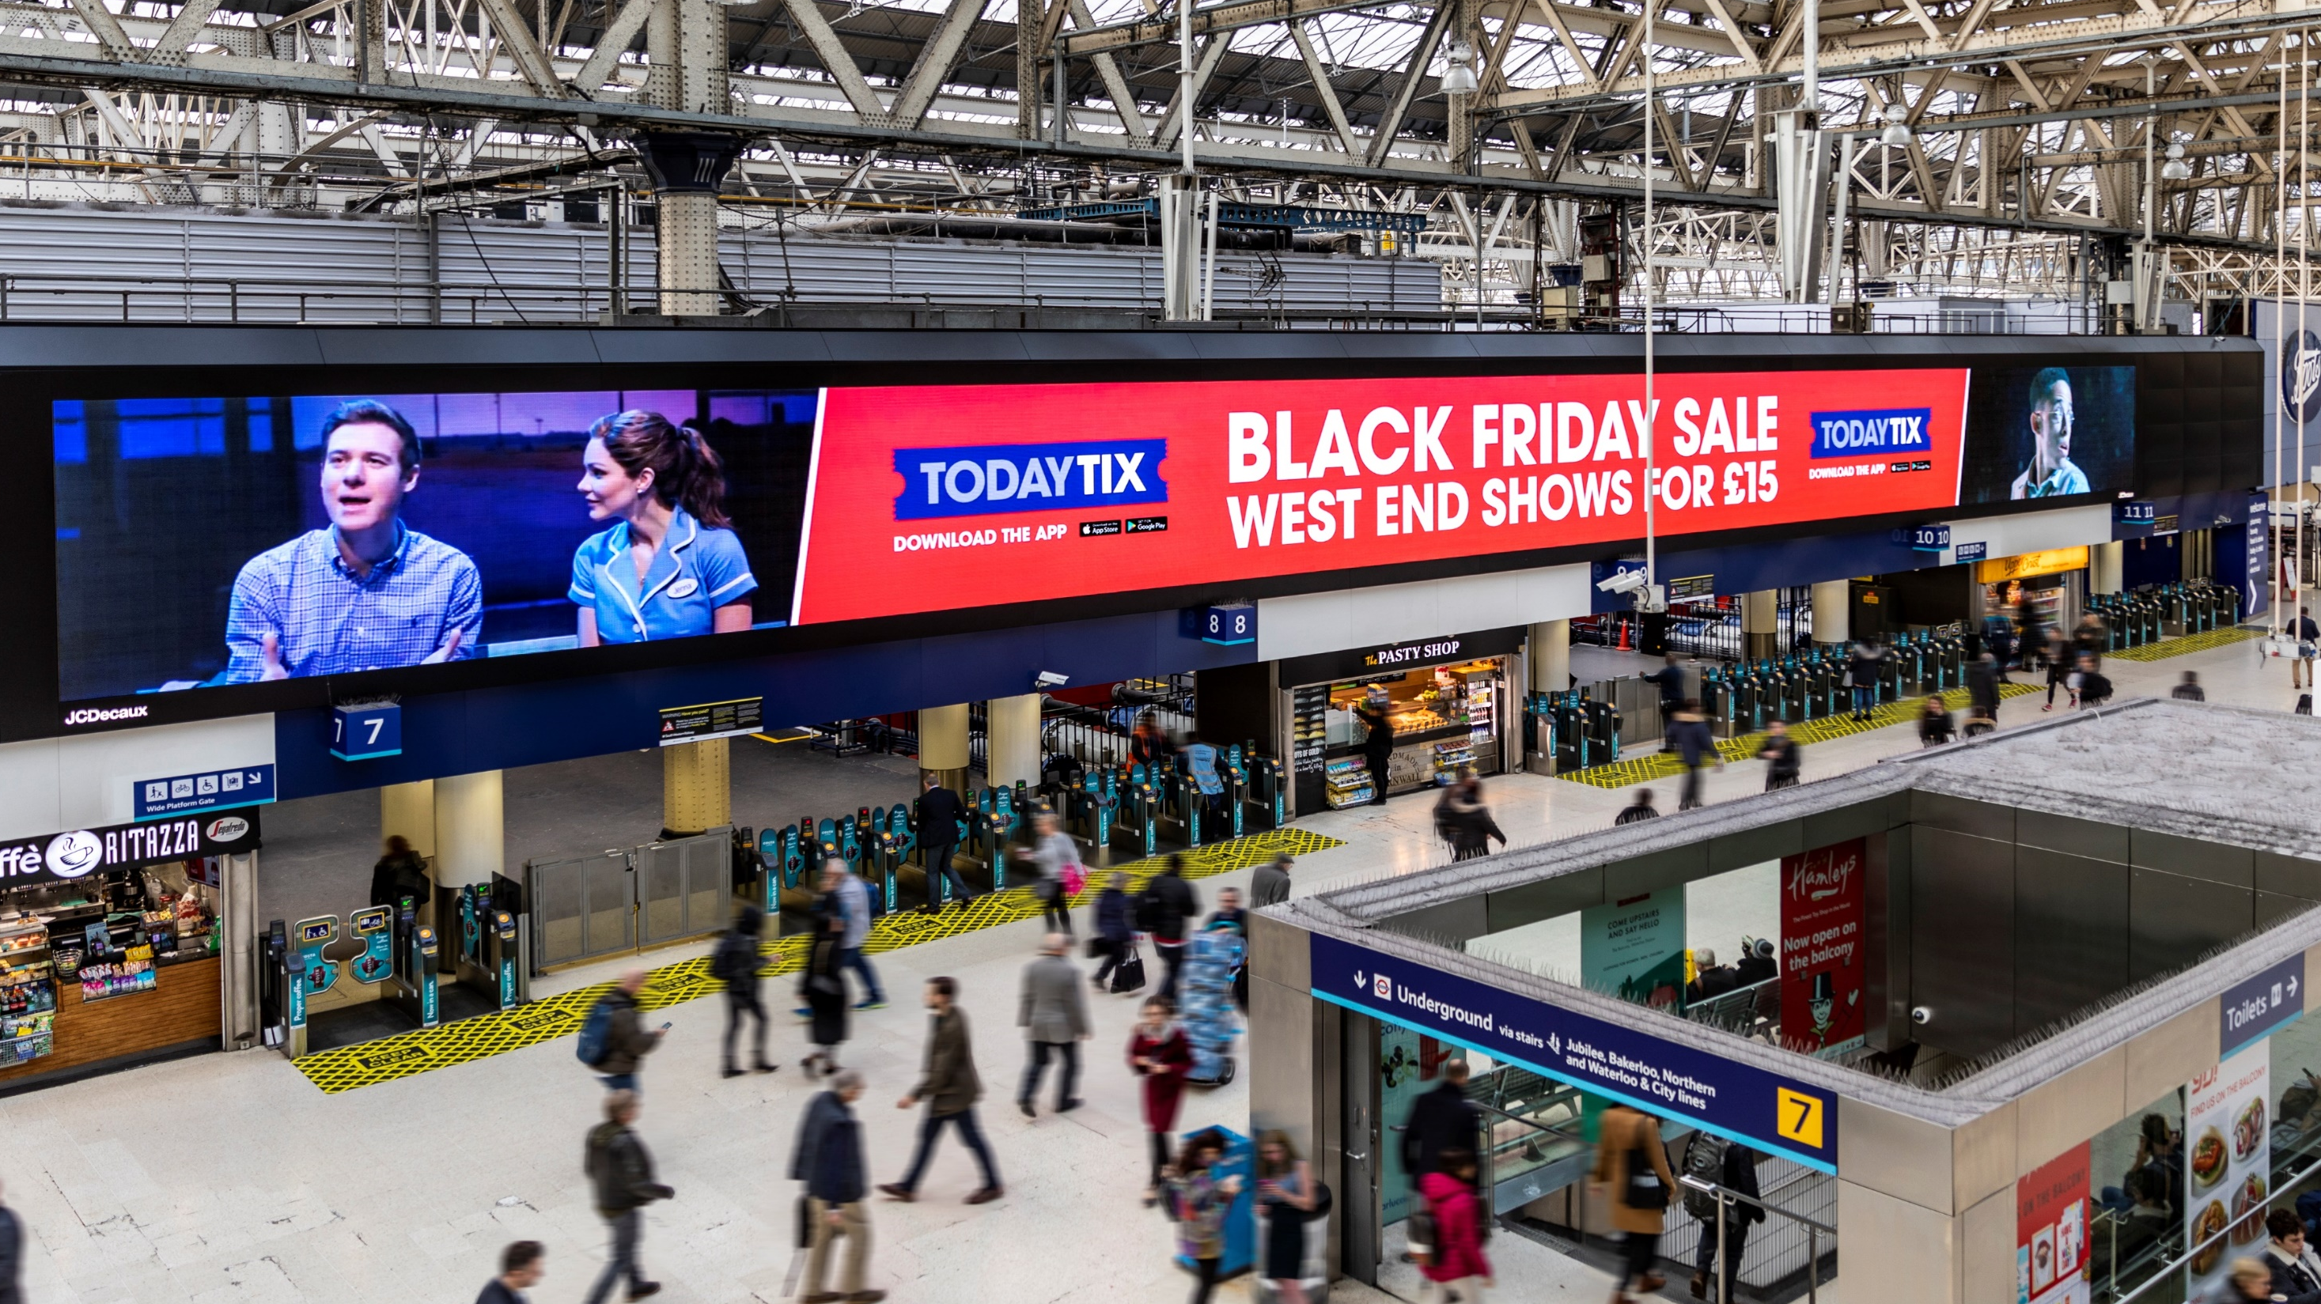
BLACK FRIDAY/CYBER MONDAY 25TH AND 28TH NOV 2022

Slide 2
BLACK FRIDAY 2021
£4.8bn
Spend in 2021
£275
Per shopper
33%
Planned to spend
Source: OnePoll 2021
Notes:
Brits were set to spend £4.8bn on Black Friday in 2021 equating to £275 spend on average per shopper. This means that 33% planned to spend in the Black Friday sales.
Source: https://www.finder.com/uk/black-friday-statistics Analysis conducted by finder.com

Slide 3
ITEMS PURCHASED 2021
Source: YouGov July 2022 *Audience defined as those who intended to purchase items during Black Friday/Cyber Monday 2021
Notes:
Having created an audience on YouGov defined as those who intended to purchase items during Black Friday/Cyber Monday last year, this graph shows the top items purchased. For example, 26% of this audience brought clothes or shoes.

Slide 4
AVERAGE SPEND BY GENDER
£335
£190
Source: OnePoll 2021

Slide 5
MILLENNIALS LEAD THE WAY IN SPEND
Computing Equipment
Source: OnePoll 2021
Notes:
Generation X are planning to spend the most on average (£339), a 12% increase from 2020. 2Baby boomers are hot on their tracks, with shoppers planning to increase their average spending by 23% to £310. Millennials follow with a budget of £271, 27% less than their average spend from 2020. Those from generation Z will be spending 35% more than last year, the largest increase of all generations, with a budget of £175. On the other end of the spectrum, the silent generation have seen the largest drop in their Black Friday spend. Those in this generation will be spending an average of £163 in the sales, 28% less than in 2020.
Gen Z (born after 1996)
Millennials (1981-1996)
Gen X (1965-1980)
Boomers (1946-1964)
Silent (1928 -1945)

Slide 6
GEN Z LEAD THE WAY IN TAKING PART
Source: OnePoll 2021
Notes:
Generation Z has the biggest proportion of their population taking part in Black Friday and Cyber Monday, with 54% planning to spend. 48% of millennials also say they will shop for deals. Following these are generation X (35%) and baby boomers (15%). Only 11% of the silent generation are looking to spend, making this the lowest proportion of Black Friday spenders. Gen Z (born after 1996)
Millennials (1981-1996)
Gen X (1965-1980)
Boomers (1946-1964)
Silent (1928 -1945)

Slide 7
GEN Z LEAD THE WAY IN TAKING PART
Source: OnePoll 2021
Notes:
The younger the generation, the more they are likely to spend. So looking at the dark blue bars, Generation Z had the biggest proportion of their population taking part in Black Friday and Cyber Monday last year, with 59% saying they were going to spend. 55% of millennials also said they were going to shop for deals making them a close second. Following these is Generation X (37%) and Baby boomers (24%). Only 11% of the silent generation were looking to spend, the lowest proportion of Black Friday spenders.
Gen Z (born after 1996)
Millennials (1981-1996)
Gen X (1965-1980)
Boomers (1946-1964)
Silent (1928 -1945)

Slide 8
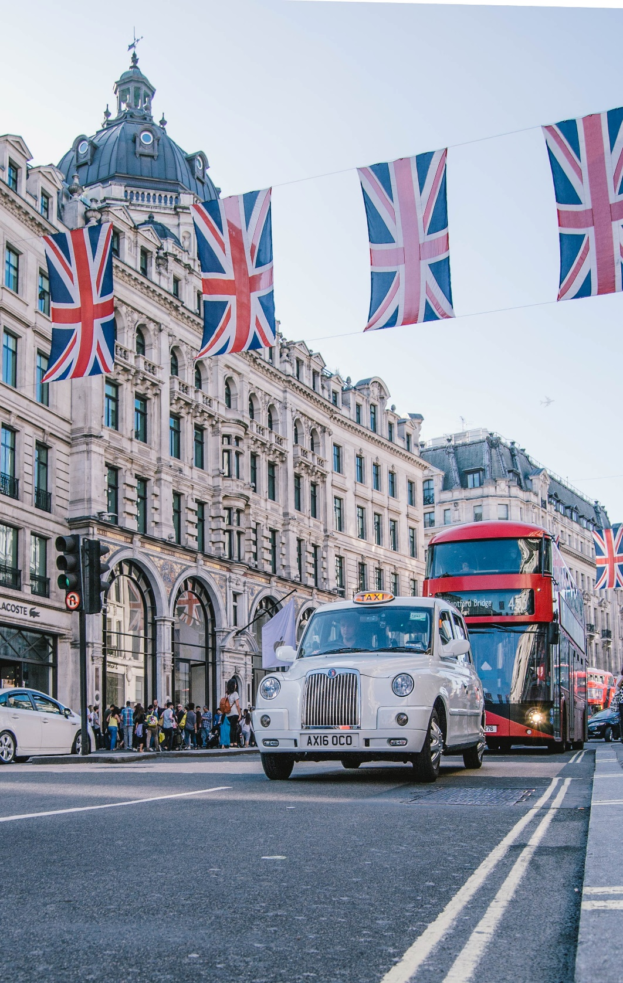
TOTAL SPEND BY REGION
Region | % Spending | Average Spending
London | 46% | £468
South East | 29% | £218
North West | 26% | £219
South West | 27% | £280
West Midlands | 38% | £202
Scotland | 32% | £292
Yorkshire and the Humber | 33% | £224
East Midlands | 29% | £134
North East | 30% | £219
Wales | 23% | £338
Northern Ireland | 41% | £246
Londoners spent the most on Black Friday and Cyber Monday in 2021
Source: OnePoll 2021
Notes:
Residents in London are most likely to take part in Black Friday shopping, with 46% saying they will spend. Northern Ireland is the next most likely at 42%, followed by the West Midlands (38%), Scotland (31%) and the East of England (32%). The region least likely to take part is Wales, where only 24% say they will do some Black Friday or Cyber Monday shopping.

Slide 9
SPEND BY GENERATION IN STORE & ONLINE
Generation | Online only | Online and in-store | In-store only
Gen Z (born after 1996) | 40% | 43% | 16%
Millennials (1981-1996) | 37% | 48% | 15%
Gen X (1965-1980) | 47% | 31% | 22%
Source: OnePoll 2021

Slide 10
PRIMED BY OOH ACTIONS AFTER SEEING OOH ADS
+77%
POSTED/SHARED CONTENT ABOUT A PRODUCT/SERVICE ON SOCIAL
+61%
TAKEN A PHOTO OF AN OOH USING A MOBILE PHONE
+49%
TALK TO FRIENDS/FAMILY ABOUT A PRODUCT/SERVICE/BRAND SEEN ON OOH
+49%
SEARCH FOR PRODUCTS/SERVICES VIA MOBILE AFTER SEEING OOH
Source: YouGov July 2022 *Audience defined as those who intended to purchase items during Black Friday/Cyber Monday 2021

Slide 11
BEST ENVIRONMENTS HEAVY EXPOSURE TO OOH
+57%
RAIL
+40%
STREET
FUNITURE
+60%
SUPERMARKET
+37%
LARGE FORMAT
+48%
MALLS
Source: YouGov July 2022 *Audience defined as those who intended to purchase items during Black Friday/Cyber Monday 2021
Notes:
This audience has heavy exposure to OOH in multiple environments.

Slide 12
PRIMED BY OOH STATEMENTS AGREED ABOUT ADVERTISING
+52%
+49%
+46%
+43%
+42%
TALKED WITH FAMILY / FRIENDS
ABOUT PRODUCTS /
SERVICES SEEN ADVERTISED OOH
RESEARCHED PRODUCTS
SERVICES ON THEIR MOBILE
OOH
HELPS ME CHOOSE WHAT I BUY
“I trust OOH
advertising"
OFTEN RECOMMEND TO FAMILY/ FRIENDS THINGS SEEN ON OOH
ADVERTISMENT
Source: YouGov July 2022 *Audience defined as those who intended to purchase items during Black Friday/Cyber Monday 2021

Slide 13
BLACK FRIDAY/CYBER MONDAY 25TH AND 28TH NOV 2022

