Slide 1
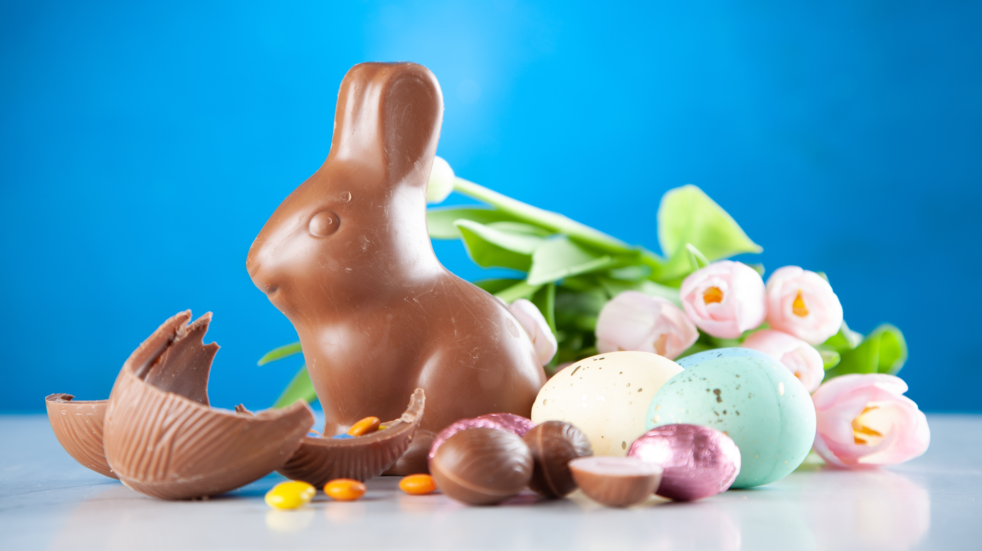
EASTER 7^{TH –} 9TH APRIL 2023

Slide 2
EASTER 2022
£892m
spend for Easter in the UK
75%
of Brits planned to celebrate Easter
80m
Easter eggs are sold each year in the UK
Source: Finder.com (2022)
Notes:
These facts and figures from Finder.com show just how popular Easter is in the UK.

Slide 3
AUDIENCE DEMOGRAPHICS
59% 41%
FEMALE MALE
58% 27%
ABC1 Millennials
Source: YouGov Profiles 2023: Target audience are those who ‘celebrate Easter and exchange gifts with family/friends’ vs. Nat Rep
Notes:
More women celebrate Easter compared to men. In terms of social demographics, over half are ABC1.

Slide 4
AUDIENCE LIFESTYLE
72% 73%
sit down together
for a meal
64% 65%
enjoy cooking like to try new
for others recipes
go out to eat as a treat
Source: YouGov Profiles 2023: Target audience are those who ‘celebrate Easter and exchange gifts with family/friends’ vs. Nat Rep
Notes:
When looking at lifestyle habits, we can see that this audience is more likely to enjoy cooking/eating dinner with family.

Slide 5
EASTER ACTIVITIES 2022
Source: YouGov Profiles 2023: Target audience are those who ‘celebrate Easter and exchange gifts with family/friends’ vs. Nat Rep
Notes:
This chart shows that people enjoy visiting eating chocolate eggs, visiting family and tucking into hot-cross buns.

Slide 6
EASTER GIFTS 2022
Source: YouGov Profiles 2023: Target audience are those who ‘celebrate Easter and exchange gifts with family/friends’ vs. Nat Rep
Notes:
This chart shows that chocolates and sweets are popular gift choices for Easter.

Slide 7
EASTER TREATS
+74%
SPEND £50 - £75 ON
CHOCOLATES AND SWEETS
+41%
EAT CHOCOLATE
MORE THAN ONCE A DAY
+34%
BUY BEST QUALITY PRODUCTS
+16%
BUY BECAUSE OF PROMOTIONS/DEALS
Source: YouGov Profiles 2023: Target audience are those who ‘celebrate Easter and exchange gifts with family/friends’ vs. Nat Rep (*more likely than the average adult)
Notes:
As you can imagine, chocolates and sweets are popular over Easter with 74% of people buying them.

Slide 8
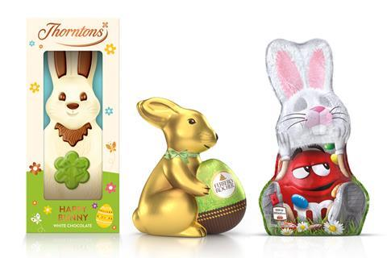
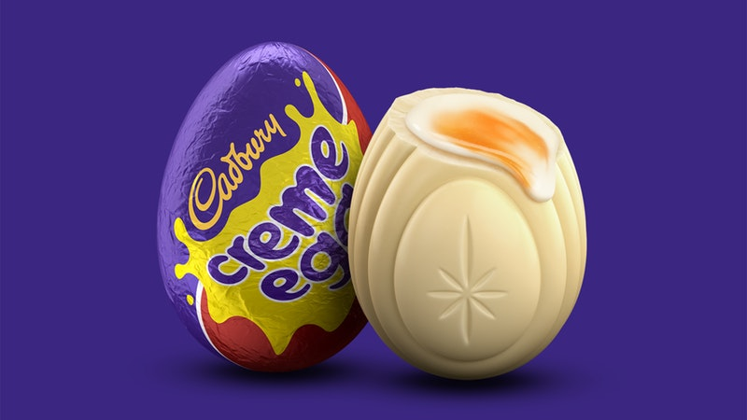
NEW PRODUCT DEVELOPMENT LAUNCHES AND TRENDS
Cadbury unveils the white chocolate crème egg for 2023
Thorntons, Ferrero and Mars have added new product lines for Easter
Source: The Grocer 2023
Notes:
For Easter 2023, Ferrero said it was ‘confident consumers will still want to spend on special occasions’ despite the cost of living crisis.
Ferrero UK has unveiled its Easter 2023 range, featuring new launches from Thorntons and Ferrero Rocher alongside the return of popular lines. As part of the expanded range, which is available from January 2023, Thorntons is launching a white chocolate bunny in a 90g format. The brand’s 170g bunny was the third-bestselling branded line in value sales within novelties, worth £1.48m. Thorntons’ kids eggs will also undergo a full pack redesign. The brand’s eggs are the third-fastest growing medium egg gift range, supported by a 30% rise in penetration in 2022.
Cadbury is unveiling the white chocolate crème egg – which is set to become a yearly Easter product staple and will be available in selected stores across the UK.

Slide 9
PRIMED BY OUT-OF-HOME
+27% +17%
TALKED WITH FRIENDS/ WENT TO STORE TO
FAMILY ABOUT BUY A PRODUCT
PRODUCTS/SERVICES
+23% +25%
PURCHASED PRODUCTS/ TRUST OUT-OF-HOME SERVICES ONLINE
+23% +33%
MADE A PURCHASE TOOK A PHOTO USING MOBILE OF AN AD
Source: YouGov Profiles 2023: Target audience are those who ‘celebrate Easter and exchange gifts with family/friends’ vs. Nat Rep (more likely than the average adult)
Notes:
These stats show the actions that people from this audience are more likely to take after seeing Out-of-Home ads.

Slide 10
EASTER 7^{TH –} 9TH APRIL 2023

