Slide 1
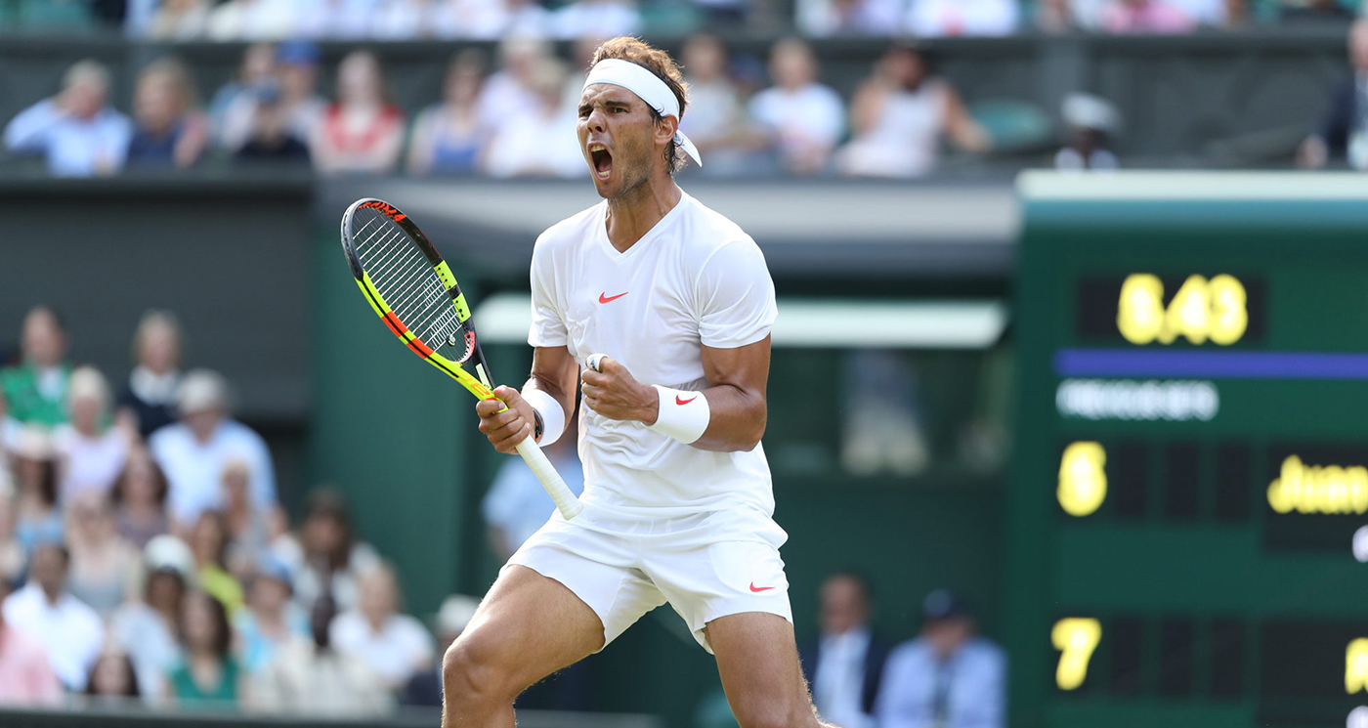
WIMBLEDON 2022 27 June – 10 July
Notes:
The 134th championships

Slide 2
2021 VIEWERSHIP
25.8m
viewers
29.4m
stream requests online (the most ever)
7.8m
peak viewers of Men’s Final
Source: BBC
Notes:
25.8m people watched Wimbledon 2021 on BBC TV and a total of 29.4m streams on BBC iPlayer and BBC Sport combined made it the most streamed Wimbledon ever.
The culmination of Euro 2020 and Wimbledon on Sunday, July 11 saw a peak BBC TV audience of 25m tune into the final between Italy and England, with a peak audience of 7.8m witnessing Novak Djokovic beat Matteo Berrettini in the Men’s Singles Final at Wimbledon for his 20th grand slam.

Slide 3
OFFICIAL SUPPLIERS
Source: Wimbledon
Notes:
Loads of brands across various categories

Slide 4
NEW PARTNERSHIP
There is a huge buzz around British tennis and Wimbledon is set once again to be a high point of the summer….This is a fantastic opportunity for us to use our connectivity to deliver a world-class experience for fans both on and off the court.
Max Taylor
Vodafone Consumer Director
Source: Wimbledon
Notes:
Vodafone announced in January 2022 a multi-year partnership with Wimbledon. Throughout the partnership, Vodafone will use its world-leading connectivity and the power of 5G to help enhance the Wimbledon experience for fans. Vodafone will use the latest in Augmented Reality, Virtual Reality, 360, haptic and IoT technology to inspire fans and bring them closer to the action.

Slide 5
AFFLUENT FANBASE
+46%
more likely
to
earn £100k+
+32%
more likely
to have
a monthly disposable income of £2,000+
+29%
more likely
to have
a total savings amount of £100k+
+32%
more likely
to
own their home outright
+94%
more likely
to
plan to spend more on luxury this year than last year
Wimbledon audience
Source: YouGov Profiles 2022 – Audience defined as ‘Wimbledon is one of my TOP interests’ vs. nat rep
Notes:
High earnings, disposable income and savings amounts. Plan to spend more on luxury items than the previous year.

Slide 6
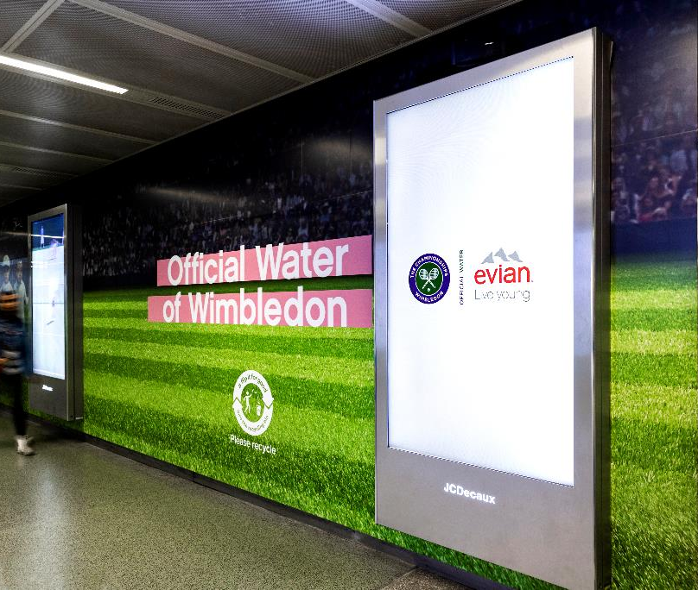
HEAVY OOH USERS
+54%
Supermarkets
+34%
Malls
+50%
more likely to have heavy exposure to OOH advertising in rail stations
+32%
LF digital
+24%
SF digital
Source: YouGov Profiles 2022 – Audience defined as ‘Wimbledon is one of my TOP interests’ vs. nat rep
Notes:
This audience are more likely to have heavy exposure to these environments/formats.

Slide 7
FAN BEHAVIOUR PRIMED BY OUT-OF-HOME
+33%
MORE LIKELY TO VISIT A STORE TO BUY A PRODUCT AFTER SEEING OOH
+47%
MADE A PURCHASE ONLINE AFTER SEEING OOH
+90%
MORE LIKELY TO SHARE CONTENT ON SOCIAL MEDIA ABOUT A PRODUCT/BRAND AFTER SEEING OOH
+65%
RESEARCHED A PRODUCT ONLINE AFTER SEEING OOH AD
Source: YouGov Profiles 2022 – Audience defined as ‘Wimbledon is one of my TOP interests’ vs. nat rep

Slide 8
TAP INTO CONTEXTUAL MOMENTS
NEUROSCIENCE
+18%
AD RECALL
+17%
SALES EFFECT
+16%
+17%
uplift in Digital Out-of-Home Effectiveness
Source: The Moments of Truth 2020

Slide 9
IBM WATSON AI RAIL & AIRPORT
60,000
different contextually relevant creatives
Multiple
award shortlistings and winner of ‘Best use of Data/Insight’ at Campaign Tech Awards
Source: DOOH.com
Notes:
Dynamic updates within seconds of them happening, played out across out-of-home screens in key locations.
This resulted in over 60,000 different creatives, contextually relevant to their locations.

Slide 10
JAGUAR #FEELWIMBLEDON LONDON WATERLOO
30%
of target audience visited Jaguar website
24%
visited the FeelWimbledon website
19%
shared the ad on social media
Source: Mindshare/HPI 2016
Notes:
In 2016 rail users had the chance to enter a bespoke virtual reality (VR) stand, which placed users in the shoes of Jaguar UK brand ambassador Andy Murray, and allowed them to experience what it was like to play at Wimbledon itself and see the crowds going wild! Not only did commuters get to feel like they were a part of the event itself, but they were also provided with constant dynamic live updates on-the-go displayed on Motion@Waterloo.
Mindshare’s research (produced through HPI) also showed that the Jaguar Wimbledon campaign led 30% of the target audience to visit the main brand website, 24% visited the FeelWimbledon website, 20% searched for ‘FeelWimbledon’ online, 19% shared the ad on social media and 15% tweeted about ‘Jaguar’ or used #FeelWimbledon’ – overwhelming results!

Slide 11
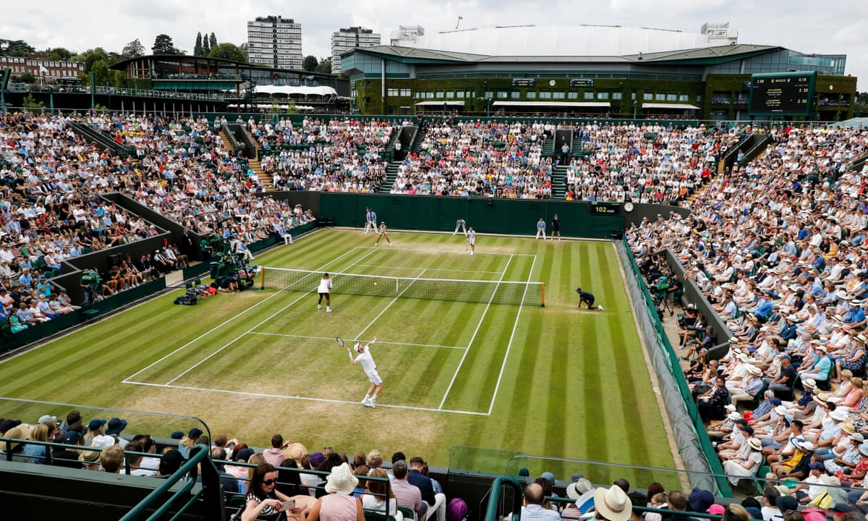
ACTIVATION OPPORTUNITIES

Slide 12
LONDON WATERLOO

Slide 13
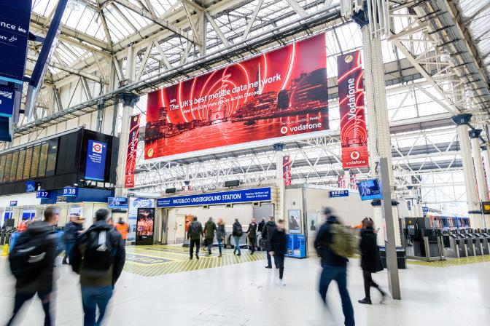
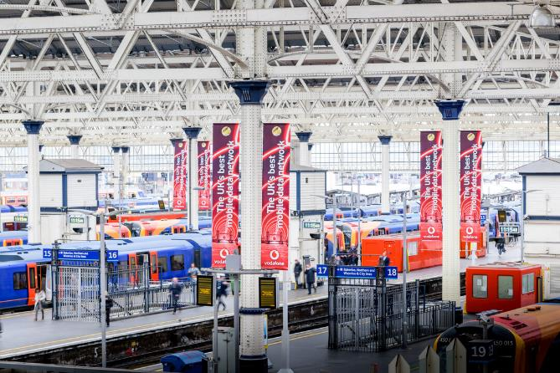
Notes:
Great opportunity for Vodafone to take over Waterloo featuring Emma Raducanu as brand ambassador (mirror Jaguar’s campaign feat. Andy Murray)

Slide 15
ST PANCRAS IMMERSION ZONE

Slide 17
TARGET TENNIS FANS

Slide 18
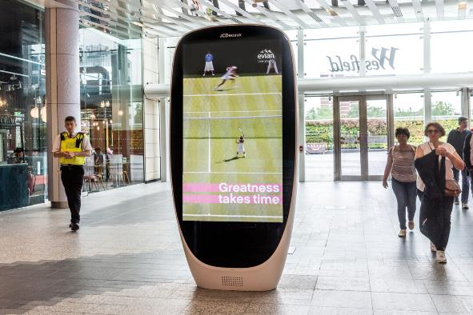
RETAIL AND RAIL PACKAGES
100 mall digital 6-sheets
100 rail digital 6-sheets
40 supermarket
digital 6-sheets
15% SOT national
£55k investment
15% SOT national
£24k investment
Tesco & Waitrose
15% SOT national
£50k investment
Audience data is from Adsquare analysing the mobile devices of people who are interested in tennis within proximity of our screens.
Source: Route, Adsquare *Site lists and impressions can be generated once locations have been selected and confirmed as available.

Slide 19
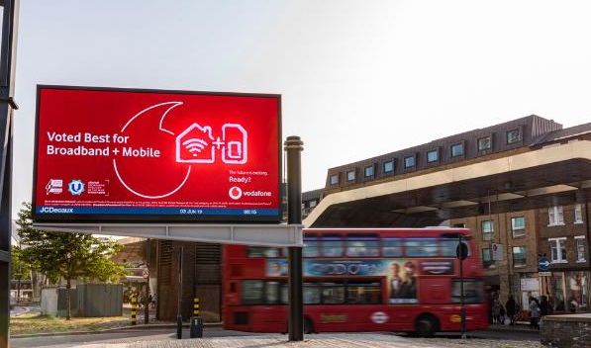
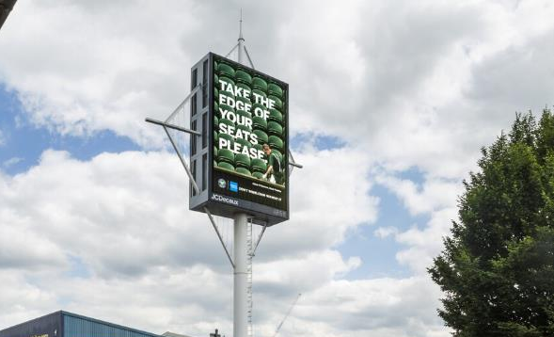
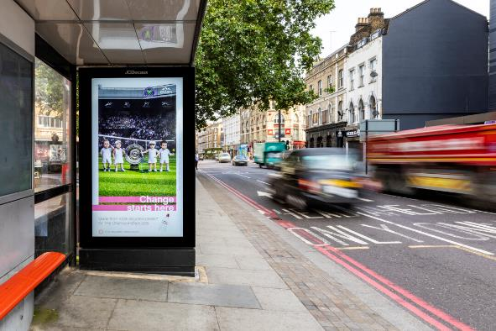
ROADSIDE PACKAGES
15 digital 48-sheets
15 digital towers
100 roadside
digital 6-sheets
20% SOT national
£100k investment
15% SOT national
£100k investment
15% SOT national
£30k investment
Audience data is from Adsquare analysing the mobile devices of people who are interested in tennis within proximity of our screens.
Source: Route, Adsquare *Site lists and impressions can be generated once locations have been selected and confirmed as available.

Slide 20
THE CITY

Slide 21
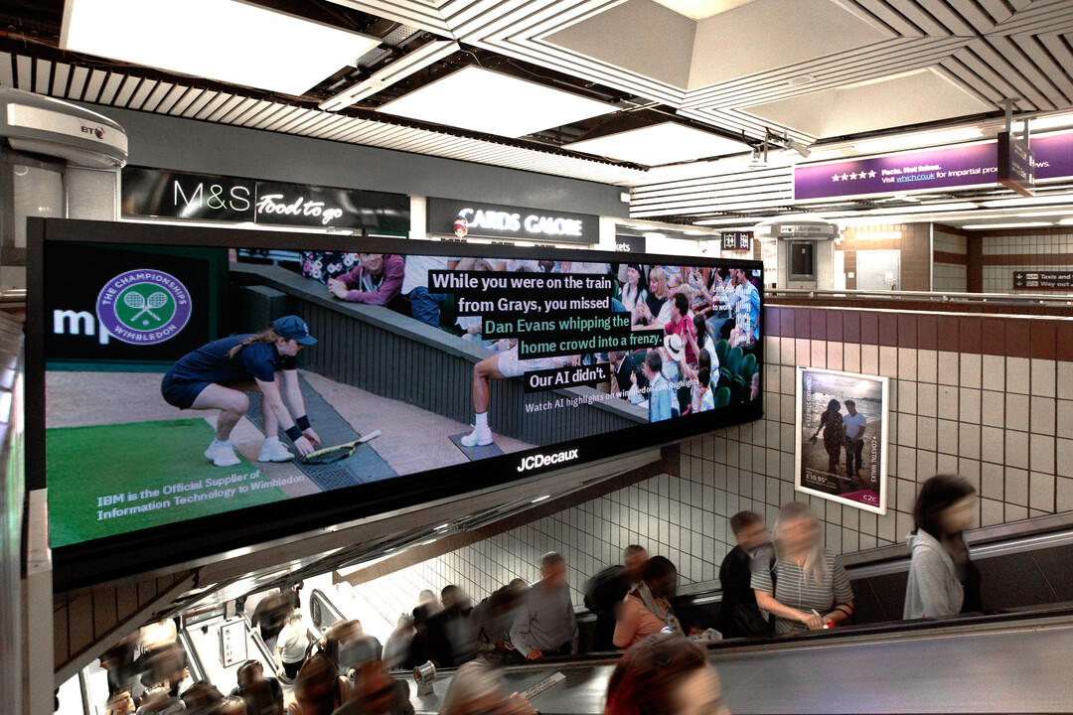
MOTION@THECITY PACKAGE
TWO WEEK ACTIVATION
London Blackfriars
Cannon Street
City Thameslink
Fenchurch Street
Liverpool Street
Route Impressions: 6.4 million
Based on 20% SOT
Investment: £46,000
9
screens

Slide 22
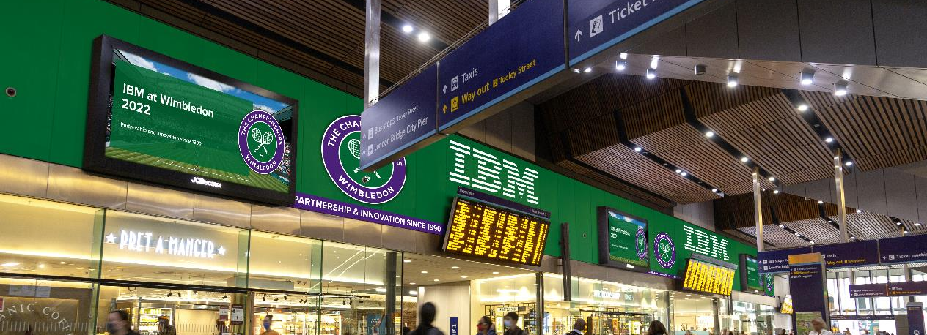
* Artist’s impression

Slide 23
* Artist’s impression

Slide 24
AIRPORT

Slide 25
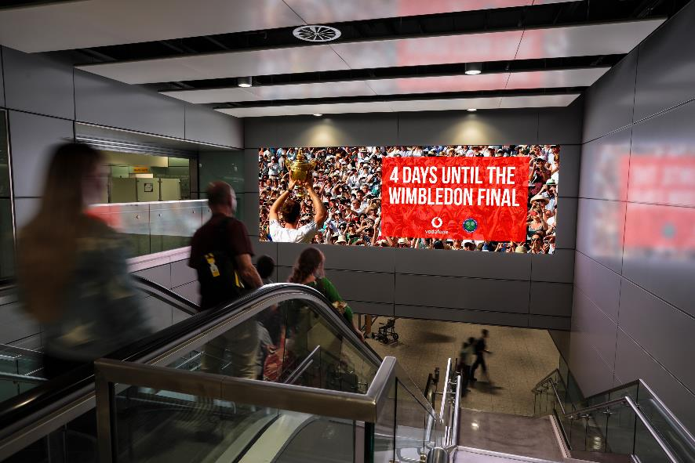
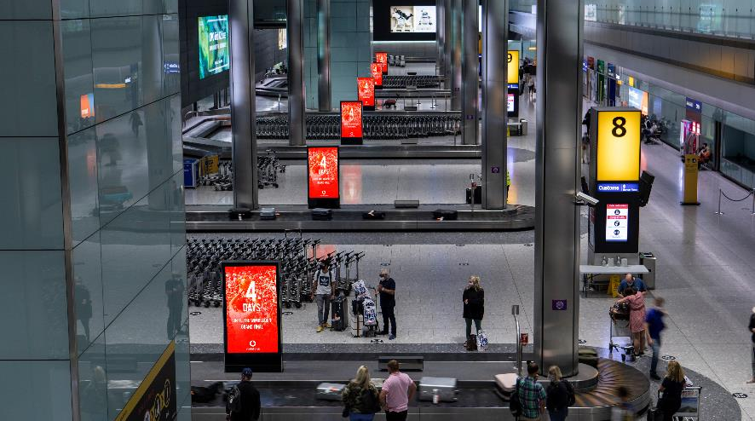
TARGET ARRIVALS: HEATHROW AIRPORT
T3 & T5 Motion Showcase
T2, T3, T5 CAPS
Ratecard £85,575 - 20% discount. Total investment £68,460 gross
2 weeks, 33% SOT, 4 large landscape digital full motion screens
Positioned directly above the escalators, located after Immigration, targeting 100% of arriving passengers as they make their way to Baggage Reclaim. Perfect opportunity for a brand to make a big impact by welcoming passengers to London. Can purchase one terminal.
Ratecard £89,110 - 25% discount. Total investment £66,883 gross
2 weeks, 16.67% SOT, 103 large portrait digital full motion screens
Exclusive opportunity to have a dominant presence in Baggage Reclaim at all Heathrow Terminals. Reaching arriving passengers as soon as they enter the UK. Can purchase one terminal.
* Images shown are artist’s impressions

Slide 26
* Images shown are artist’s impressions

Slide 27
PROGRAMMATIC

Slide 28
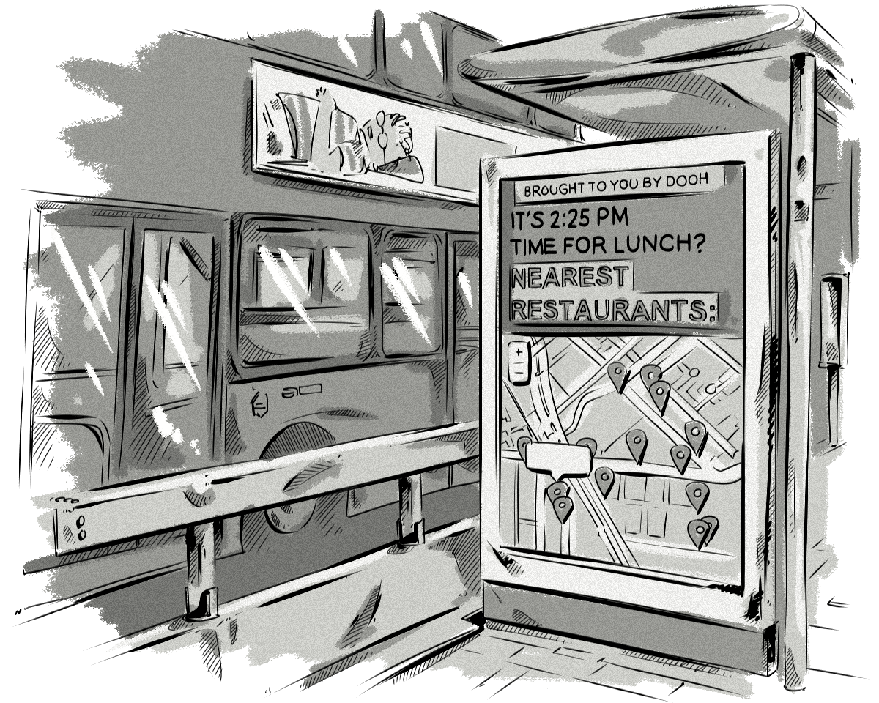
WHY PROGRAMMATIC
Utilising triggers and signals
Data driving efficiency
Increased flexibility
Omnichannel planning
Notes:
Why programmatic DOOH is even better
Alright, so take everything great about DOOH and then layer extra data, better targeting, and easy access on top. That’s what you’re looking at with programmatic DOOH.

Slide 29
TRIGGERS AND SIGNALS
Only buy when a certain condition is met and control content deployment based on real-world events. This will increase the relevancy and efficiency of your campaign. Triggers include, but are not limited to:
Weather
Time
Location
Sales
Sporting results
UV/pollen index
Custom data

Slide 30
EASILY ACCESSIBLE
Notes:
More and more DSPs are getting on board with programmatic DOOH. It’s making it much simpler to add DOOH to multichannel campaigns, and we’re already seeing buyers make use of this opportunity to great effect.
One of the best things about adding DOOH to a multichannel campaign is that it doesn’t have to be hard. At the end of the day, a digital out-of-home screen is essentially just that: a screen. Dynamic content, video content, interactive content – all of it can be and is played on DOOH displays around the world.
This means that existing content can often be adapted quite easily to suit a digital out-of-home display. The medium’s support for adaptive HTML5 formats, in particular, can be a big help in allowing buyers to reuse existing content from an online and/or mobile campaign in a programmatic DOOH campaign.
And as an added bonus, programmatic allows you to buy across multiple publishers at the same time. It’s much quicker and easier to build a programmatic campaign targeting screens across a variety of networks than it is to reach out to each business individually to coordinate your buy.
As more DSPs begin to support programmatic DOOH and more buyers begin incorporating the medium into their campaigns, the format will likely become an integral part of most mainstream media buys.

Slide 31
WIMBLEDON 2022 27 June – 10 July
Notes:
The 134th championships

