Slide 1
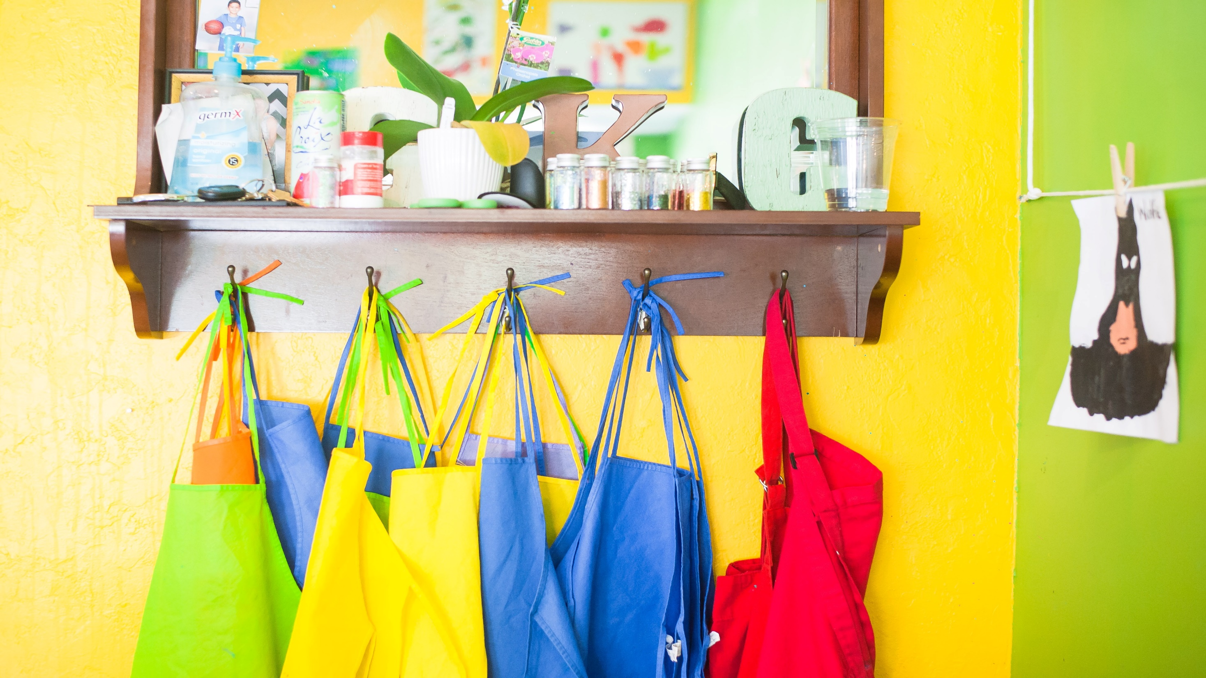
SCHOOL HOLIDAYS 2022

Slide 2
SCHOOL’S OUT!
11.8m
people in the UK
are 16 and under
8.5x
more likely to spend between £750-£999 on school holidays
Source: Equifax 2021, YouGov Profiles 2022: Target audience are those who are parents or carers of children 18 or under in their household vs Nat Rep
Notes:
With school holidays in the UK occurring every six or so weeks, parents are set to spend more across the leisure industry to keep their children entertained.
Key school holiday dates include:
Summer half term: Monday 30 May – Friday 3 June 2022
Summer holiday: Monday 25 July to Wednesday 31 August 2022
Autumn half-term holiday: Monday 24 to Friday 28 October 2022
Christmas holiday: Monday 19 December 2022 to Monday 2 January 2023
Spring half-term holiday: Monday 10 to Friday 17 February 2023
Easter holiday: Monday 3 to Friday 14 April 2023

Slide 3
AUDIENCE PROFILE
Notes:
The target audience are those who are parents and have children living with them who are 18 years vs Nat Rep.

Slide 4
PREMIUM AUDIENCE…
1 in 3
are AB
+43%
earn over £100,000 per annum
+22%
agree that they spend a lot on clothes
Source: YouGov Profiles 2022: Target audience are those who are parents/carers with children 18 vs Nat Rep.

Slide 5
TOP SUPERMARKET
1 in 4
use Tesco as their main supermarket
+39%
more likely to choose a supermarket based on special offers
Source: YouGov Profiles 2022: Target audience are those who are parents/carers with children 18 vs Nat Rep.

Slide 6
SHOP, SHOP, SHOP
67%
are influenced by their children in what to buy
81%
like owning good quality products
66%
pay more for products which improve their life
Source: YouGov Profiles 2022: Target audience are those who are parents/carers with children 18 or under at home vs Nat Rep.

Slide 7
MOVIE TIME!
+26%
prefer to watch films when they come out at the cinema
59%
usually eat snacks while watching TV/movies
Source: YouGov Profiles 2022: Target audience are those who are parents/carers with children 18 or under at home vs Nat Rep.

Slide 8
SNACKAHOLICS CURRENT CUSTOMER BY INDEX
198
153
+95%
more likely to spend over £150 per month on snacks
153
159
161
169
170
135
Source: YouGov Profiles 2022: Target audience are those who are parents/carers with children 18 or under at home vs Nat Rep.
Notes:
Greats news for FMCG brands, as top favourites for the target audience include sweet and savoury snacks.
The target audience are 4.5 x more likely to spend over £150 per month on snacks and more than 1 in 2 eat snacks whilst watching movies/TV.

Slide 9
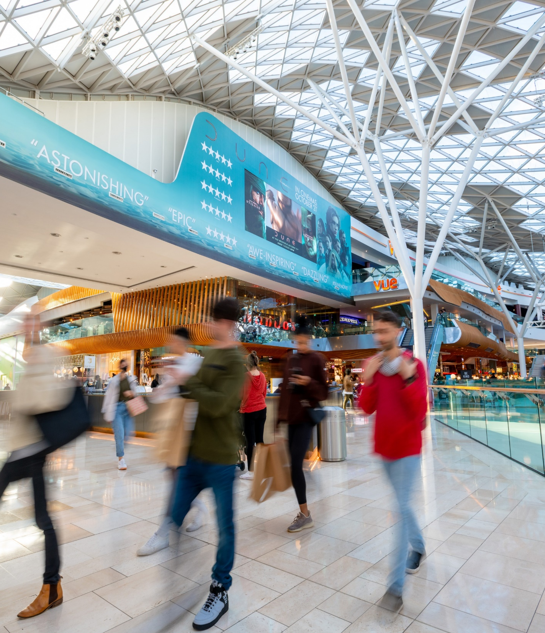
PRIMED BY OUT-OF-HOME
+42%
trust OOH
+45%
search for products/services on their mobile
+27%
become aware of new products/services
Source: YouGov Profiles 2022: Target audience are those who are parents/carers with children 18 or under at home vs Nat Rep.
Notes:
The target audience are primed by Out-of-Home…

Slide 10
KEY RAIL TERMINI
UK STATIONS | INDEX
Chelmsford | 253
Bristol Temple Meads | 160
Brighton | 143
Liverpool Central | 138
Liverpool Lime Street | 126
LONDON STATIONS | INDEX
London Cannon Street | 203
London Fenchurch Street | 193
London Waterloo (East) | 147
London Blackfriars | 122
London Farringdon | 118
Source: YouGov Profiles 2022: Target audience are those who are parents/carers with children 18 vs Nat Rep.
Notes:
Key rail termini where the target audience over-index…

Slide 11
MALL HOTSPOTS
MALLS | INDEX
Eldon Square | 212
Telford Shopping Centre | 207
Lakeside Shopping Centre | 200
East Kilbride Shopping Centre | 187
Bluewater Shopping Centre | 176
Westfield Stratford | 173
St David’, Cardiff | 171
Victoria Centre | 163
Metrocentre | 162
Liverpool ONE | 151
Westfield London | 138
61%
like to touch and feel products before they buy them
Source: YouGov Profiles 2022: Target audience are those who are parents/carers with children 18 or under at home vs Nat Rep.
Notes:
Key mall hotspots where the target audience over-index…

Slide 12
ACTIVITIES BY SEASON
Notes:
The target audience are those who are parents who have children living with them who are 18 years or younger vs Nat Rep.

Slide 13
SUMMERTIME ACTIVITIES
Source: YouGov Profiles 2022: Target audience are those who are parents/carers with children 18 or under at home vs Nat Rep.

Slide 14
THE HOLIDAY MINDSET

Slide 15
RISING EXCITEMENT FOR THE HOLIDAYS
82%
92%
1 in 3
89%
63%
of all adults plan on having at least one holiday this year
of frequent rail/underground users plan on having a holiday this year
adults have already started researching their holidays
of 18-34s plan on having at least one holiday this year
Source: Kinetic Alfresco Life – February 2022
Notes:
From the stats above, people in the UK are excited for the Jubilee Bank Holiday weekend in June and are expected to be Out-of-Home and spending more.

Slide 16
HOLIDAY ATTITUDES
Source: Kinetic Alfresco Life – February 2022
Notes:
From the data above, consumers are keen to travel again and make up for lost time since the pandemic.
According to YouGov, who ran a study in 2021, over 1 in 2 or 56% of people in the UK are living by the mantra ‘life is too short’.

Slide 17
PLANNING MULTIPLE HOLIDAYS 2022
Source: Kinetic Alfresco Life – February 2022 *Heavy underground users are those that get the underground or train at least once a week
Notes:
Over 82% of all adults are likely to take at least one holiday in 2022.
92% of heavy rail users, those defined as using a train at least once a week, are likely to take at least one holiday in 2022. These stats highlight the importance of advertising Out-of-Home in rail/transport environments over the coming months.

Slide 18
RESEARCH TIME SLOTS ALL ADULTS
Source: Kinetic Alfresco Life – February 2022
Notes:
As we can see from the graph, Q1 and Q2 are the most crucial times of the year for researching and book their holidays.

Slide 19
SCHOOL HOLIDAYS 2022

