Slide 1
SPRING IN OUR STEP AUTOMOTIVE FOCUS

Slide 2
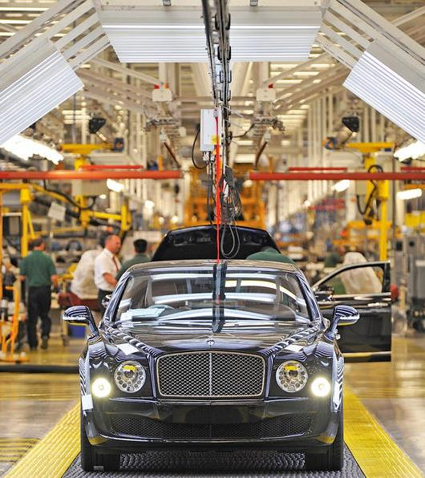
MOTORS FOR THE MASSES
37M
UK adults own at least one car
37%
use a car to get to work
Over 1M
Brand new cars were built in the UK in 2020
Source: YouGov Profiles & UK Motors Industry

Slide 3
TIME FOR A TEST DRIVE
1 in 3
car owners are considering buying a new car
1 in 10
UK adults are considering buying a car with lockdown savings
+14%
increase in intent to upgrade current car vs August 2020
Source: Sentiment Tracker 2021

Slide 4
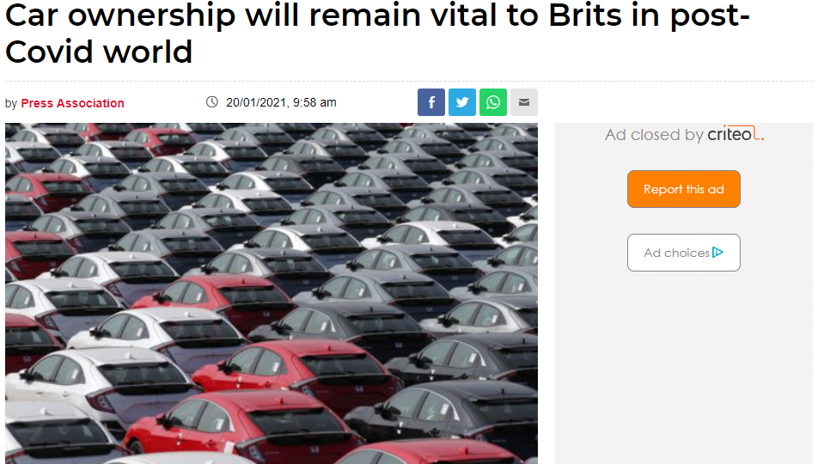

Slide 5
INCREASED RELIANCE ON CAR OWNERSHIP
86%
say they could not support their current lifestyle without a car
Source: Sentiment Tracker 2021 & WhatCar Report

Slide 6
INCREASED CAR BRAND CONSIDERATION
+11%
increase in Car brand consideration 2021 vs 2020
+40%
surge in Car brand consideration post 1st lockdown vs same period in 2019
AWARENESS
CONSIDERATION
ACTIVATION
Source: YouGov Brand Index

Slide 7
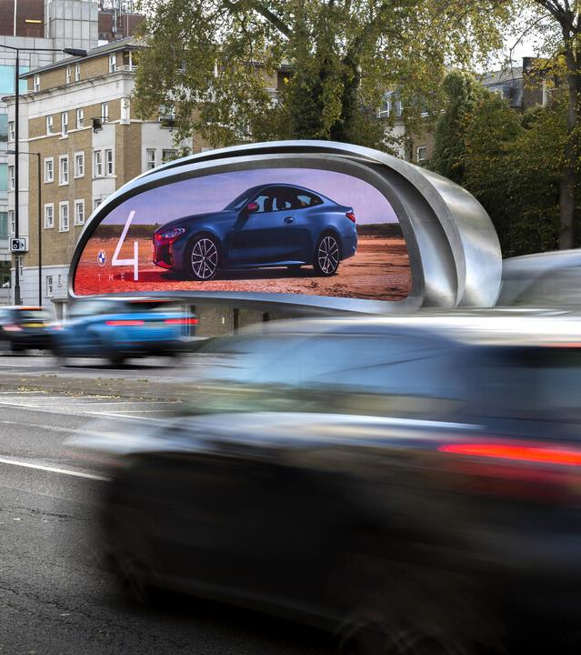
BUOYANT MOTORS AD-MARKET
£660M
Predicted advertising spend within motors sector 2021
+30%
2021 FC vs 2020
10p in every £1
of motors ad-spend will be spent in OOH
Source: WARC Nov

Slide 8
CONSUMERS WANT TO KNOW MORE - NOW
Over 1 in 2
want to know more or the same
Source: Sentiment Tracker 2021

Slide 9
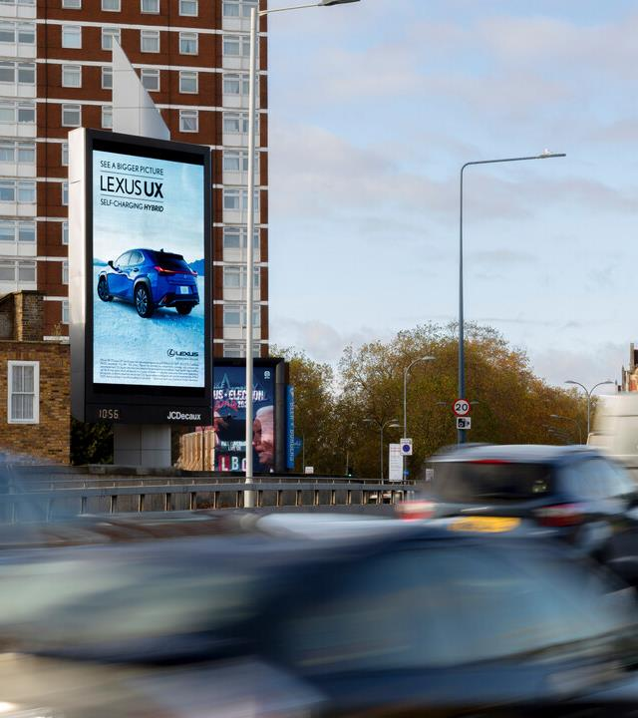
MOTORS BRAND TRACKER DIGITAL LARGE FORMAT
AWARENESS
+9%
CONSIDERATION
+2%
Source: JCDecaux Brand Tracker 2020

Slide 10
OUT-OF-HOME SPRINGS BACK ROADSIDE AUDIENCE PREDICTION
Forecasts based on: Schools & retail return by 22nd March Easter Holidays 1st April – 18th April

