Slide 1
SPRING IN OUR STEP FINANCE FOCUS

Slide 2
FINANCES UNDER CONTROL
1 in 4
have been managing their money better in 2021
+18%
increase in UK adults being unconcerned about personal finances vs August 2020
35M
UK adults currently own a credit card
Source: Sentiment Tracker 2021
Notes:
With £38billion in lockdown savings across the UK

Slide 3
WHAT ARE WE CURRENTLY SAVING FOR
18M
Holiday
11M
Property
6M
New car
+18%
+95%
+7%
+41%
+40%
+10%
Source: YouGov Profiles
Notes:
Reference environments
London & Malls

Slide 4
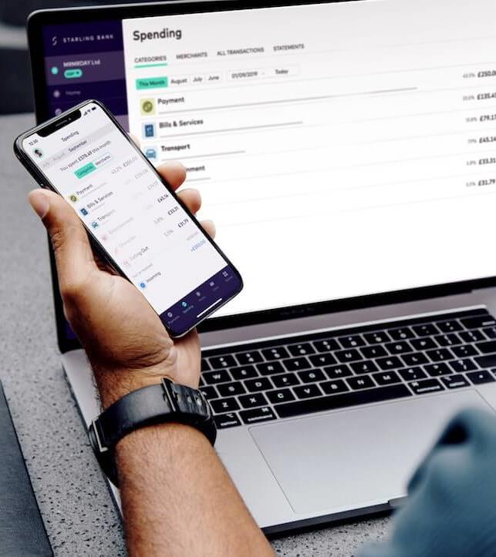
BEHAVIOURAL CHANGE STILL NEEDED
1 in 3
have never used mobile or online banking
45M
don’t use mobile payment apps when in-store
83%
of UK adults own a smartphone
Source: YouGov Profiles

Slide 5
EMERGENCE OF CRYPTO
8.4M
Agree cryptocurrencies are the future of online transactions
1.7M
UK adults have used cryptocurrencies as a payment method
+26%
Increase in interest within the past month
Source: YouGov Profiles
Notes:
¾ of UK adults have some form of personal investment
With £38billion in lockdown savings across the UK
TradeStation - Best Trading Platform.
Coinbase - Best Crypto Exchange.
eToro - Low Fees.
Kraken - Maker-Taker Fee Schedule.
Bittrex - Most Altcoins.
Gemini - Offers Gemini Dollar.
Robinhood - Best Mobile App.

Slide 6
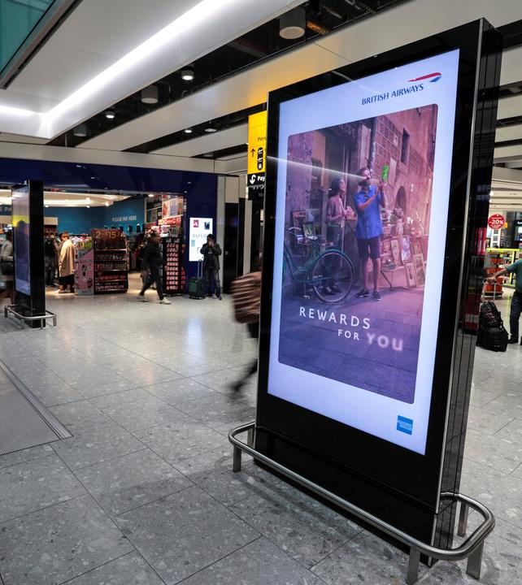
LACK OF MEDIA ACTIVITY IMPACTS FINANCE CATEGORY REPUTATION
-5%
decrease in Finance category reputation 2019 vs 2020
-11%
decrease in Finance category reputation 2021 vs 2020
AWARENESS
CONSIDERATION
ACTIVATION
Source: YouGov Brand Index

Slide 7
FINANCE BRAND TRACKER RAIL
AWARENESS
+27%
CONSIDERATION
+9%
ACTION
+50%
Source: JCDecaux Brand Tracker 2020

Slide 8
OOH SPRINGS BACK RAIL AUDIENCE PREDICTION
Forecasts based on: Schools & retail return by 22nd March Easter Holidays 1st April – 18th April

