Slide 1
SUMMER 2022 21ST JUNE – 23RD SEPTEMBER

Slide 2
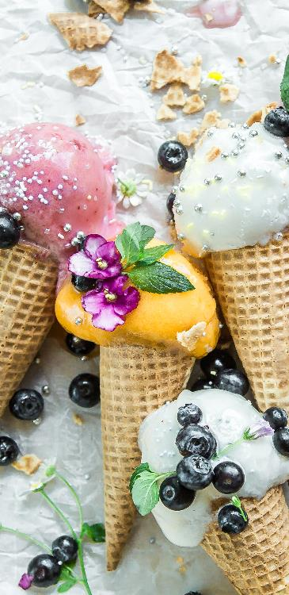
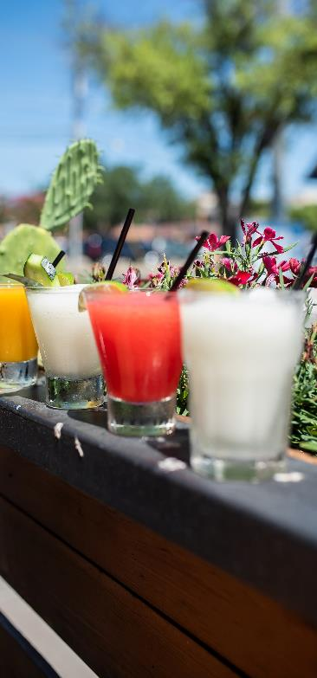
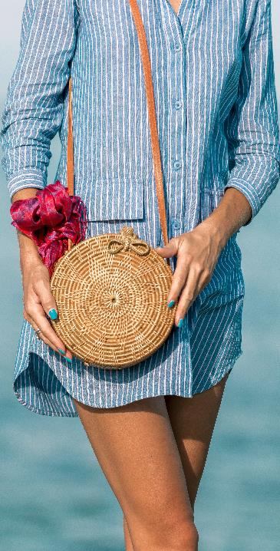
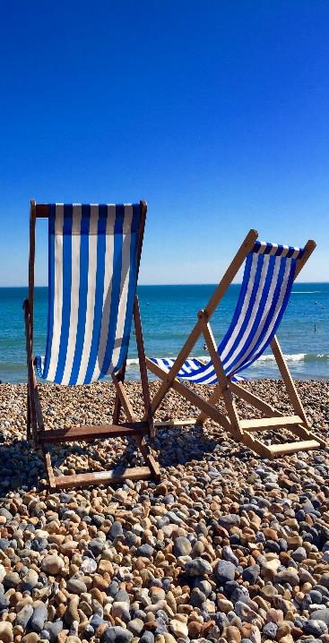
SUMMER 2022 CONTENTS
FOOD
DRINKS
FASHION
ACTIVITIES
Notes:
The audience is based on those who choose Summer as their favourite season (YouGov 2022).
The first few slides are about the Summer season in general and the selected audience.
The information is grouped into four categories; Summer food, drinks, fashion and activities with each picture on Slide 2 linking to the relevant section.

Slide 3
SUMMER FAVOURITE SEASON
No.1 Season
Source: YouGov Profiles (2022)
Notes:
According to YouGov, most people (35%) choose Summer as their favourite season of the year

Slide 4
SUMMER FACTS & FIGURES
Strongest
seasonal sales for UK retailers in more than 4 years in Summer 2021 (June)
17%
increase in UK retail sales in Summer 2021 with strong growth in-store in June
Sources: The Guardian June 2021, British Retail Consortium (BRC) covering 30th May - July 2021
Notes:
According to an article from The Guardian and a report from The British Retail Consortium (BRC), UK retailers saw their strongest seasonal sales (17% increase) and strong growth in-store in Summer 2021.

Slide 5
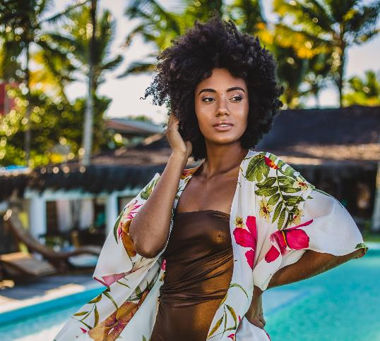
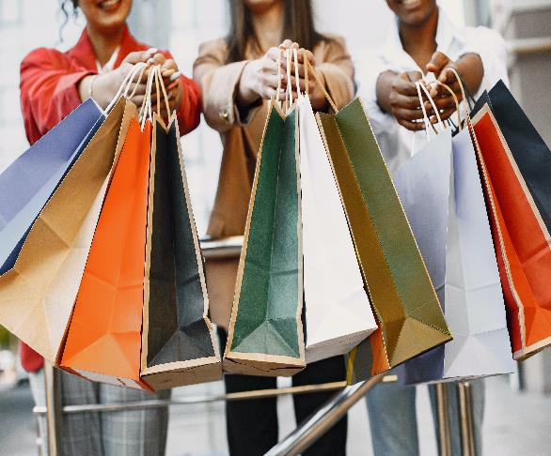
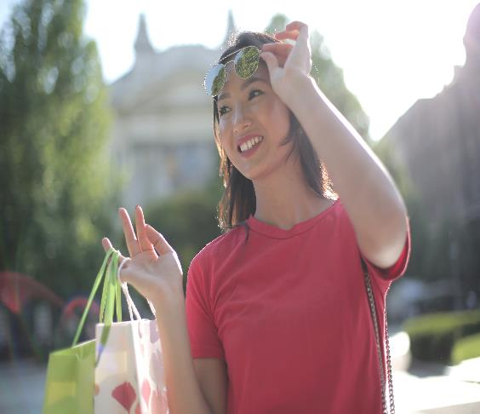
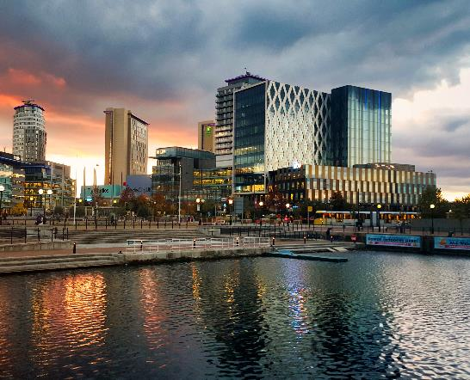
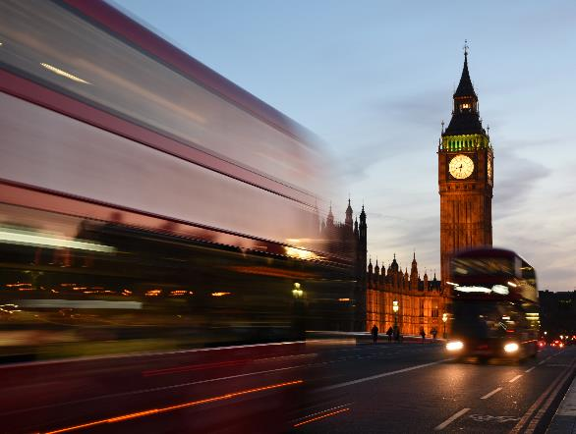
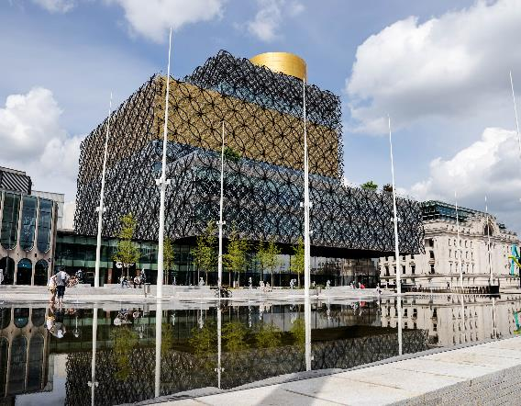
+19%
EARN £50K - 60K
PER YEAR*
55%
ABC1
33%
MILLENNIALS
+39%
MANCHESTER*
+25%
LONDON*
+11%
BIRMINGHAM*
Source: YouGov Profiles 2022: Audience are those who chose Summer as their favourite season vs. Nat Rep. *more likely than the average adult
Notes:
The Summer audience mainly consists of people who are ABC1, Millennials, and earn at least £50,000 per annum.
Manchester has the highest index with London and Birmingham closely behind.

Slide 6
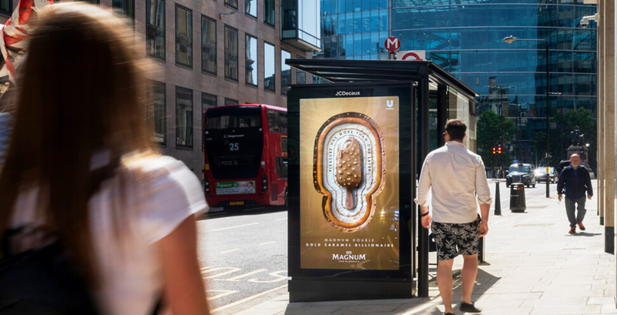
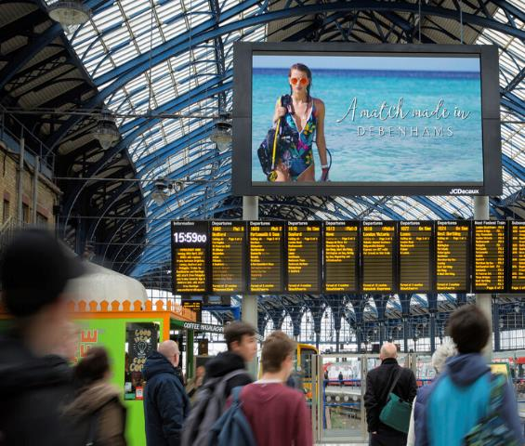
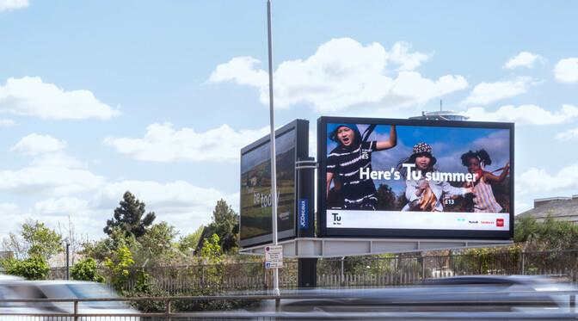
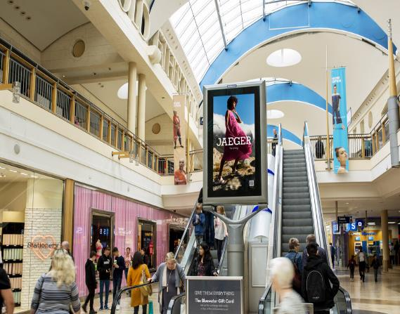
HEAVY EXPOSURE
TO OOH
+46%
RAIL
+38%
STREET FURNITURE
IN MULTIPLE ENVIRONMENTS
+43%
+29%
LARGE FORMAT
+11%
MALLS
SPEND 9-10 HOURS TRAVELLING OOH
Source: YouGov Profiles 2022: Audience are those who chose Summer as their favourite season vs. Nat Rep (more likely than the average adult)
Notes:
This audience has heavy exposure to OOH in multiple environments.

Slide 7
PRIMED BY OOH ACTIONS AFTER SEEING OOH ADS
+37%
+22%
+11%
+26%
RESEARCHED PRODUCTS /
SERVICES ON THEIR MOBILE
TALKED WITH FAMILY / FRIENDS
ABOUT PRODUCTS /
SERVICES SEEN ADVERTISED OOH
MADE A PURCHASE USING THEIR MOBILE
“I trust OOH
advertising"
Source: YouGov Profiles 2022: Audience are those who chose Summer as their favourite season vs. Nat Rep. (more likely than the average adult)
Notes:
These stats show the actions that people from this audience are more likely to take after seeing OOH ads.

Slide 8
FOOD

Slide 9
ICE CREAM FAVOURITES FAVOURITE BRANDS
BRAND (ICE CREAM) | % of audience who positively rate
MAGNUM | 92%
HAAGEN-DAZS | 66%
CORNETTO | 65%
BEN AND JERRY’S | 56%
WALL’S | 46%
20%
eat ice-cream several times per month
Source: YouGov Profiles 2022: Audience are those who chose Summer as their favourite season vs. Nat Rep
Notes:
This slide shows the favourite ice cream brands with Magnum being the most popular

Slide 10
SNACK FAVOURITES FAVOURITE BRANDS
BRAND (SNACKS) | % of audience who have purchased in last 30 days
WALKERS | 30%
DORITOS | 17%
PRINGLES | 13%
MINI CHEDDARS | 12%
HULA HOOPS | 10%
24%
eat snacks / crisps several times per week
Source: YouGov Profiles 2022: Audience are those who chose Summer as their favourite season vs. Nat Rep.
Notes:
The slide shows the favourite snack/crisp brands with walkers being the most popular.

Slide 11
BARBECUES FACTS & FIGURES
£834m
spent on barbecue occasions in 2020
488%
increase in barbecue-related searches in June 2021 according to Google Trends research
70%
of audience are
meat-eaters
Sources: The Grocer (2021); YouGov Profiles 2022: Audience are those who chose Summer as their favourite season vs. Nat Rep
Notes:
According to an article from The Grocer, £834m was spent on barbecues in 2020 and there was a 488% increase for barbecue-related google searches

Slide 12
TESCO SUMMER BBQ CONTEXUAL DOOH CONSIDERABLE SALES UPLIFT INCREASE WHEN USING CONTEXTUAL
DUR
+4%
POST
+2%
DUR
+6%
POST
+3%
DUR
+9%
POST
+6%
DUR
+13%
POST
+12%
Static vs no advertising
Contextual Static vs no advertising
Motion vs no advertising
Contextual Motion vs no advertising
Source: JCDecaux Tesco EPOS case study 2018
Notes:
As the Tesco case study shows, contextual DOOH can significantly increase sales during and post campaign.

Slide 13
SUMMER FOOD EATING HABITS
70%
like to experience
new foods / cuisines
63%
sit down together
for a meal
57%
enjoy cooking for themselves and others
Source: YouGov Profiles 2022: Audience are those who chose Summer as their favourite season vs. Nat Rep
Notes:
From these stats we can see that the Summer audience enjoys cooking, trying new foods and eating with family at meal-time

Slide 14
SUMMER FOOD CASUAL DINING
BRAND (RESTAURANT) | INDEX %
ASK ITALIAN | +199%
CAFÉ ROUGE | +188%
CÔTE BRASSERIE | +118%
PIZZA EXPRESS | +114%
WAHACA | +102%
+63%
spend between £100 - £200 per month eating out at restaurants
Source: YouGov Profiles 2022: Audience are those who chose Summer as their favourite season vs. Nat Rep (more likely than the average adult)
Notes:
This slide shows the favourite casual dining restaurants with Ask Italian being the most popular.

Slide 15
DRINKS

Slide 16
ALCOHOL FAVOURITES TOP BEVERAGES
ALCOHOL (TYPE) | INDEX %
ALCOPOPS E.G. SMIRNOFF ICE | +113%
WINE | +65%
VODKA | +59%
TEQUILA | +58%
Source: YouGov Profiles 2022: Audience are those who chose Summer as their favourite season vs. Nat Rep. (more likely than the average adult)
Notes:
This slide shows the favourite alcoholic beverages with alcopops such as Smirnoff Ice being most popular.

Slide 17
DRINKS (ALCOHOL) PURCHASE BEHAVIOUR
+46%
drink alcohol at bars
several times
per month
+40%
spend £100-£150
on alcohol monthly
in pubs/restaurants
+37%
purchase alcohol
several times per week
Source: YouGov Profiles 2022: Audience are those who chose Summer as their favourite season vs. Nat Rep. (more likely than the average adult)
Notes:
The slide shows how often the summer audience purchases alcohol at bars, pubs, and restaurants, and how much they are likely to spend.

Slide 18
FASHION

Slide 19
FASHION RETAIL ATTITUDES & BEHAVIOUR
41%
visit shopping malls / high streets
in their free time
+59%
have purchased luxury accessories
i.e. hats, sunglasses
in the past 12 months*
+13%
have spent between £150 –£300
on clothes in the last three months*
Source: YouGov Profiles 2022: Audience are those who chose Summer as their favourite season vs. Nat Rep. *more likely than the average adult
Notes:
The summer audience enjoys visiting shopping malls and high streets and purchasing clothes and accessories.

Slide 20
FASHION RETAIL ATTITUDES & BEHAVIOUR
+40% +32%
I SEE MYSELF AS I KEEP UP TO
MORE FASHIONABLE DATE WITH
THAN MOST FASHION TRENDS
+29% +28%
LUXURY GOODS I HAVE
ARE A GOOD EXPENSIVE INVESTMENT TASTE
+10% +10%
BUY IN-STORE HAVE A
TO TRY ‘SUMMER’
BEFORE BUYING WARDROBE
Source: YouGov Profiles 2022: Audience are those who chose Summer as their favourite season vs. Nat Rep. (more likely than the average adult)
Notes:
The summer audience see themselves as highly fashionable and up to date with current fashion trends.

Slide 21
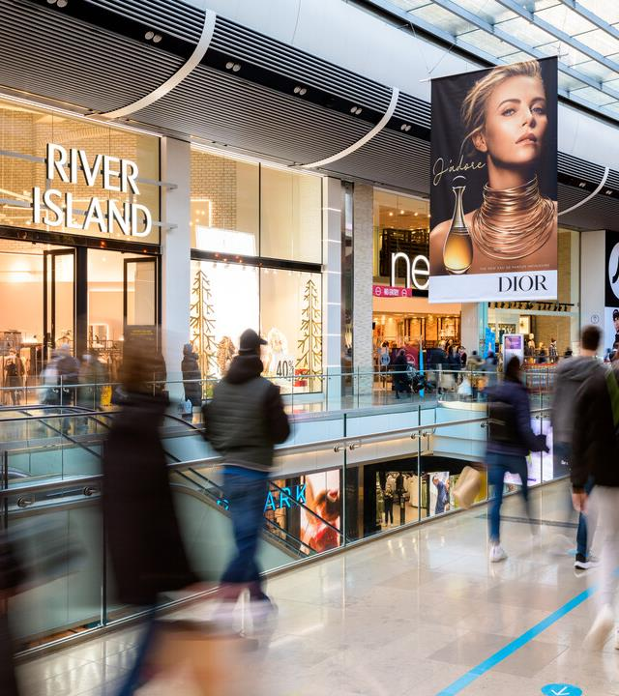
TOP FASHION BRANDS LUXURY
LUXURY BRAND | INDEX %
MULBERRY | +76%
PRADA | +59%
LANCOME | +47%
DIOR | +45%
VIVIENNE WESTWOOD | +43%
+21%
“I am willing to pay more for luxury brands”
Source: YouGov Profiles 2022: Audience are those who chose Summer as their favourite season vs. Nat Rep. (more likely than the average adult)
Notes:
The slide lists the top luxury brands that the Summer audience are more likely to purchase and shows that they are willing to purchase luxury brands (+21% more likely than the Nat Rep.)

Slide 22
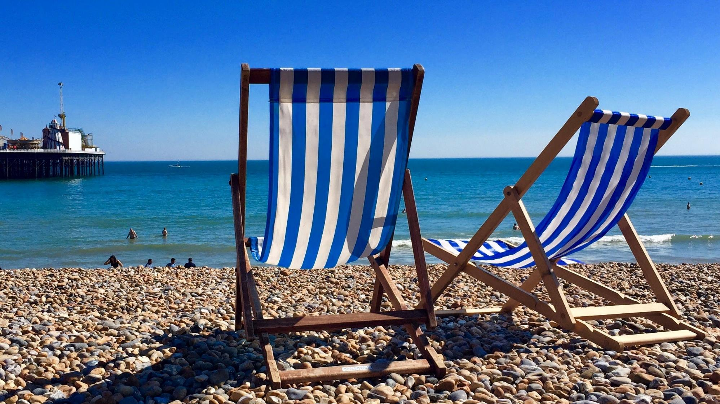
ACTIVITIES

Slide 23
SUMMER ACTIVITIES TOP ACTIVITIES IN SUMMER
+43% +42%
HOST GO TO
A DINNER PARTY SPORTING EVENTS
+15% +11%
ATTEND OUTDOOR VISIT
PERFORMANCES FRIENDS/FAMILY
+28% +12%
GO SHOPPING TRAVEL
+21%
“Sunshine / warm weather makes me want go out”
Source: YouGov Profiles 2022: Audience are those who chose Summer as their favourite season vs. Nat Rep (more likely than the average adult)
Notes:
Dinner parties are most popular with the summer audience. Going out to events and visiting friends/family is also important to them.

Slide 24
SUMMER TRAVEL HOLIDAYS
1in4
have had a holiday
in the past 12 months
45%
have travelled
for leisure
+67%
intend to go on holiday
in August 2022*
+11%
“I enjoy shopping at airports”
Source: YouGov Profiles 2022: Audience are those who chose Summer as their favourite season vs. Nat Rep. *more likely than the average adult
Notes:
A quarter of this audience has recently travelled and many intend to travel. They enjoy shopping while at airports

Slide 25
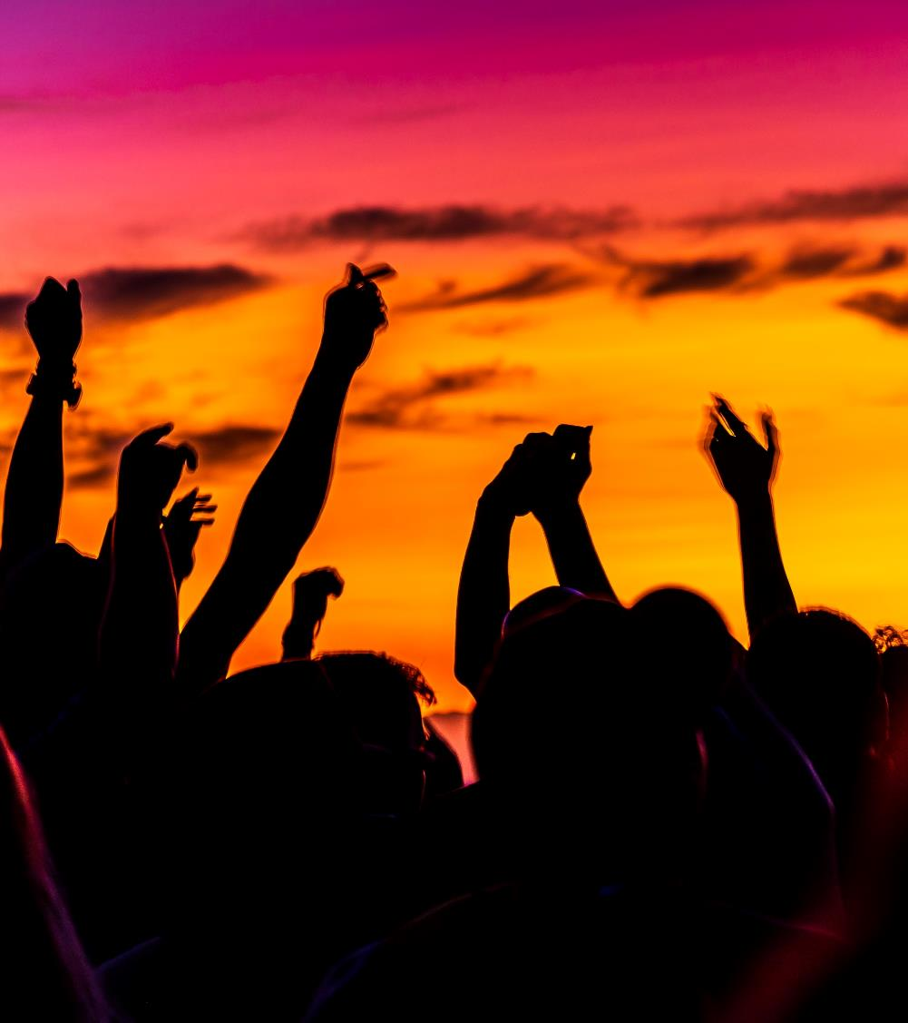
FAVORITE FESTIVALS TOP 5 FESTIVALS
FESTIVAL | INDEX %
GLASTONBURY | +76%
BBC PROMS | +59%
READING AND LEEDS | +47%
V FESTIVAL | +45%
REWIND FESTIVAL | +43%
+12%
“I am obsessed with music”
Source: YouGov Profiles 2022: Audience are those who chose Summer as their favourite season vs. Nat Rep (more likely than the average adult)
Notes:
The slide lists the top 5 favourite summer festivals with Glastonbury being most popular.

Slide 26
SUMMER 2022 21ST JUNE – 23RD SEPTEMBER
Notes:
Thank you for reading!

