Slide 1
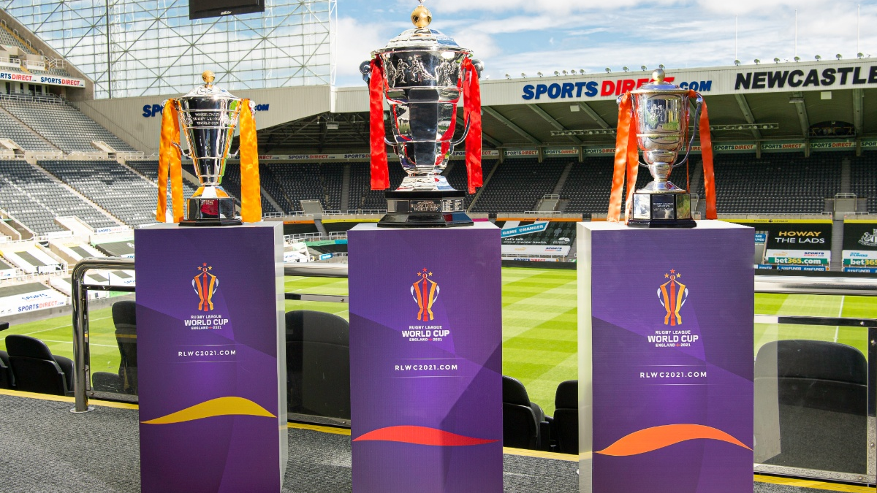
RUGBY LEAGUE WORLD CUP 2021 15 October – 19 November 2022
Notes:
The 134th championships

Slide 2
BREAKING NEW GROUND
61
matches
3
competitions
5,000+
tickets sold for the
opening match
5000+
16th
staging
Source: rlwc2021.com
Notes:
The 2021 Rugby League World Cup will be the sixteenth staging of the Rugby League World Cup and will be held in England. It was originally going to be held between 23 October 2021 and 27 November 2021, however the pandemic and the subsequent withdrawals of Australia and New Zealand caused the tournament to be postponed.
Excitement continues to rise with this Autumn’s tournament breaking new ground in staging a record-breaking 61 matches across three competitions simultaneously for the very first time.
The tournament has also smashed the record for the number of tickets sold for an England-based rugby league fixture with the opening match at Headingley between England and Brazil followed by Papua New Guinea v Canada having already sold over 5,000 tickets.

Slide 3
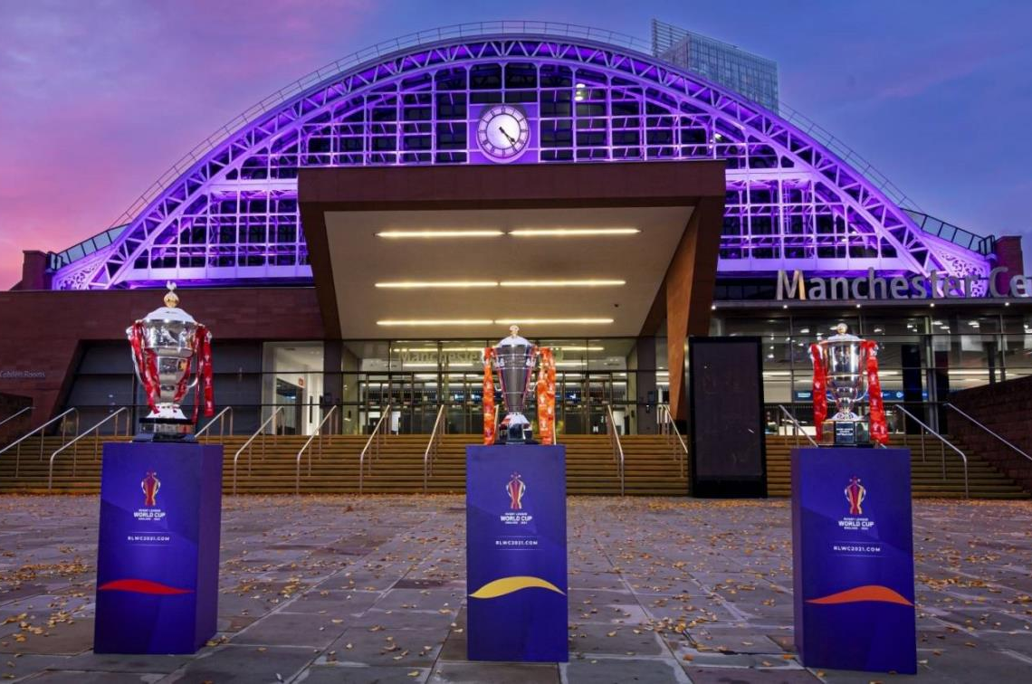
THE POWER OF TOGETHER
“
…it’s incredibly exciting to be in the final phase of preparation for what is set to be the biggest, best and most inclusive Rugby League World Cup in history.
RLWC2021 Chief Executive, Jon Dutton
Source: rlwc2021.com
Notes:
RLWC2021 is set be a trailblazing tournament with the men’s, women’s and wheelchair competitions being staged together for the first time.

Slide 4
A TRULY GLOBAL CELEBRATION
MEN’S
A special occasion
The pinnacle event in International Rugby League
16 nations
KEY DATES:
15 Oct 2022 - Men’s group stages start
4 Nov 2022 - Men’s quarter-finals start
11 Nov 2022 - Men’s semi-finals start
19 Nov 2022 - Men’s final
WOMEN’S
An unprecedented platform
Bigger & better than ever
8 nations
KEY DATES:
1 Nov 2022 - Women’s group stages start
14 Nov 2022 - Women’s semi-finals start
19 Nov 2022 - Women’s final
WHEELCHAIR
An iconic event
A truly inclusive sport, for all
8 nations
KEY DATES:
3 Nov 2022 - Wheelchair group stages start
13 Nov 2022 - Wheelchair semi-finals
18 Nov 2022 - Wheelchair final
Source: rlwc2021.com
Notes:
Every second of every one of the 61 matches is being broadcast live across BBC platforms.
The tournament will be a truly global celebration of rugby league with teams flying in from all corners of the globe to fight for the opportunity to get their hands on one of the three famous trophies, with the women’s competition hosting teams from four different continents for the first time in history.

Slide 5
MORE MATCHES IN MORE PLACES THAN EVER BEFORE
21
venues
18
host towns & cities
NEWCASTLE
KIRKLEES
TEES VALLEY
YORK
PRESTON
LEEDS
HULL
BOLTON
WIGAN & LEIGH
MANCHESTER &
TRAFFORD
ST HELENS
DONCASTER
LIVERPOOL
WARRINGTON
LONDON
SHEFFIELD
COVENTRY
Source: rlwc2021.com
Notes:
The matches will be held across 18 Host towns and cities – meaning more matches in more places than ever before.
Bolton - The University of Bolton Stadium - team base for France (Men's).
Coventry - Coventry Building Society Arena
Doncaster - Eco-Power Stadium - team base for Samoa (Men’s).
Hull - MKM Stadium - team base for Fiji (Men's).
Kirklees - John Smiths Stadium
Leeds - Elland Road and Headingley Stadium - The city will also be the team base for Jamaica and Ireland (Men’s) and England, Papua New Guinea, Brazil and Canada (Women’s) teams.
Liverpool - Liverpool will play a key role during the tournament with the city providing the training bases for Italy and Tonga.
London - The Emirates Stadium and The Copper Box Arena - team base for the England, Australia, Ireland and Spain (Wheelchair) teams.
Newcastle - St James’ Park and Kingston Park - team base for the Scotland (Men's) team.
Preston - Preston will host Wales (Men's) team as their training base
Sheffield - Bramall Lane and The EIS - team base for the Greece (Men’s) and France, Wales, Scotland and USA (Wheelchair) teams.
St Helens - Totally Wicked Stadium - base for Tonga and Italy (Men's) teams.
Tees Valley - Riverside Stadium - team base for the Cook Island (Men's).
Manchester & Trafford - Old Trafford and Manchester Central
Warrington - Halliwell Jones Stadium - team base for the Papua New Guinea (Men's) team.
Wigan & Leigh - DW Stadium and Leigh Sports Village
York - LNER Community Stadium - team base for New Zealand (Men’s) and Australia, New Zealand, France, Cook Islands (Women’s) teams.

Slide 6
SPONSORS
Source: Sportspromedia.com
Notes:
This year, there’s a greater mix of B2B and B2C businesses.
Online car retailer Cazoo has been named the principal sponsor of next year’s Rugby League World Cup (RLWC2021) in England.
The precise financial terms of the deal were not made public, but both parties confirmed the agreement is for a seven-figure fee. The pact represents the biggest sponsorship deal in the history of the Rugby League World Cup and the biggest commercial agreement in the sport outside of Australia.

Slide 7
NEW PARTNERSHIP
The Rugby League World Cup is a champion for diversity and inclusion, and we share those values and beliefs at Vodafone – we’re here to help bring to life the ‘Power of Together’ with this brilliant new partnership.
Nick Gliddon
Director of Vodafone business UK
Source: Sportspromedia.com
Notes:
9 June 2022 - The Rugby League World Cup (RLWC) 2021 has named telecommunications brand Vodafone as the tournament’s official technology partner.
The deal adds to Vodafone’s UK sports partnerships portfolio, which also includes a multi-year agreement with the All England Lawn and Tennis Club (AELTC) for the Wimbledon tennis Grand Slam, as well as a partnership with English top-flight rugby union club Wasps Rugby. The telecommunications brand also has an ambassador deal with British tennis star Emma Raducanu.

Slide 8
RLWC FANATICS RUGBY LEAGUE WORLD CUP = TOP SPORTING INTEREST
+31%
more likely
to be
male
+21%
more likely
to be a
baby boomer
+18%
more likely
to
earn £50k+
+19%
more likely
to have
a monthly disposable income of £1,000+
+135%
more likely
To be
actively
on the lookout to buy new tech
Audience
profile
Source: YouGov Profiles 2022 – Audience defined as ‘Rugby League World Cup is one of my TOP interests’ vs. nat rep

Slide 9
DRINKING HABITS
+163%
spend £200-£300 monthly on alcohol at the supermarket*
1in5
say lager is their favourite alcoholic beverage
+47%
say watching sports on TV is the main occasion for drinking alcohol at home*
Source: YouGov Profiles 2022 – Audience defined as ‘Rugby League World Cup is one of my TOP interests’ vs. nat rep (*more likely than the average adult)

Slide 10
EATING HABITS
+81%
spend £75-£100 monthly on takeaways
+152%
current subscribers to a recipe box service
+52%
cook from scratch at least once per week
Source: YouGov Profiles 2022 – Audience defined as ‘Rugby League World Cup is one of my TOP interests’ vs. nat rep (more likely than the average adult)

Slide 11
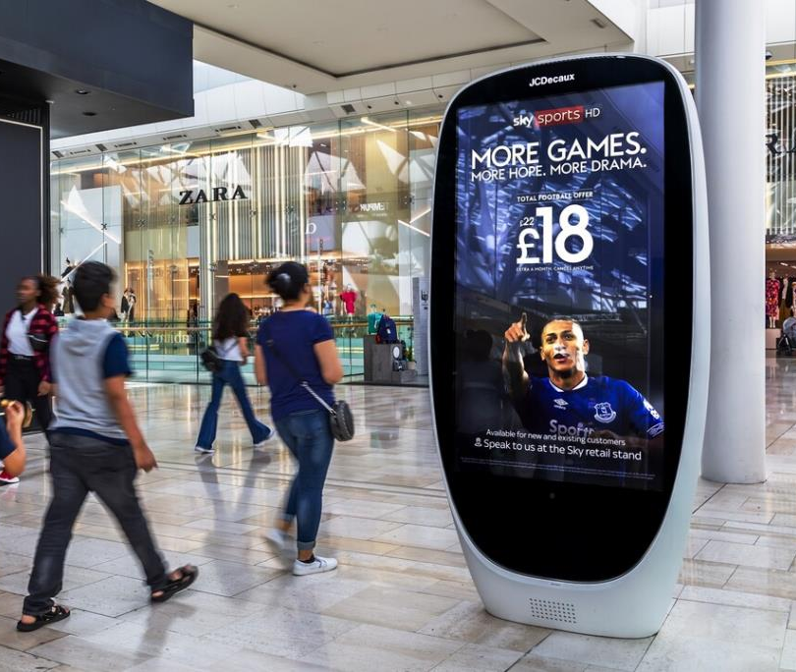
HEAVY OOH USERS
+141%
Supermarkets
+133%
Rail
+195%
more likely to have heavy exposure to OOH advertising in malls
+115%
SF digital
+56%
LF digital
Source: YouGov Profiles 2022 – Audience defined as ‘Rugby League World Cup is one of my TOP interests’ vs. nat rep
Notes:
This audience are more likely to have heavy exposure to these environments/formats.

Slide 12
FAN BEHAVIOUR PRIMED BY OUT-OF-HOME
+114%
MORE LIKELY TO GET IN TOUCH FOR MORE INFO VIA A MOBILE AFTER SEEING OOH
+112%
MORE LIKELY TO SHARE CONTENT ON SOCIAL MEDIA ABOUT A PRODUCT/BRAND AFTER SEEING OOH
+103%
MADE A PURCHASE ONLINE AFTER SEEING OOH
+59%
RESEARCHED A PRODUCT ONLINE AFTER SEEING OOH AD
Source: YouGov Profiles 2022 – Audience defined as ‘Rugby League World Cup is one of my TOP interests’ vs. nat rep

Slide 13
OWN THE MOMENT CONTEXTUAL DOOH
NEUROSCIENCE
+18%
AD RECALL
+17%
SALES EFFECT
+16%
+17%
uplift in Digital Out-of-Home Effectiveness
Source: The Moments of Truth 2020

Slide 14
TESCO SUMMER BBQ CONTEXUAL DOOH CONSIDERABLE SALES UPLIFT INCREASE WHEN USING CONTEXTUAL
DUR
+4%
POST
+2%
DUR
+6%
POST
+3%
DUR
+9%
POST
+6%
DUR
+13%
POST
+12%
Static vs no advertising
Contextual Static vs no advertising
Motion vs no advertising
Contextual Motion vs no advertising
Source: JCDecaux Tesco EPOS case study 2018

Slide 15
PROGRAMMATIC

Slide 16
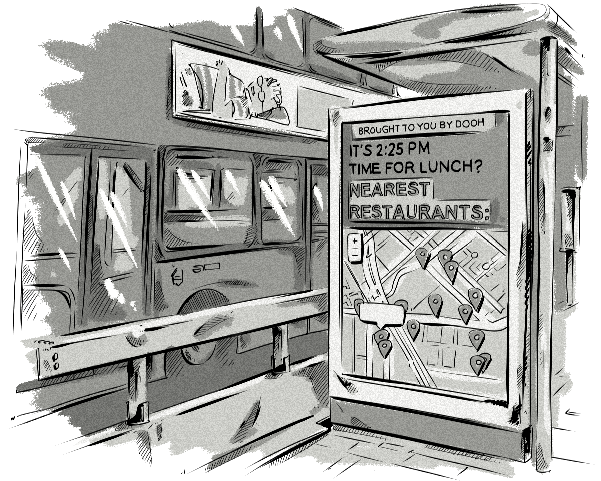
WHY PROGRAMMATIC
Utilising triggers and signals
Data driving efficiency
Increased flexibility
Omnichannel planning
Notes:
Why programmatic DOOH is even better
Alright, so take everything great about DOOH and then layer extra data, better targeting, and easy access on top. That’s what you’re looking at with programmatic DOOH.

Slide 17
TRIGGERS AND SIGNALS
Only buy when a certain condition is met and control content deployment based on real-world events. This will increase the relevancy and efficiency of your campaign. Triggers include, but are not limited to:
Weather
Time
Location
Sales
Sporting results
UV/pollen index
Custom data

Slide 18
EASILY ACCESSIBLE
Notes:
More and more DSPs are getting on board with programmatic DOOH. It’s making it much simpler to add DOOH to multichannel campaigns, and we’re already seeing buyers make use of this opportunity to great effect.
One of the best things about adding DOOH to a multichannel campaign is that it doesn’t have to be hard. At the end of the day, a digital out-of-home screen is essentially just that: a screen. Dynamic content, video content, interactive content – all of it can be and is played on DOOH displays around the world.
This means that existing content can often be adapted quite easily to suit a digital out-of-home display. The medium’s support for adaptive HTML5 formats, in particular, can be a big help in allowing buyers to reuse existing content from an online and/or mobile campaign in a programmatic DOOH campaign.
And as an added bonus, programmatic allows you to buy across multiple publishers at the same time. It’s much quicker and easier to build a programmatic campaign targeting screens across a variety of networks than it is to reach out to each business individually to coordinate your buy.
As more DSPs begin to support programmatic DOOH and more buyers begin incorporating the medium into their campaigns, the format will likely become an integral part of most mainstream media buys.

Slide 19
RUGBY LEAGUE WORLD CUP 2021 15 October – 19 November 2022
Notes:
The 134th championships

