Slide 1
BACK TO SCHOOL AUGUST – SEPTEMBER 2022
Notes:
This deck is based on the ‘Back to School’ audience. This audience was created on YouGov consisting of those who participated in back to school shopping in 2021 vs. Nat Rep.

Slide 2
BACK TO SCHOOL
£1.2bn
back to school costs in 2018
9m
school pupils in England
3rd
largest retail event
Image is pixelated.
Source: Mintel 2019; gov.uk 2022
Notes:
These facts and figures show the importance of Back to school in the UK with it being the 3 largest retail event and people collectively spending £1.2bn in 2018.

Slide 3
2021 SALES PROJECTIONS
“
Back to school has always been a key shopping time for retailers…
This season (2021) will be defined by choice as online sales remain robust and brick and mortar browsing regains momentum as shoppers seek to make up for lost time.
+12%
expected increase in total retail sales compared to pre-pandemic
+6.7%
expected year-on-year sales growth compared to 2020
“
Kelly Devine, Divisional President, Mastercard UK and Ireland
Source: Mastercard 2021
Notes:
These facts and figures are projections for 2021.

Slide 4
2022 UNIFORM COSTS SLASHED
£337
typical school uniform spend per child
£50
cut to the average cost of uniforms under the new legislation
Source: The Mirror 2022
Notes:
New guidance on nationwide school uniform policy could see some parents save hundreds when buying essential clothing for their children to return to school in September. The move will be a relief to many families struggling with the current cost of living crisis.
Schools will be forced to keep expensive branded uniform items to a minimum, while encouraging parents to get their uniform essentials from cheaper supermarket alternatives.
Families with school-age children typically spend £337 on uniform for each of their children at secondary school, according to The Children's Society, a figure three times higher than what parents describe as a "reasonable cost" to clothe their kids for the school year.
Currently, some schools decide on more expensive, or school-branded, clothing despite the fact that this drives up costs for parents. Under the new legislation, this will not be allowed - a move that Department for Education officials believe could cut the average cost of uniforms by £50.

Slide 5
BACK TO SCHOOL SHOPPERS
59%
are
female
57%
are
ABC1
34%
are
+211%
more likely
to have
at least
2 children in the household
+30%
more likely
to have an
annual household income of £60K - £70K
Audience
profile
millennials
Source: YouGov 2022. Audience are those who participated in back to school shopping in 2021 vs. Nat Rep

Slide 6
PURCHASE INTENT TOP 5 STORES
34%
24%
24%
School Uniform Shop
20%
14%
Source: YouGov 2022. Audience are those who participated in back to school shopping in 2021 vs. Nat Rep.
Notes:
These are the top 5 stores the back to school audience intends to purchase from with Asda and Tesco being top two

Slide 7
SUPERMARKET SHOPPING
15%
purchase back to school clothing from Tesco
+17%
have purchased clothes, shoes or accessories from a supermarket in the last 12 months*
+84% have heavy exposure to OOH outside supermarkets*
Source: YouGov 2022. Audience are those who participated in back to school shopping in 2021 vs. Nat Rep (*more likely than the average adult)
Notes:
This audience has heavy exposure to OOH ads outside of supermarkets and often shops at Tesco for back to school clothing.

Slide 8
SHOPPING CENTRES
SHOPPING MALL | INDEX
WESTFIELD LONDON (WHITE CITY) | +118%
LAKESIDE (ESSEX) | +97%
ELDON SQUARE (NEWCASTLE) | +77%
LIVERPOOL ONE (LIVERPOOL) | +61%
BLUEWATER (KENT) | +39%
+90% have heavy exposure to OOH inside shopping malls
Source: YouGov 2022. Audience are those who participated in back to school shopping in 2021 vs. Nat Rep (more likely than the average adult)
Notes:
These are the top shopping malls for this audience

Slide 9
WESTFIELD FOOTFALL 2018
Westfield London
Christmas 133%
Summer 116%
Westfield Stratford City
Christmas 112%
Summer 110%
Source: Westfield
Notes:
The weekly footfall data for both Westfield centres (2018, but in any “normal” year the phasing will be the same), represented here as the index against the average weekly footfall for the year shows that outside of the last three weeks in December, the summer school holiday period is the highest footfall period of the year, running at 10%+ against the average.
Christmas weeks – w/c 10th, 17th, 24th Dec
Summer weeks – w/c 23rd, 30th July & 6th, 20th, 13th, 27th Aug

Slide 10
RETAIL ATTITUDES & BEHAVIOURS
+100%
SAY THEIR CHILDREN INFLUENCE
WHAT THEY BUY*
65%
LIKE TO TRY IN-STORE
BEFORE BUYING
+49%
KEEP UP TO DATE
WITH FASHION TRENDS*
+35%
SPEND A LOT
ON CLOTHES*
Source: YouGov 2022. Audience are those who participated in back to school shopping in 2021 vs. Nat Rep (*more likely than the average adult)
Notes:
The back to school audience spend a lot on clothes and say that their children help influence what they buy. They are also more likely to keep up to date with fashion trends and like to go in-store to try before buying.

Slide 11
PRIMED BY OOH
+62%
TRUST OOH ADVERTISING
+49%
OFTEN RECOMMEND PRODUCTS/SERVICES
SEEN ADVERTISED OOH TO FRIENDS/FAMILY
+40%
AGREE ADVERTISING HELPS THEM CHOOSE WHAT TO BUY
+21%
HAVE GONE TO STORE TO BUY A PRODUCT
AFTER SEEING OOH ADS
Source: YouGov 2022. Audience are those who participated in back to school shopping in 2021 vs. Nat Rep (more likely than the average adult)
Notes:
This audience agrees that advertising helps them with what to buy and say that they trust OOH advertising. They are also more likely to go to store and recommend to friends/family after seeing OOH.

Slide 12
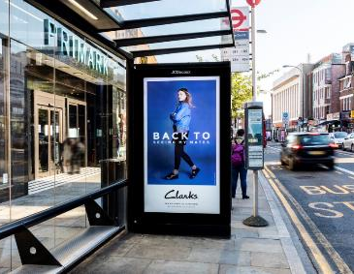
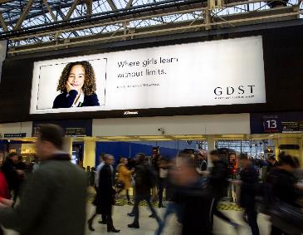
HEAVY EXPOSURE TO OOH
+68%
DIGITAL
SMALL FORMAT
+49%
DIGITAL
LARGE FORMAT
+48%
RAIL STATIONS
Source: YouGov 2022. Audience are those who participated in back to school shopping in 2021 vs. Nat Rep (more likely than the average adult)
Notes:
This audience has heavy exposure to OOH in multiple environments. As well as heavy exposure to OOH in supermarkets and malls, they also have heavy exposure to Digital Small and Large Format and OOH at rail stations.

Slide 13
BACK TO SCHOOL AUGUST – SEPTEMBER 2022
Notes:
Thank you for reading!

