Slide 1
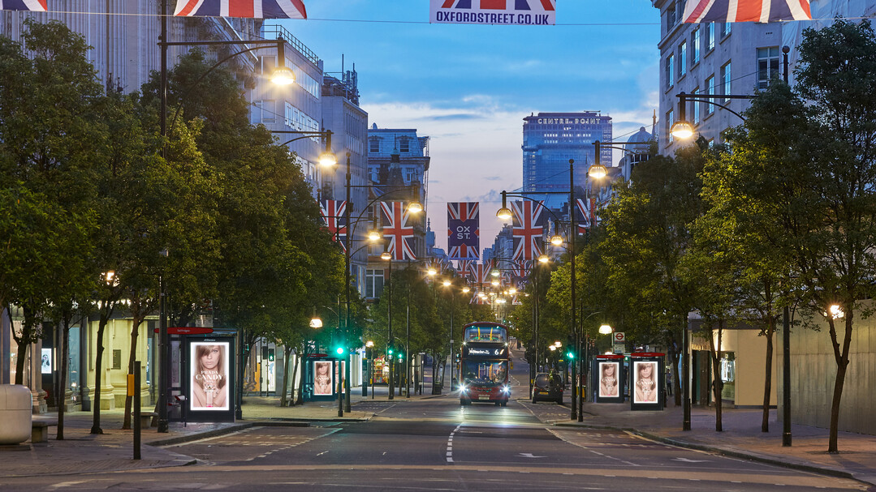
THE NEW WEST END

Slide 2
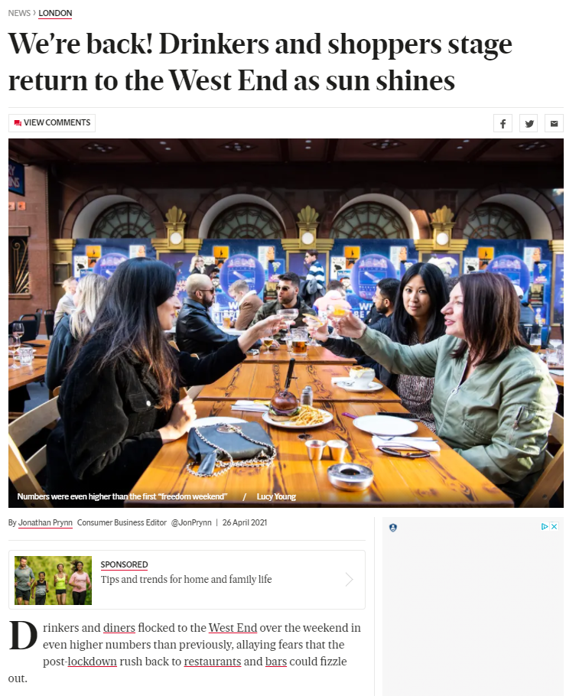
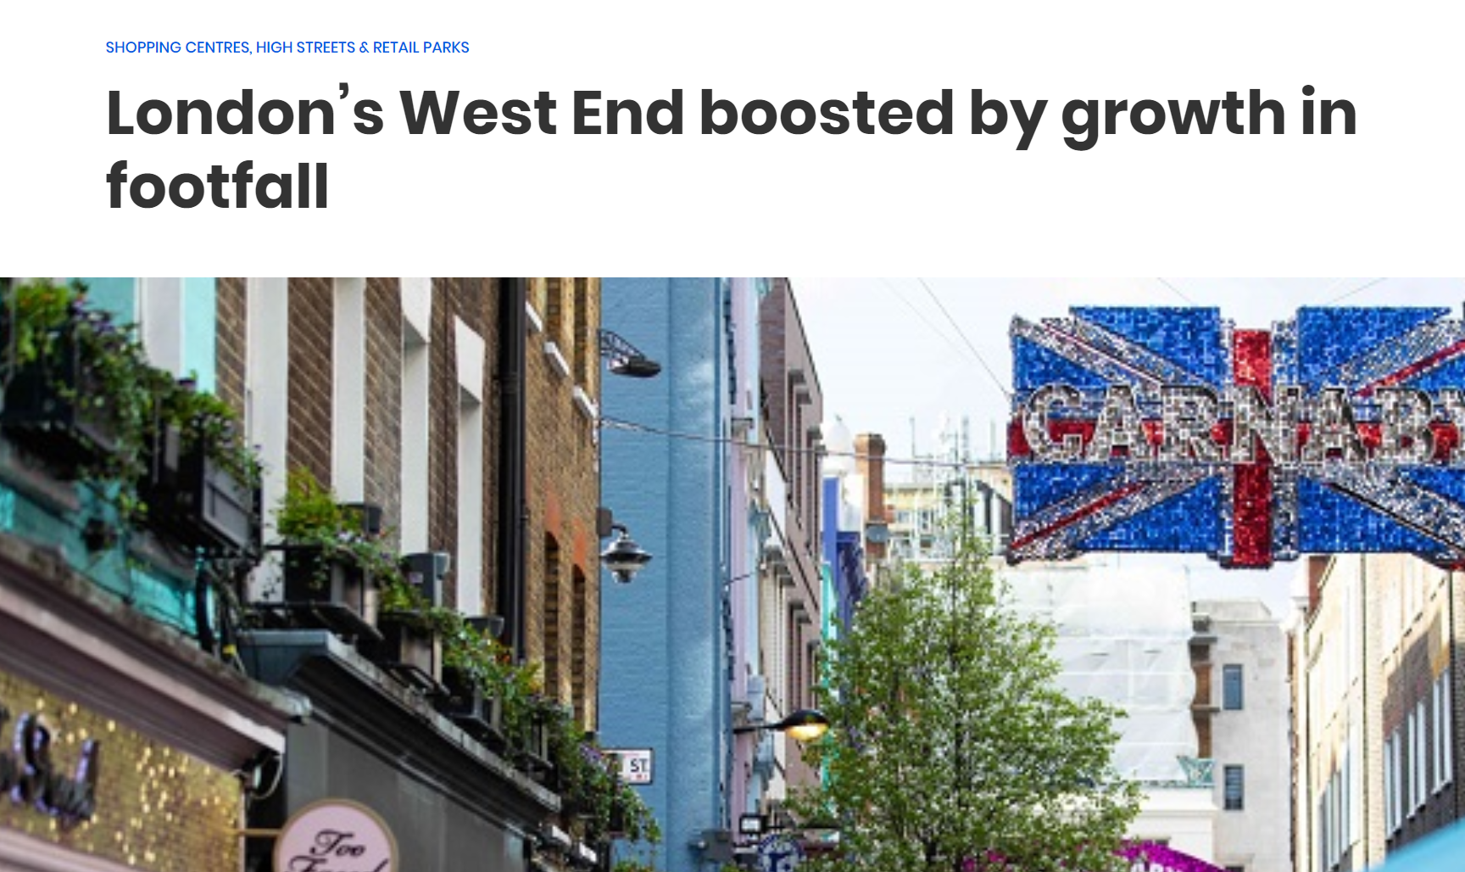
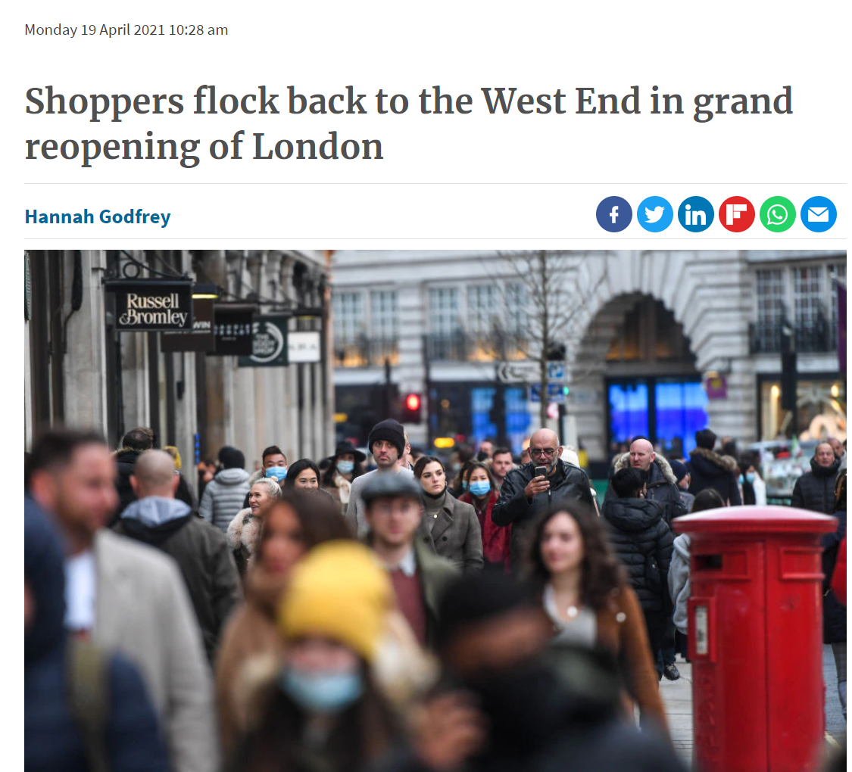
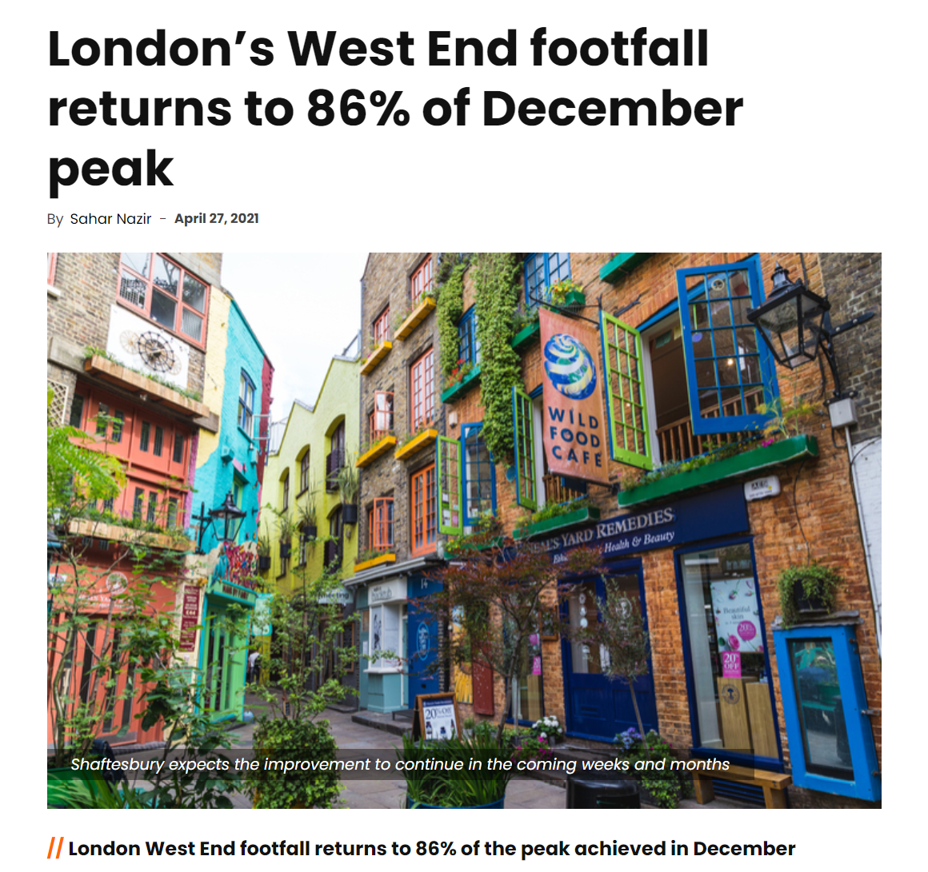
SHOPPERS RETURN TO LONDON’S WEST END

Slide 3
BOUNCING BACK
41%
audience levels and set to increase
16m
impressions delivered
2/3 visitors
pre-covid were UK based
Source: JCDecaux mobility tracker, Retail Gazette
Notes:
https://www.retailgazette.co.uk/blog/2021/05/londons-west-end-sustains-footfall-amid-positive-summer-forecast/

Slide 4
RISING CONSUMER CONFIDENCE
Source: Retail Gazette

Slide 5
OFFICE RETURN
61%
want to return to the office full-time
Thriving hub
of professional workforce
70%
of film industry based in the area
Source: Retail Gazette, Hubble HQ
Notes:
https://www.retailgazette.co.uk/blog/2021/05/londons-west-end-sustains-footfall-amid-positive-summer-forecast/

Slide 6
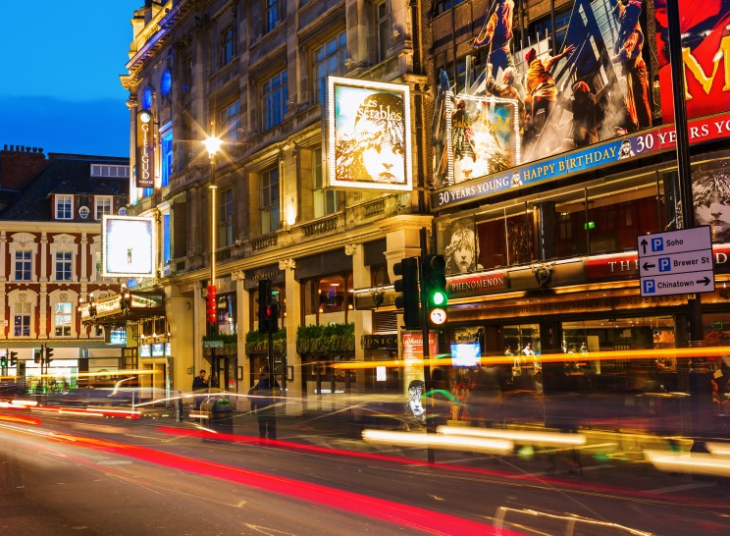
WEST END LIFTS THE CURTAIN FOR THE FIRST TIME IN 14 MONTHS
1 third
of theatres to reopen this week
+23%
of Londoners feel ‘very comfortable’ visiting the theatre
Source: YouGov. More likely than average adult, Reuters
Notes:
Those living and working in london

Slide 7
RELIABLE AUDIENCE
+63%
more likely
to be
be planning to travel overseas
+65%
more likely
to
not be worried about job loss
+33%
more likely
to have an
improved household economic situation
+47%
more likely
to agree
feel comfort-able visiting work-place
+48%
more likely
to agree
feel very comfort-able visiting rail stations
Living and working in London
Source: YouGov. More likely than average adult.
Notes:
People who visit a mall once a month or more are:

Slide 8
SHOPPER MINDSET
+51%
agree
“I often notice advertising in bus stops”
+36%
agree
“Dynamic advertising captures my attention”
Source: YouGov. More likely than average adult.
Notes:
Out of 250 respondents, UK adults who celebrate Christmas.

Slide 9
CATEGORIES PLANNING TO MORE IN VS PRE-COVID
9%
13%
14%
19%
26%
BEAUTY
TECHNOLOGY
FASHION
ENTERTAINMENT
HOME AND DIY
Source: Retail week
Notes:
Which, if any, of the following areas do you plan to spend more on this year compared to pre-Covid-19?
https://www.retail-week.com/customer/data-post-lockdown-spending-priorities-has-covid-changed-what-and-how-we-shop/7036977.article?authent=1

Slide 10
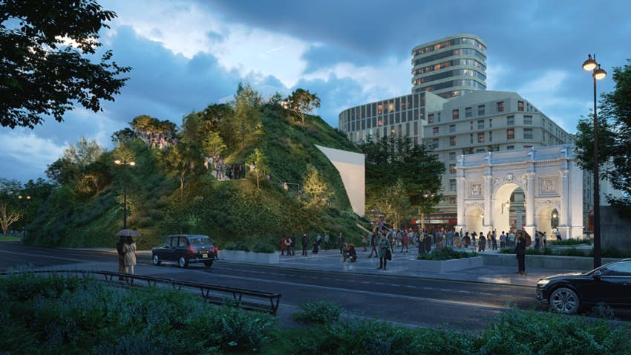
OXFORD STREET REGENERATION
£190m
investment to regenerate area post-covid (Westminster and NWE co)
Year round
events programme & campaigns
Marble Arch Hill – opens 21 June
Source: Retail Gazette
Notes:
to regenerate Oxford Street and surrounds – in particular the 25m artificial hill and viewing platform that will be built at Marble Arch.

Slide 11
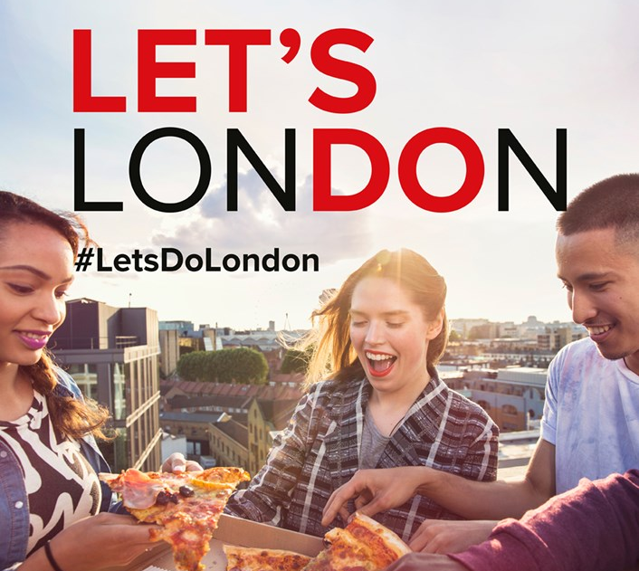
LET’S DO LONDON MAYOR ANNOUNCES PLANS FOR BIGGEST DOMESTIC TOURISM CAMPAIGN
“The biggest domestic tourism campaign London has ever seen to champion our businesses, cultural institutions and attractions that have suffered so much during the pandemic. This is about getting the message out to Londoners and people across the country that our capital stands ready to entertain, inspire and enthral once again.”
Sadiq Khan, Mayor of London
£6m
investment
Source:TimeOut
Notes:
Mayor launches new ‘Let’s Do London’ campaign to attract domestic visitors to our city and bring central London’s economy back to life

Slide 12
THE NEW WEST END

