Slide 1
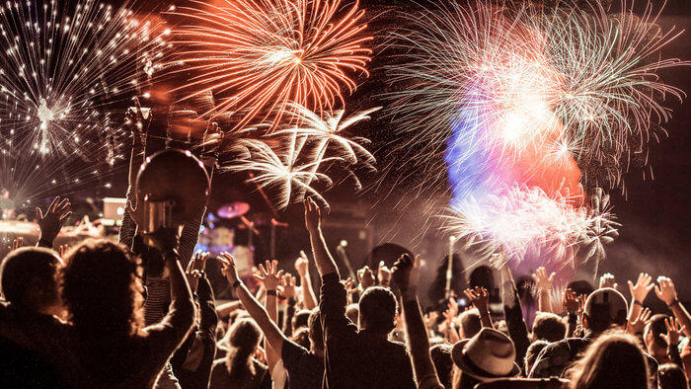
FREEDOM DAY 19 JULY 2021
Notes:
70m vaccine doses given
28.5m fully vaccinated
43% of population fully vaccinated

Slide 2
CELEBRATING FREEDOM DAY
Notes:
Nightclubs opening
Restrictions on large scale events no longer apply
Rule of six on indoor gatherings ended
30 person limit on events e.g. weddings lifted

Slide 3
THE END IN SIGHT
65%
agree they can now plan for the future
75%
agree the end is now in sight
Source: JCDecaux sentiment tracker 2021

Slide 4
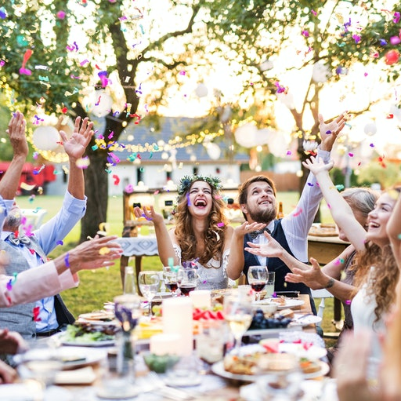
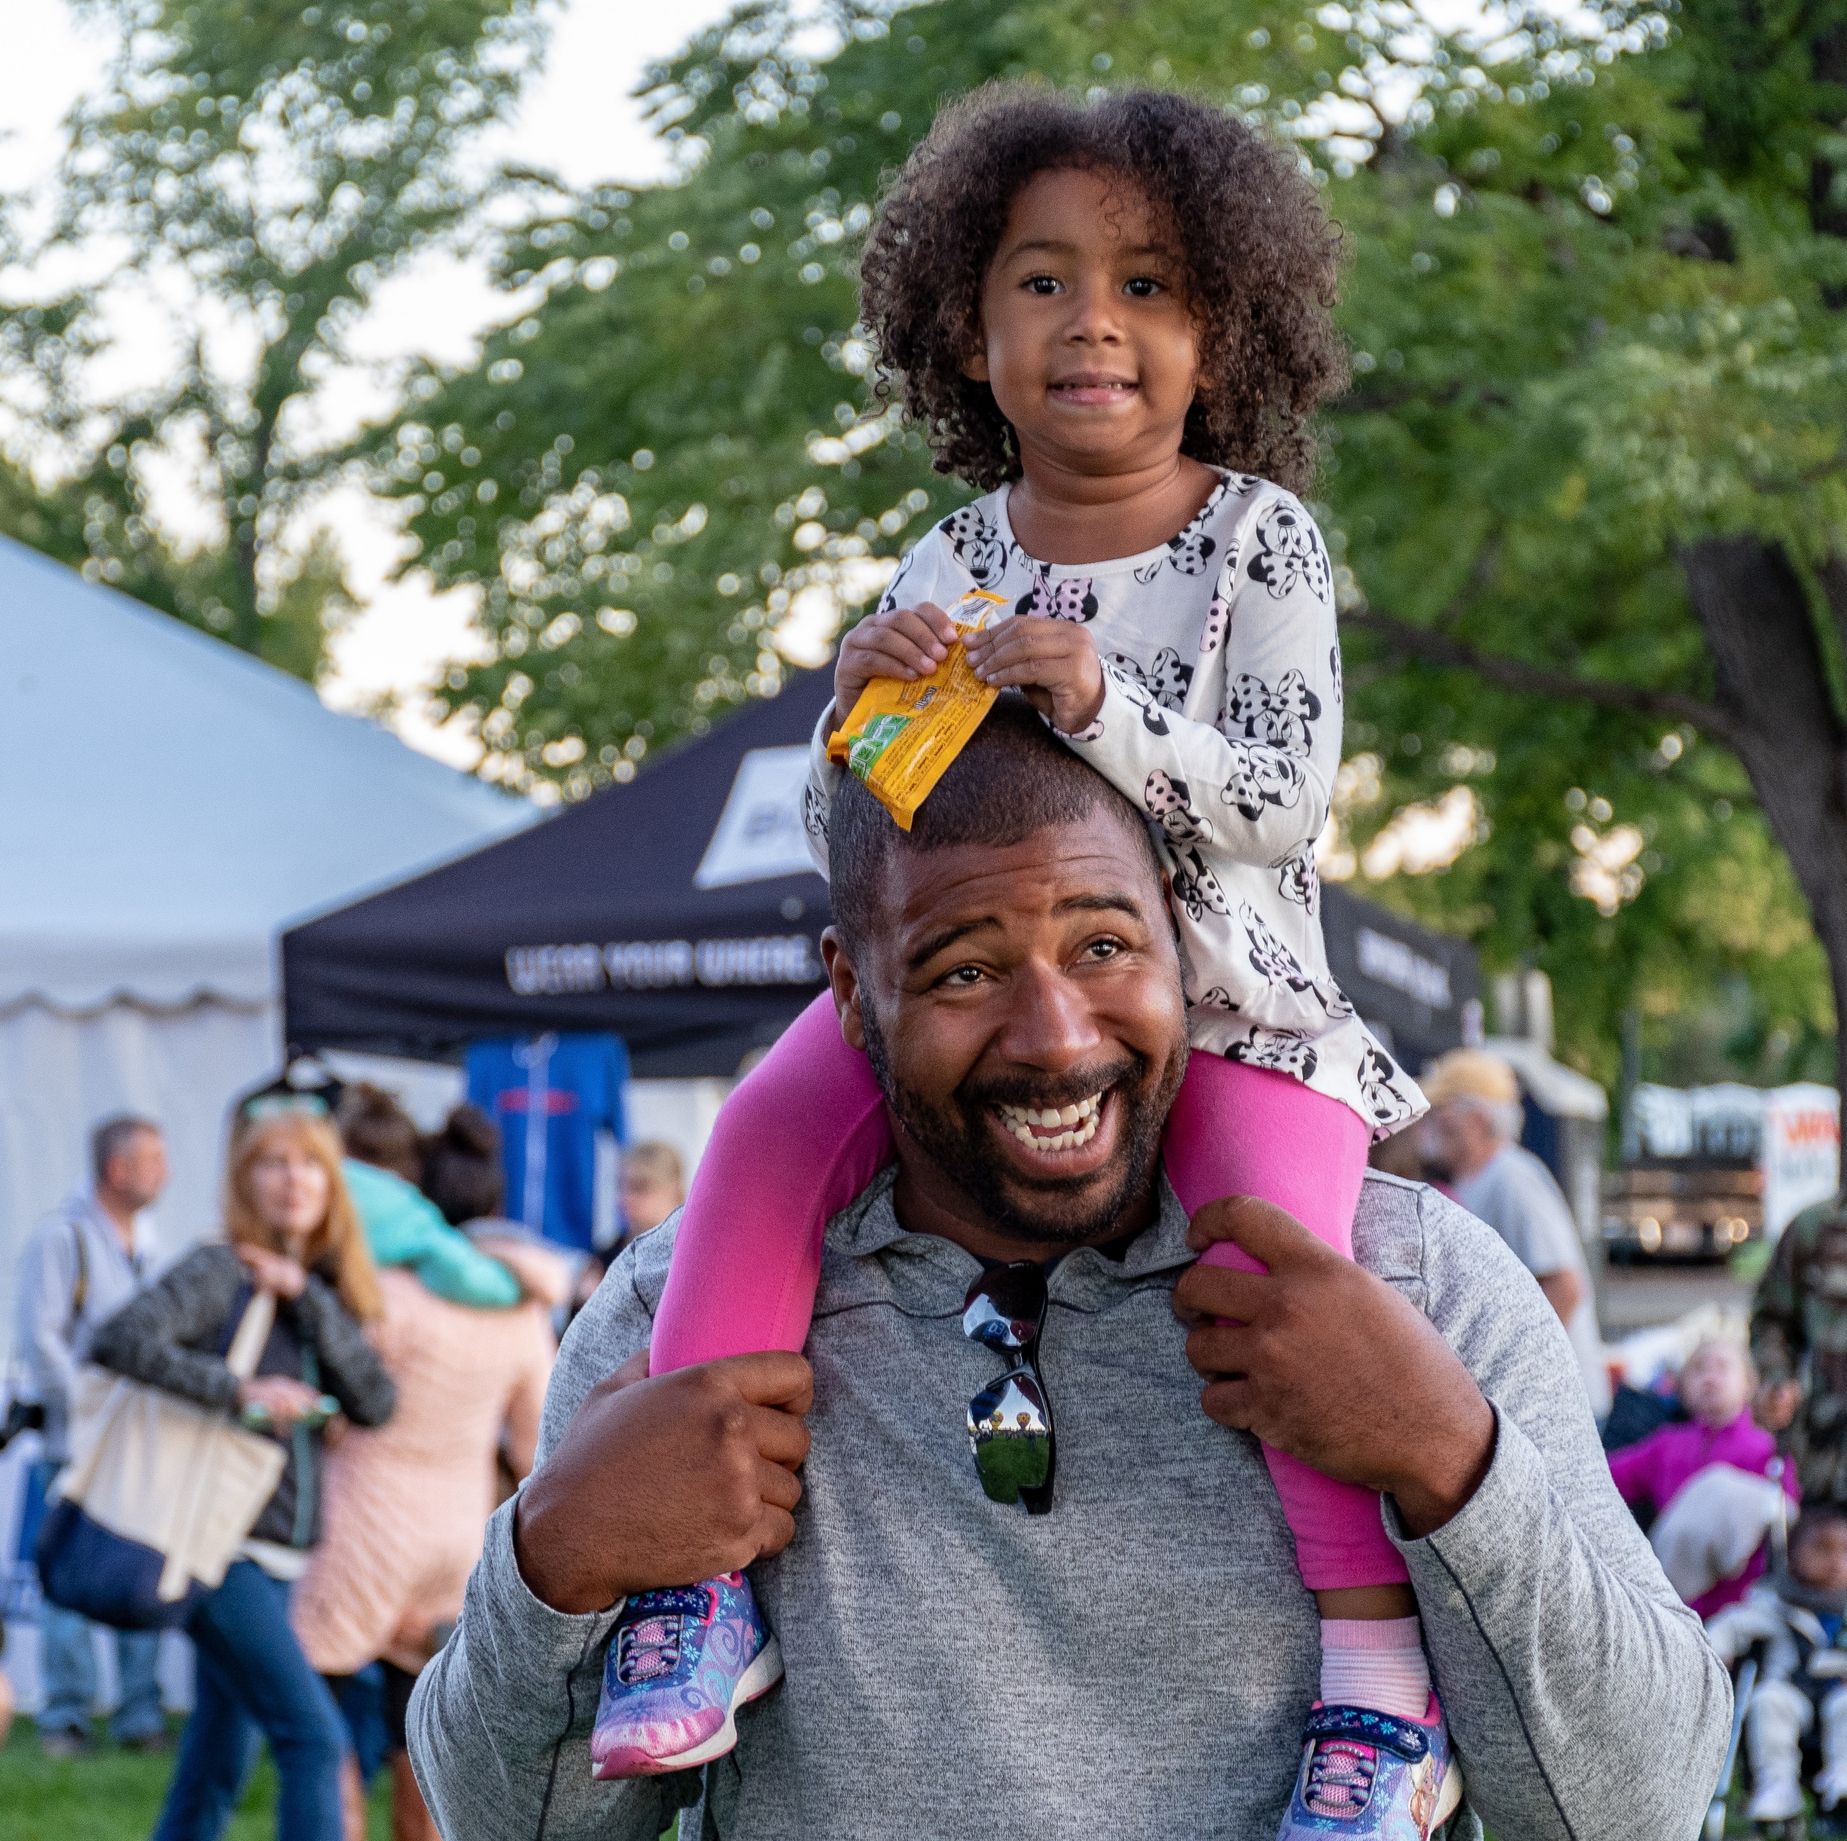
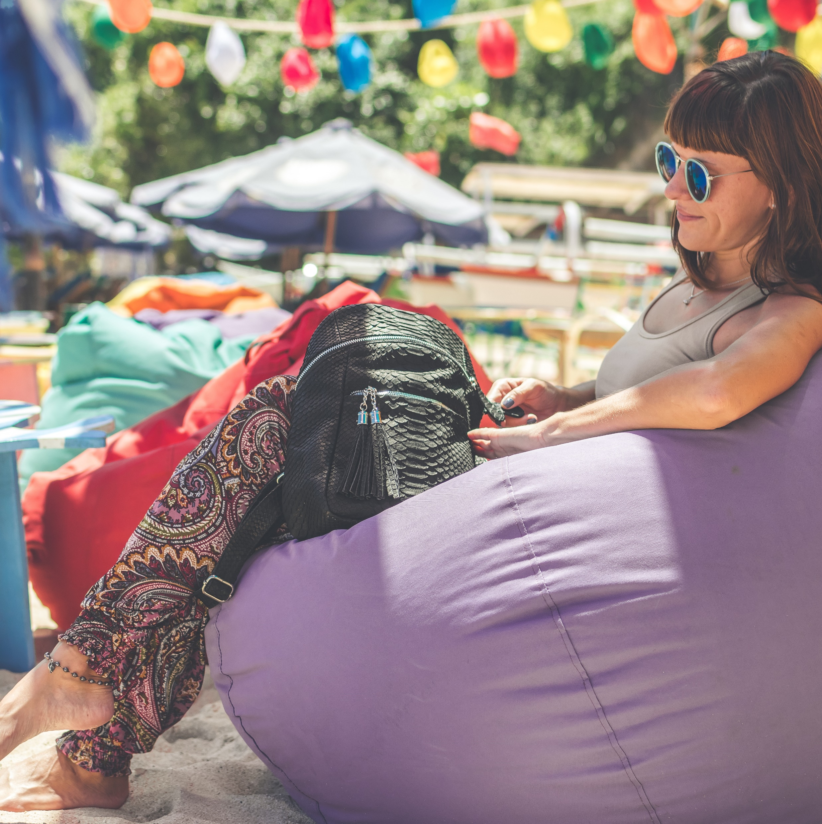
THE SUMMER OF OUR LIVES
55%
agree this is going to be a great summer
47%
will be spending more time OOH vs pre-Covid-19
50%
plan to spend as much time OOH as possible
Source: JCDecaux sentiment tracker 2021

Slide 5
ACTIVITIES PLANNED FOR THIS YEAR
Source: JCDecaux sentiment tracker 2021

Slide 6
ACTIVITIES PLANNED FOR THIS YEAR
Source: JCDecaux sentiment tracker 2021

Slide 7
SEPTEMBER KEY MONTH FOR AIR TRAVEL
Source: JCDecaux sentiment tracker 2021

Slide 8
JULY KEY FOR UK GETAWAYS
Source: JCDecaux sentiment tracker 2021

Slide 9
FREEDOM DAY 19 JULY 2021
Notes:
70m vaccine doses given
28.5m fully vaccinated
43% of population fully vaccinated

