Slide 1
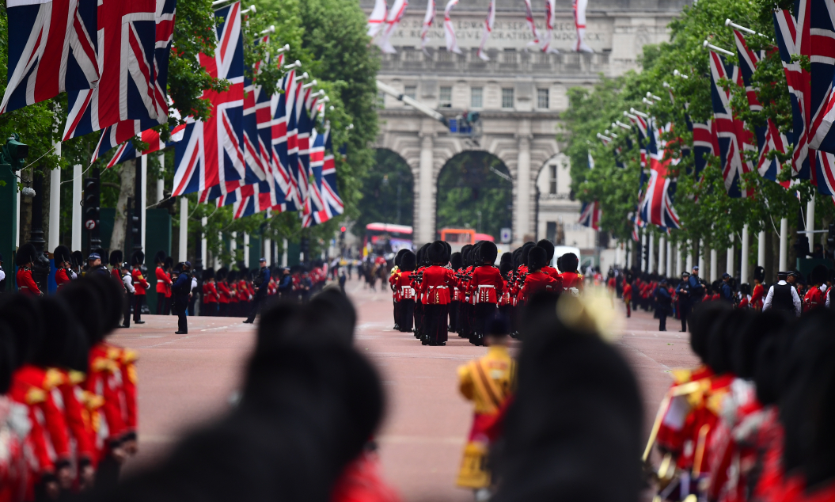
THE QUEEN’S PLATINUM JUBILEE
THURSDAY 2ND JUNE – SUNDAY 5TH JUNE 2022
14.7m
£200bn
watched The Diamond Jubilee in 2012
saved during lockdown in the UK
+30%
86%
#1
Queen Elizabeth II was voted the most popular monarch in the UK
rise in hospitality revenue during The Diamond Jubilee 2012
of Brits are proud to be British
79%
1 in 3
+20%
44%
46%
of people agree that sunshine and warm weather makes them want to go out more
search for products/services after seeing OOH
more likely to trust OOH
agree that OOH helps them to become aware of new products/services
agree that they’re spontaneous decision makers and follow their own instincts
Source: YouGov Profiles 2022: Target audience are those who rate Queen Elizabeth II on a 5-point scale positively vs Nat Rep, YouGov Queen Elizabeth II survey Q4 2021, The Guardian, The Telegraph
Notes:
On 6th February 2022, Queen Elizabeth II became the first British Monarch to celebrate a Platinum Jubilee – signifying 70 years on the throne.
To celebrate this historic moment, the UK will have a four day bank holiday weekend from Thursday 2nd – Sunday 5th June 2022. The event offers advertisers a unique opportunity to target consumers who are in the mindset to celebrate and purchase more luxury items, in the lead up and during the festivities.
The timeline of events for The Platinum Jubilee in June 2022 are as follows:
Thursday 2nd June – The Queen’s Birthday Parade at Buckingham Palace
Friday 3rd June – Service of Thanksgiving at St Paul’s Cathedral
Saturday 4th June – The Derby at Epsom Downs & Platinum Party at The Palace
Sunday 5th June – The Big Jubilee Lunch & The Platinum Jubilee Pageant
More information about the order of events can be found here: https://www.royal.uk/platinum-jubilee-central-weekend

