Slide 1
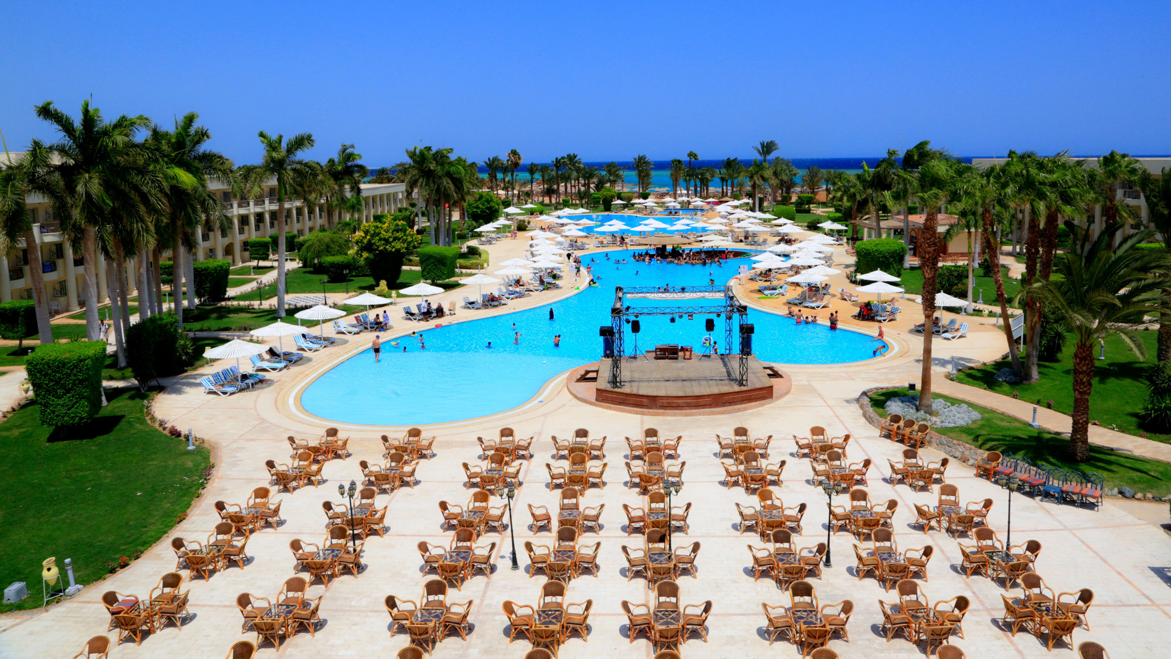
2023 THE CONSCIENTIOUS TRAVELLER
Notes:
The travel industry is still recovering from the COVID-19 pandemic and facing a new challenge altogether – the impact that high inflation, increasing interest rates, rising energy bills and an uncertain economic situation are set to have on people’s appetite for holidays. Some of the trends for 2023 show the various tactics holidaymakers are employing in a bid to overcome the rising cost of living; from the demand for all-inclusive holidays to the wave of early bookers keen to lock in the best price for their trip.
General message is: customers where possible are prioritising holidays in the face of cost of living pressures.

Slide 2
ALL INCLUSIVE, ALL THE WAY
57%
of those with young families are planning to take an all-inclusive holiday
29%
planning to take an all-inclusive holiday
Popular destinations
Balearics
Canary Islands
Turkey
Source: ABTA – Travel in 2023 report
Notes:
‘People looking to lock in one total and upfront cost to better manage their money’.

Slide 3
WINTER SUN
42%
have booked or plan to take a winter break this year
People from across the UK and Ireland are avoiding the cost of soaring energy bills and enjoying a cheaper cost of living by booking long-stay winter breaks to the Canary Islands this season
Canary Islands Tourist Board
1in5
say to escape for some winter sun is their top motive for planning to travel over winter
Source: ABTA – Travel in 2023 report; TTG Media Limited
Notes:
Extended winter breaks are proving popular for the months ahead, as people look to swap the cold, damp days of the UK for warmer, sunnier locations.
Scheduled airline capacity to the Canary Islands is up by a third this winter from the UK and Ireland compared with pre-pandemic levels.

Slide 4
INCREASE IN BOOKINGS FOR LONGER TRIPS 21 – 28 NIGHTS THIS WINTER VS WINTER 2019
CAPE VERDE
DOMINICAN REPUBLIC
FLORIDA
MEXICO
Source: ABTA – Travel in 2023 report
Notes:
TUI reported an increase in bookings for longer trips of between 21 and 28 nights this winter vs winter 2019 driven mainly by trips to long-haul destinations such as Mexico, the Dominican Republic, Florida and Cape Verde.

Slide 5
EARLY BIRDS OR ‘WAIT AND SEE’ APPROACH
easyJet holidays report that demand is being driven by the family market for early bookings
1in3
say booking early to get the best price for a holiday is the main incentive
42%
are taking a more cautious approach – doing it later than normal to manage the impact of rising costs of living
Source: ABTA – Travel in 2023 report
Notes:
ABTA’s members were experiencing a higher-than-average level of early bookings including for travel in summer 2023, with easyJet holidays reporting that demand is being driven by the family market.

Slide 6
EXPERT ADVICE
36%
likely to seek assistance from trusted travel advisors
Key reasons
Package holiday security (45%)
Up-to-date advice (38%)
Good value for money (31%)
71%
looking to take out a good travel insurance policy
Source: ABTA – Travel in 2023 report
Notes:
An even more conscientious approach to holiday planning than before the pandemic will lead to a rise in bookings with trusted travel professionals.
ABTA also noted that more people are planning to consult a travel professional than pre-pandemic – with over a third (36 per cent) now likely to seek assistance.
Key reasons included the security of a package holiday (45 per cent), up-to-date advice (38 per cent) and good value for money (31 per cent).
Those surveyed will also be more diligent around other less ‘exciting’ aspects of their booking, with 71 per cent looking to take out a good travel insurance policy, and 63 per cent paying closer attention to terms and conditions.

Slide 7
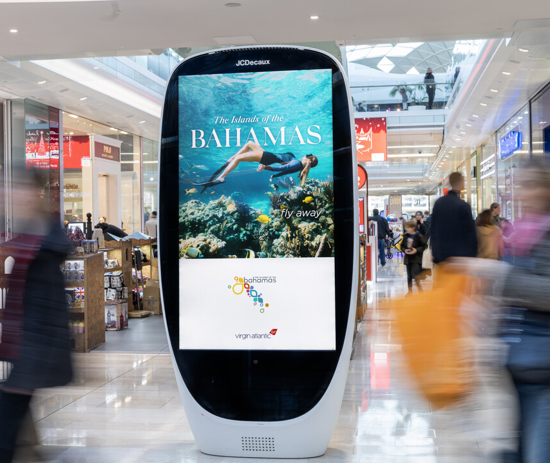
HEAVY OOH USERS
+69%
Supermarkets
+69%
Rail
+77%
more likely to have heavy exposure to OOH advertising in malls
+31%
LF digital
+41%
SF digital
Source: YouGov Profiles January 2023. More likely than average adult. Those who are planning a holiday in the next 12 months vs nat rep
Notes:
Those planning a holiday in the next 12 months are more likely to have heavy exposure to these environments/formats…

Slide 8
PRIMED BY OUT-OF-HOME
+55%
more likely
to
spend over an hour +
OOH commuting per day
+57%
more likely
to
comment on things seen on OOH ads on social media
+52%
more likely
to
trust the ads seen on posters/
billboards
+42%
more likely
to
recommend things seen on posters/
billboards to friends and family
+18%
more likely
to have
researched a product/ service on mobile after seeing OOH ad
Audience
Source: YouGov Profiles January 2023. More likely than average adult. Those who are planning a holiday in the next 12 months vs nat rep
Notes:
OOH is an effective way of targeting those planning a holiday in the next 12 months

Slide 9
Notes:
Travel creative looks great on OOH

Slide 10
2023 THE CONSCIENTIOUS TRAVELLER

