Slide 1
MOTHER’S DAY SUNDAY 19TH MARCH 2023

Slide 2
MOTHER’S DAY
5th
most popular national and religious event in the UK
£1.34bn
total UK spend in 2021
30m
cards sold in 2019
Source: YouGov Mother’s Day Survey Q4 2022, Statista, British Retail Consortium
Notes:
From retail to hospitality, Mother’s Day 2023 is a great opportunity for brands to capitalise on people celebrating with their loved ones.
According to The Simpson Group, Mother’s Day is the second largest card giving event in the UK, after Christmas.

Slide 3
MOTHER’S DAY POPULARITY UK
Source: YouGov Mother’s Day Survey Q4 2022
Notes:
Gen X, those who were born between 1965 to 1976, ranked the highest age cohort for popularity with Mother’s Day. Whilst Millennials ranked last out of the three groups shown.

Slide 4
TOP #5 GIFTS PURCHASED
73%
of UK shoppers bought a Mother’s Day present in 2019
Source: British Retail Consortium, YouGov January 2023 *Those who rate Mother’s Day positively on a 5-point scale vs Nat Rep
Notes:
For those who rate Mother’s Day positively on a 5-point scale vs Nat Rep, these are the top 5 gifts they generally buy

Slide 5
MUMS LOVE CHOCOLATE POSITIVE SATISFACTION BY %
67%
36%
45%
36%
42%
35%
40%
33%
Source: YouGov January 2023: Target audience are those who are female and have a child either below or above 18 years old vs Nat Rep.
Notes:
With over 19.4 million families in the UK, indicates Mother’s Day will be a halo event for retailers. The British Retail Consortium has stated that around £55 million is spent on chocolates for Mother’s Day, with around 4 million people buying a box for the big day.
Greats news for FMCG brands, as top favourites for parents with children above or below 18 include household staples such as Cadbury and more luxury chocolate including Lindt and Ferrero Rocher.

Slide 6
FAVOURITE ALCOHOL BEVERAGES BY INDEX
Source: YouGov January 2023: Target audience are those who are female and have a child either below or above 18 years old vs Nat Rep.
Notes:
Mother’s Day is also an excellent opportunity for alcohol brands to be bought for family get togethers and serve as presents for the day – with the most popular choice being Rosé wine, with an index of 187, followed closely by white wine, indexing at 179.
Those who are female and have a child either below or above 18 years old are +49% more likely to drink at least 9 units of alcohol per week (on average).

Slide 7
IN-STORE SHOPPING REMAINS
56%
of shoppers intend to buy gifts in-store for Mother’s Day
34%
of female consumers tend to buy ‘trendy’ flavours in confectionary and desserts
Source: GlobalData
Notes:
According to GlobalData, over half of UK consumers still admit their purchasing choices are heavily influenced by how enjoyable and unique a product is. 56% of respondents intended to buy in-store presents for Mother’s Day in 2022 – which shows consumers still want to directly interact with products and experience the retail atmosphere in the lead up to Mothering Sunday.

Slide 8
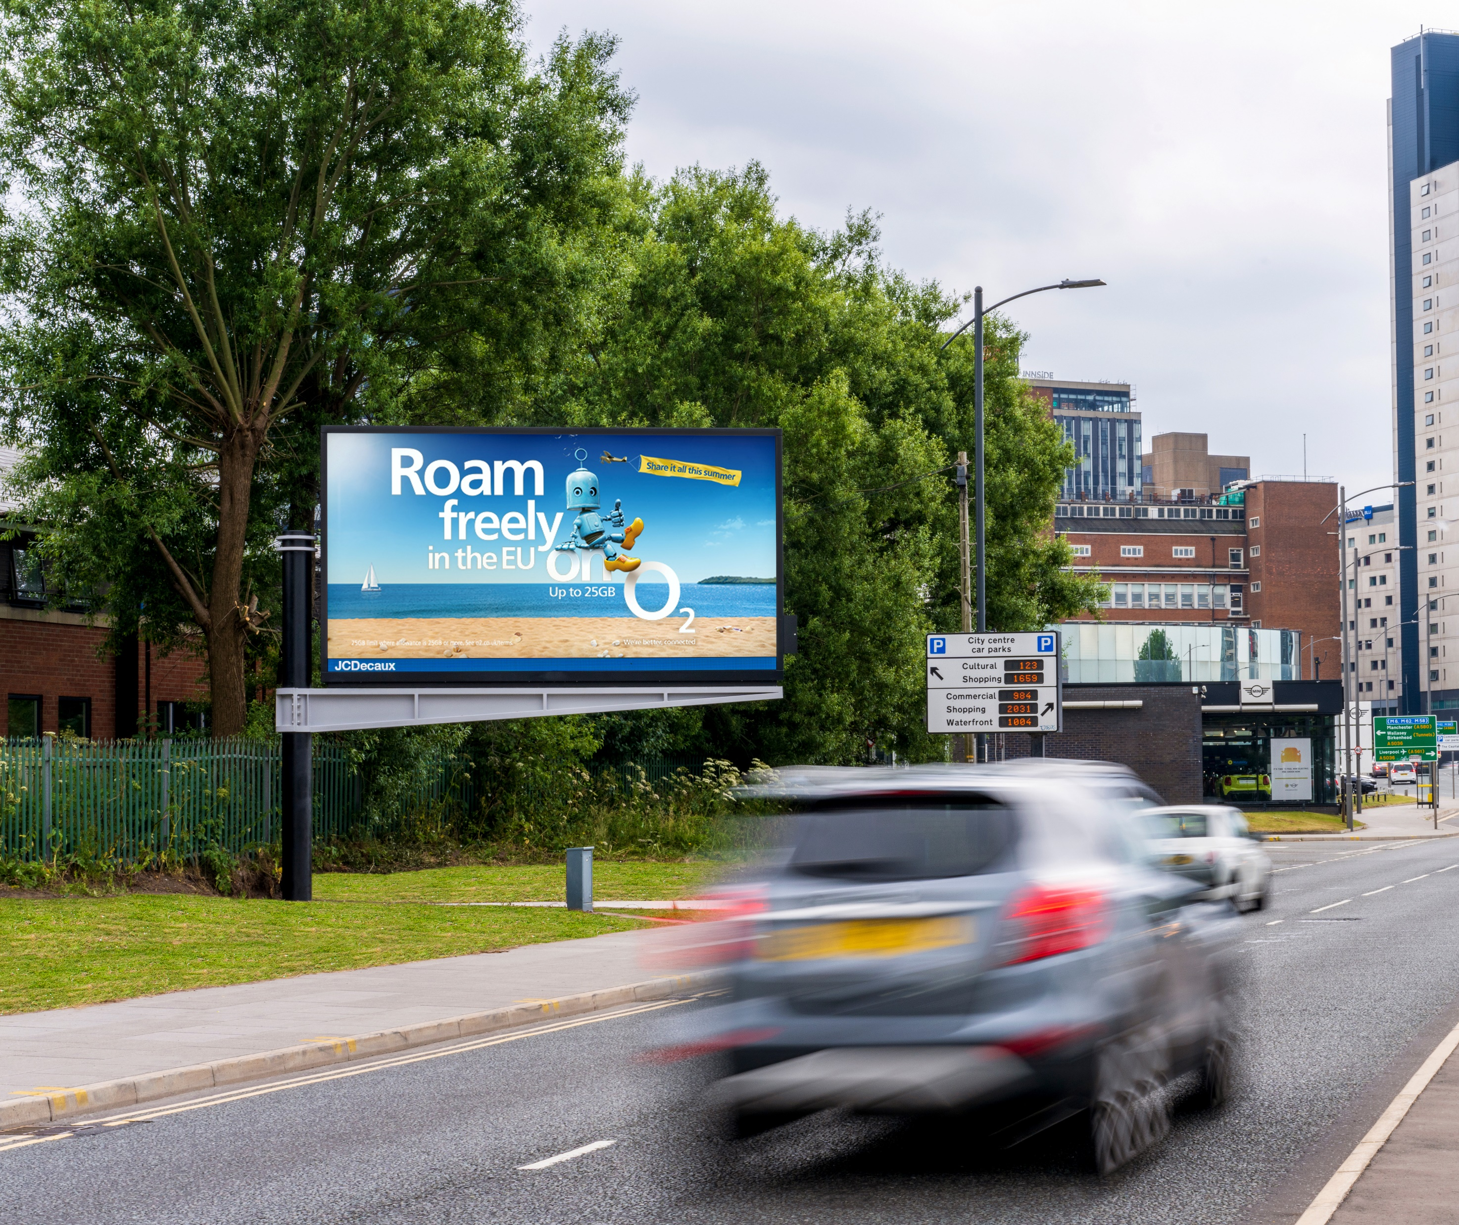
BEST OUT-OF-HOME ENVIRONMENTS HEAVY EXPOSURE
+45%
+27%
Malls
+23%
SF digital
Large Format
digital
+13%
Rail
+11%
Supermarkets
Source: YouGov January 2023 *For those who rate Mother’s Day positively on a 5-point scale vs Nat Rep **Those who are heavily exposed to OOH **
Notes:
Those who rate Mother’s Day positively on a 5-point scale, are heavily exposed to Out-of-Home…

Slide 9
1in4
of those who rate Mother’s Day positively on a 5-point scale say their main supermarket is Tesco
Source: YouGov January 2022 *For those who rate Mother’s Day positively on a 3 point scale vs Nat Rep

Slide 10
RETAIL HOTSPOTS
SHOPPING CENTRES* | INDEX
East Kilbride | 304
St Enoch | 238
Braehead | 213
Atria Watford | 195
Westfield (White City) | 188
Lakeside | 167
Metrocentre | 147
Liverpool ONE | 145
Westfield (Stratford) | 132
St David’s | 124
Eldon Square | 119
65%
like to touch/feel products before buying them
Source: YouGov January 2023 *For those who rate Mother’s Day positively on a 5-point scale vs Nat Rep
Q: Which of the following shopping centres do you tend to visit at least once a month?
Notes:
Key shopping centres where the TA over index…

Slide 11
KEY RAIL STATIONS LONDON & NATIONWIDE
LONDON STATIONS | INDEX
West Ham | 271
Lewisham | 267
London Waterloo (East) | 228
London Cannon Street | 221
London Bridge | 207
London Victoria | 203
London Paddington | 177
London St Pancras International | 177
London Charing Cross | 176
London Marylebone | 156
London Blackfriars | 147
East Croydon | 146
Barking | 144
London King’s Cross | 131
MAIN UK STATIONS | INDEX
Leicester | 248
Watford Junction | 240
Glasgow Central | 198
Birmingham Moor Street | 194
Brighton | 169
Cambridge | 149
Guildford | 143
Reading | 140
Manchester Piccadilly | 128
Liverpool Lime Street | 118
Source: YouGov January 2023 *For those who rate Mother’s Day positively on a 5-point scale vs Nat Rep *Stations visited in the last 12 months
Notes:
Key rail termini where the TA over index…

Slide 12
PRIMED BY OUT-OF-HOME
+54%
COMMENT ON PRODUCTS/SERVICES VIA SOCIAL MEDIA AFTER SEEING OOH
+38%
RECOMMEND PRODUCTS/SERVICES THEY’VE SEEN ON OOH TO FRIENDS/FAMILY
+32%
SEARCH FOR PRODUCTS/SERVICES AFTER SEEING OOH
+46%
TRUST OOH
Source: YouGov January 2023 *For those who rate Mother’s Day positively on a 5-point scale vs Nat Rep
Notes:
Great news for brands, as those who rate Mother’s Day positively on a 5-point scale are primed by OOH…

Slide 13
MOTHER’S DAY SUNDAY 19TH MARCH 2023

