Slide 1
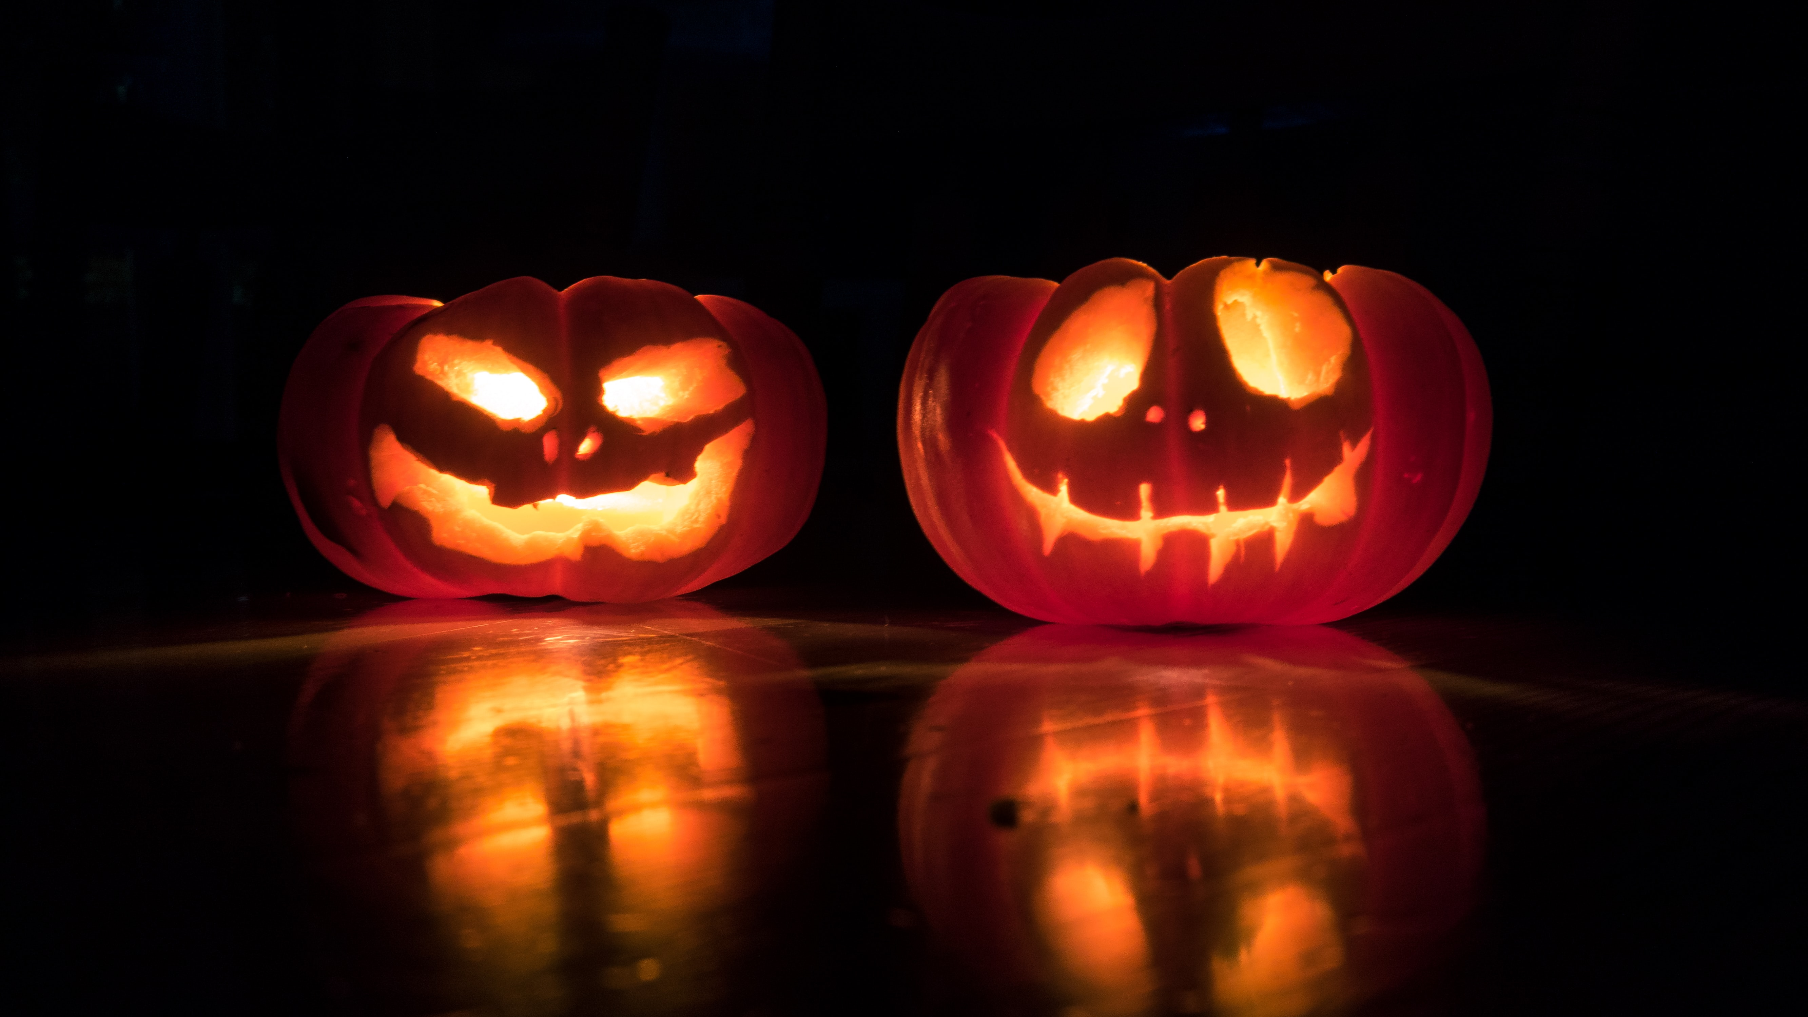
HALLOWEEN OCTOBER 2021

Slide 2
HALLOWEEN
£474m
market in 2019
+13%
on previous year
3rd
biggest shopping
event for
supermarkets
Source: Statista, Mintel, Kantar

Slide 3
INCREASING IN POPULARITY
Source: Statista

Slide 4
HALLOWEEN
61%
bought sweets
54%
bought a pumpkin
51%
bought a costume
40%
bought decorations
Source: Kantar 2019

Slide 5
2019 RETAILERS SALES UP
+22.7%
+10%
+7.7%
+2.8%
Source: Kantar
Notes:
In 2019, the retailers saw an annual sales uplift in the Halloween category.
https://www.thisismoney.co.uk/money/bills/article-8897643/How-Halloween-important-event-supermarkets.html

Slide 6
LOOKING AHEAD
57%
of families with children under 12 will go ‘trick or treating’
61%
will buy treats
1/3
of shoppers plan to do Halloween shopping 8 weeks prior
Source: Grocery Trader
Notes:
https://grocerytrader.co.uk/bigger-and-better-46-of-retailers-increasing-halloween-ranges-this-year/

Slide 7
2021 – BIGGER AND BETTER FOR RETAILERS
90%
will have a dedicated, themed range in-store
Over 1/3
will increase Halloween confectionery space
52%
of retailers will launch in-store ranges 2-4 weeks before
Source: Grocery Trader

Slide 8
TOP ACTIVITIES WITH CHILDREN IN HOUSEHOLD
Rank | Activity
1 | Trick or treating
2 | Decorated house
3 | Carved a pumpkin
4 | Watched scary movies at home
5 | Went to a Halloween fancy dress party
Source: YouGov Profiles - children in household

Slide 9
PRIMED BY OUT-OF-HOME
+74%
MORE LIKELY TO VISIT A STORE TO BUY A PRODUCT AFTER SEEING OOH
+71%
MADE A PURCHASE ON A SMARTPHONE AFTER SEEING OOH
+248%
MORE LIKELY TO SHARE CONTENT ON SOCIAL MEDIA ABOUT A PRODUCT/BRAND AFTER SEEING OOH
+119%
MORE LIKELY INTERACT DIRECTLY WITH A BRAND’S SOCIAL MEDIA AFTER SEEING OOH
Source: YouGov Profiles. Audience: Celebrate Halloween + children in household

Slide 10
NOT JUST FOR KIDS
2nd
biggest drinking occasion after New Year’s Eve
96.2m
Instagram posts with #halloween
1 in 4
Gen-Zs spent up to £100 on costumes in 2019
Source: The Grocer 2019, Instagram 2021, YouGov Profiles

Slide 11
TOP ACTIVITIES 18-24s
Rank | Activity
1 | Went to a Halloween fancy dress party
2 | Watched scary movies at home
3 | Decorated house
4 | Carved a pumpkin
5 | Watched scary movies at the cinema
Source: YouGov Profiles -18-24s

Slide 12
HEAVY OUT-OF-HOME USERS
+103%
MALL
+66%
STREET FURNITURE
+22%
SUPERMARKET
+55%
RAIL
Source: YouGov Profiles. Audience: Celebrate Halloween + 18-24 – Heavy OOH exposure

Slide 13
HALLOWEEN OCTOBER 2021

