Slide 1
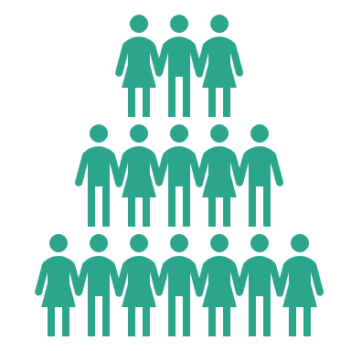
BACK ON TRACK
RAIL IN THE NEW DIFFERENT
18
88%
minute dwell time in rail stations
of pre-pandemic rail campaign reach could be delivered from September*
84%
49%
3
days in the workplace compared to 3.5 days pre-pandemic
spend the same time, or more in a station now vs pre-pandemic
will work 4-5 days in their workplace
+29%
80%
77%
89%
75%
increase in off-peak rail commuting
will purchase something when in a station
use rail for non-work purposes
use a smartphone/tablet when on the train
of the rail audience is ABC1
Source: JCDecaux Rail Survey, July 2021 (Rail Users). *based on 200 rail D6s and audiences returning to 67% of Q1 2020.
Notes:
After nearly 18 months of working from home, it’s starting to take it toll, at a business level, a personal level and on our wellbeing – which we looked at in our New Different presentation.
Nearly ¼ of companies want employees back full time, almost half of young people think that remote working is holding them back in career progression, and relationships with colleagues are being affected, missing out on face to face moments, with even the CEO of Zoom admitting he has zoom fatigue.
So as easing of restrictions, and guidance has given more clarity to businesses, many have started to unveil their post-pandemic ways of working.
Almost a quarter of businesses surveyed about their post-pandemic plans, insist employees are back in full-time, with the largest proportion expecting them back 3-4 days a week, and full time remote accounting for the lowest. A key reason why we have waited to understand what the post-pandemic rail audience looks like, is that we needed businesses to have this clarity on plans, as this will be the primary influence for what commuting will look like.
Therefore, The New Different is not that different.
And why would it be? The reasons that we used rail before are still there. Most of us live in the same place (only 1 in 10 have moved house. Houses don’t stay empty, someone else with move in), our offices haven’t moved. Leisure and hospitality facilities haven’t moved. According to the research, 75% of the rail audience is still ABC1. 51% AB – a slight increase on pre-pandemic.
Hybrid working will likely become the norm, but it was already there before COVID. The average number of days in the office will shift marginally from 3.5 days to 3 days. Frequency will be down but the audience is still the same.
An increase in using rail for leisure. As we get back into the office, the return of the ‘after work’ drink or team lunch. Going to the gym at lunchtime/after work. Doing your shopping at lunchtime or popping to the shops on the way home from work to get something for dinner. More opportunities to influence commuters.
We hope to see a positive impact on city centre street furniture audience as a result.

