Slide 1
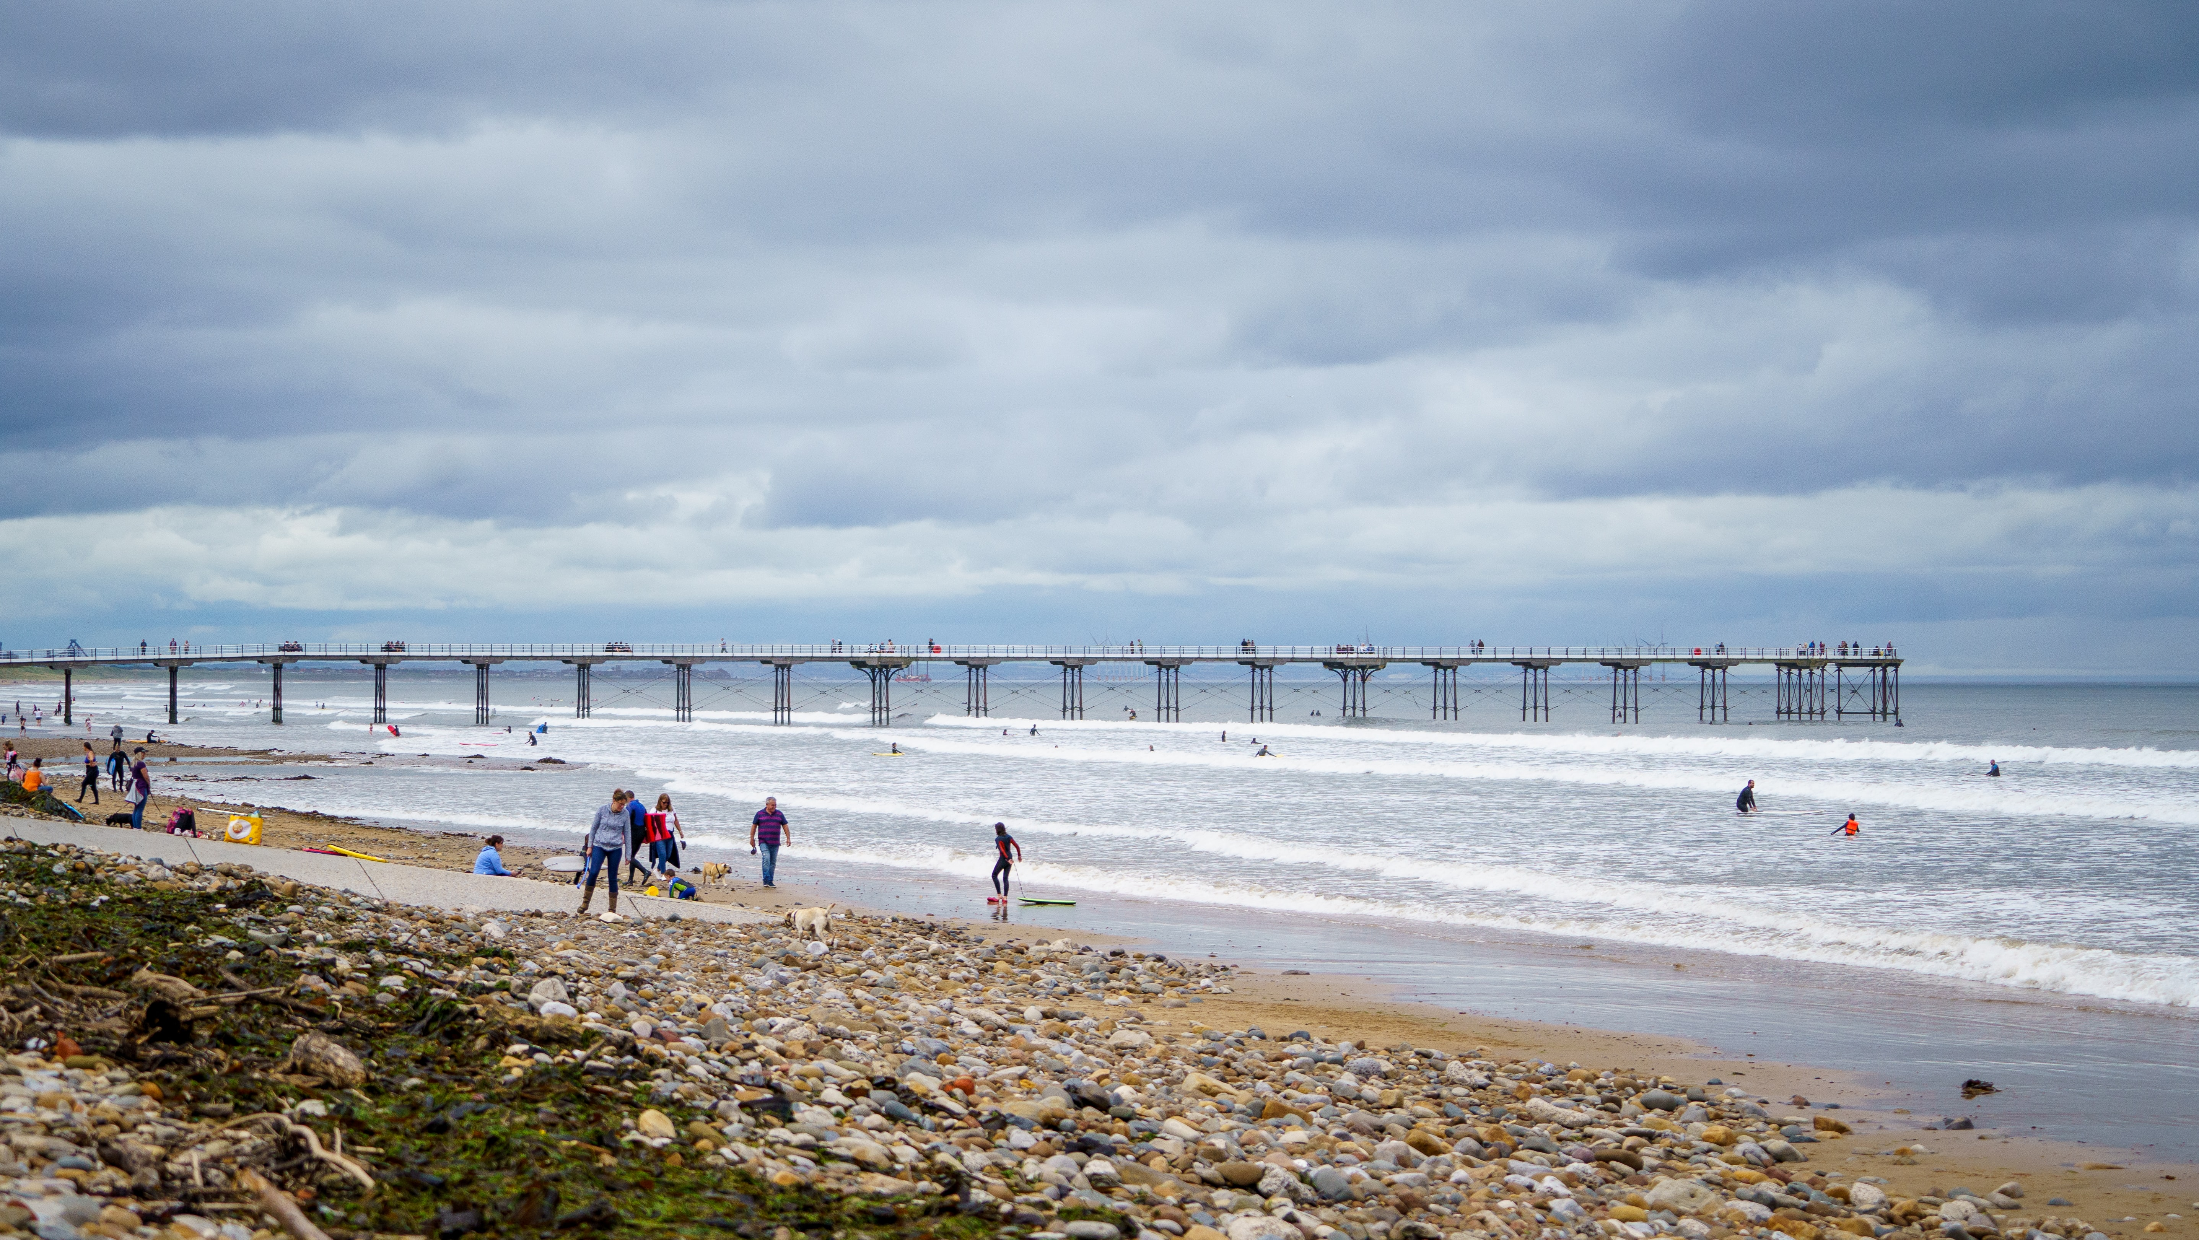
SUMMER STAYCATIONS

Slide 2
THE YEAR OF THE STAYCATION
Source: Google Trends

Slide 3
EXPLORING THE UK
54%
are planning a UK holiday this year
1 in 4
have already booked a UK holiday this year
£5.1bn
expected to be spend on UK holidays this year
Source: JCDecaux Sentiment Tracker 2021, YouGov Profiles 2021, VisitBritain

Slide 4
UK HOLIDAYMAKERS
+30%
more likely to agree large format OOH grabs their attention
2x
more likely to make a purchase on a mobile phone after seeing an OOH ad
+48%
more likely to go in store and buy a product after seeing an OOH ad
Source: YouGov Profiles 2021: ‘Have booked a UK holiday’ vs Nat Avg.

Slide 5
TOP STAYCATION SPOTS
Rank | Destination
1 | Cornwall
2 | Scottish Highlands
3 | Devon
4 | Cumbria/Lake District
5 | Yorkshire Dales
6 | Edinburgh
7 | Peak District
8 | Snowdonia
9 | The Cotswolds
10 | Dorset
Source: Holidaycottages.co.uk

Slide 6
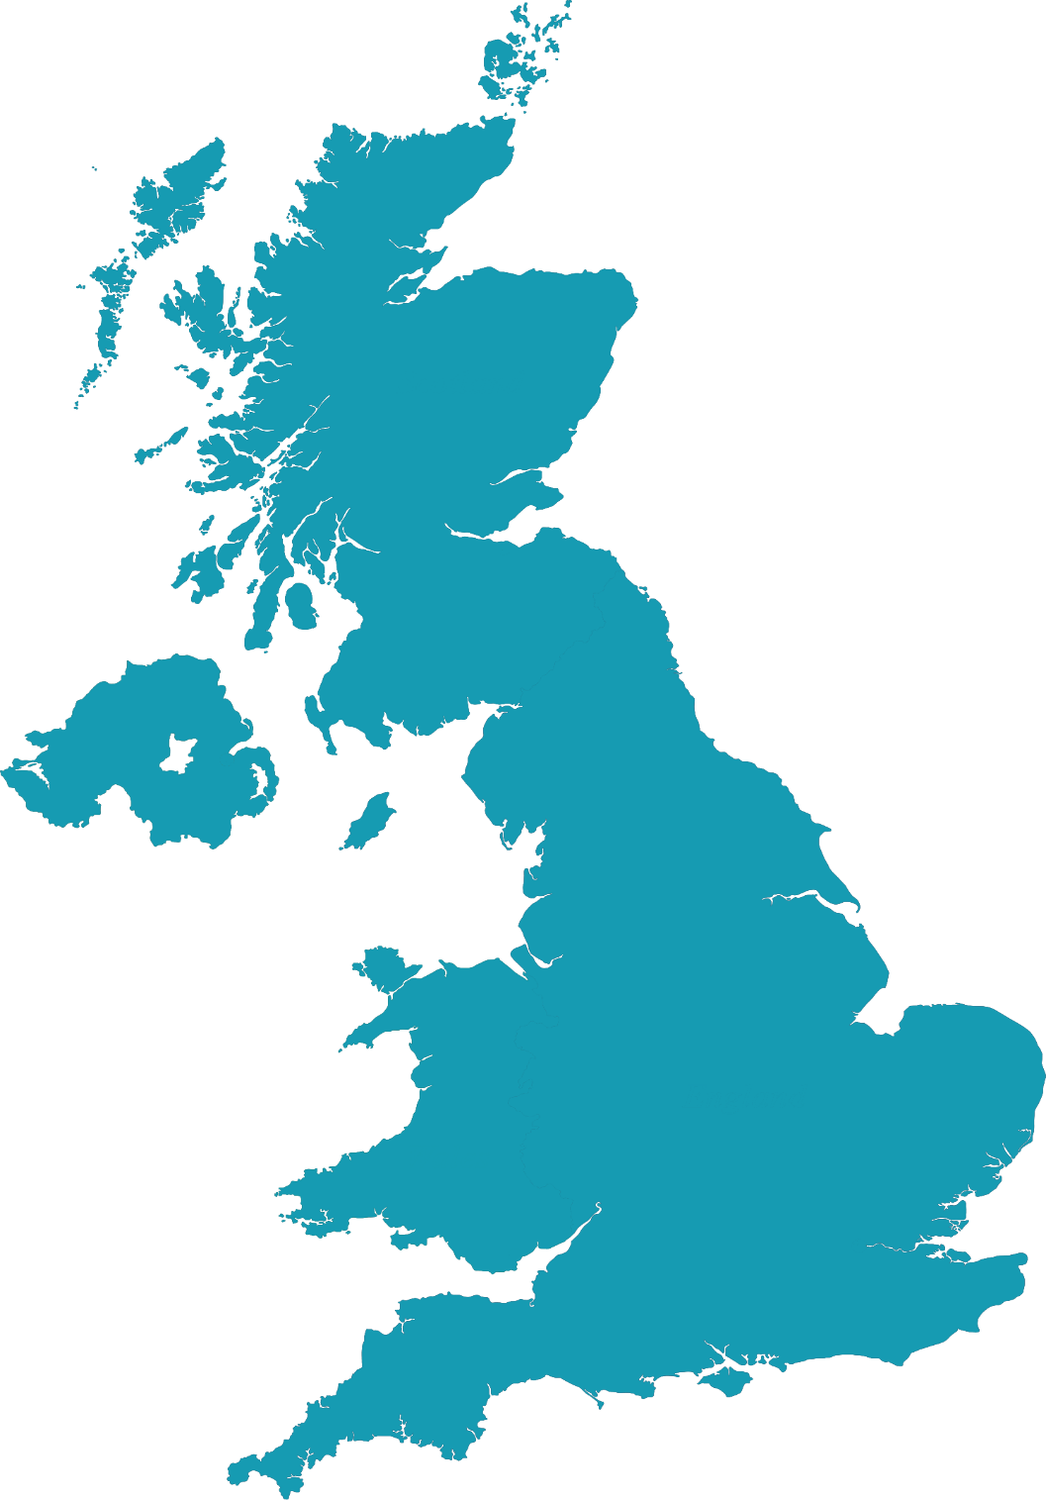
TOP 2021 DESTINATIONS 2021
GLASGOW
EDINBURGH
2
STREET FURNITURE
NEWCASTLE
LARGE FORMAT
RAIL
LEEDS
MALLS
6
AIRPORT
HULL
BRADFORD
SHEFFIELD
MANCHESTER
4
5
NOTTINGHAM
STOKE-ON-TRENT
LIVERPOOL
7
8
LEICESTER
BIRMINGHAM
9
OXFORD
NORTHAMPTON
BRISTOL
LONDON
3
10
CARDIFF
1
BRIGHTON
READING
PORTSMOUTH
SOUTHAMPTON

Slide 7
SUMMER STAYCATIONS

