Slide 1
VALENTINE’S DAY 14TH FEBRUARY 2023

Slide 2
VALENTINE’S DAY 2022
40M
planned to celebrate
£1.37B
total spend
£35
spend per person
Source: Finder.com
Notes:
While Valentine’s Day 2022 celebrations were different from prior times, Brits were still finding ways to indulge their partners, pets and themselves with gifts, dates and much more. So, how much does the day really cost? Up to 40 million Brits/just over three quarters (76%) of the nation planned to celebrate Valentine’s Day in 2022, down from 79% in 2020, and up from 69% in 2018.
People also planned to spend less with the average spend per person being £35. An increase from the forecasted £25 per person in 2021 now levelling to pre-covid 2020 numbers, which saw the average spend per person sit at £35. In 2018, the average spend per person was £28. This indicates substantial growth in this market.

Slide 3
VALENTINE’S DAY BY AGE GROUP
Source: Finder.com
Notes:
Generation Z overtook millennials as the UK’s highest-spending age group for Valentine’s Day 2022, planning to fork out a whopping £41 on average for their loved ones. The next highest spenders were millennials (£32), followed by generation X (£19) and baby boomers (£11). The silent generation are the lowest spenders, averaging £10.
Gen Z (born after 1996)
Millennials (1981-1996)
Gen X (1965-1980)
Boomers (1946-1964)
Silent (1928 -1945)

Slide 4
ROMANTIC LONDON
Region | Average Amount
London | £39
West Midlands | £24
North East | £23
Northern Ireland | £23
South East | £22
Yorkshire and the Humber | £22
North West | £22
East of England | £21
South West | £18
Wales | £18
Scotland | £17
East Midlands | £16
Source: Finder.com
Notes:
London is the UK’s most romantically minded city – or at least its biggest-spending city – with those in the capital planning on spending just below £40 on Valentine’s Day 2022. While the capital’s reign as the highest spending city still continues, the average amount per head has seen a drop of 25% since 2020 where Londoners were happy to splurge an average of £52 per head. At the other end of the scale, the East Midlands has the lowest average spend at £16.

Slide 5
VALENTINE’S DAY ACTIVITIES
Source: YouGov December 2022 *Audience defined as those who celebrated Valentine’s Day 2022
Notes:
Cooking a meal at home was still the top activity for both 2022 and 2021.

Slide 6
FAVOURITE CUISINES
Rank | Cuisine
1 | Japanese
2 | French
3 | American
4 | Spanish
5 | Mexican
6 | Thai
7 | Greek
8 | Asian
9 | Middle Eastern
10 | Italian
Source: YouGov November 2022 *Audience defined as those who celebrated Valentine’s Day 2022

Slide 7
GIFTS GIVEN 2022
Source: YouGov November 2022 *Audience defined as those who celebrated Valentine’s Day 2022
Notes:
This graph shows the top gifts given in 2022.

Slide 8
AMOUNT SPENT
Source: YouGov November 2022 *Audience defined as those who celebrated Valentine’s Day 2022
Notes:
Does not add up to 100% due to rounding.

Slide 9
PRIMED BY OUT OF HOME
+75%
POSTED/SHARED CONTENT ABOUT A PRODUCT/SERVICE/BRAND ON SOCIAL MEDIA SITES
+69%
INTERACTED DIRECTLY WITH A BRAND’S SOCIAL MEDIA AFTER SEEING OOH
+33%
more likely
​to
Spend 9-10 hours travelling OOH
+39%
WENT TO A STORE TO BUY PRODUCTS AFTER SEEING OOH
+26%
TAKEN A PHOTO OF AN ADVERT USING A MOBILE PHONE
Source: YouGov November 2022 *Audience defined as those who celebrated Valentine’s Day 2022
Notes:
These stats show that this audience is primed by Out of Home (OOH) as they research/purchase products and services and visit stores after seeing OOH.

Slide 10
BEST ENVIRONMENTS HEAVY EXPOSURE TO OOH
+36%
RAIL
+25%
MALLS
+35%
SUPERMARKET
+31%
LARGE FORMAT
+18%
STREET
FURNITURE
Source: YouGov November 2022 *Audience defined as those who celebrated Valentine’s Day 2022
Notes:
This audience has heavy exposure to OOH in multiple environments.

Slide 11
VALENTINE’S DAY IN ALL ENVIRONMENTS
STREET
FUNITURE
RAIL
SUPERMARKET
MALLS
LARGE FORMAT

Slide 12
PANDORA CHATBOT CASE STUDY
Notes:
In the lead up to Valentine’s Day, Pandora launched an exciting experiential activity within Westfield Stratford City. A love chatbot guru named Gemma invited shoppers to select witty chat up lines or light hearted jokes on screen, creating an immersive brand experience. There was also domination coverage on Channel Westfield digital 6-sheets, with copy directing consumers to the installation’s location.

Slide 13
PANDORA CHATBOT CASE STUDY
Campaign Objectives
Generate excitement about, and interaction with the Pandora brand for Valentine’s Day through a campaign that embraced the brand’s core values
Ensure Pandora was front of mind for Valentine’s gifting
Encourage consumers to visit the Pandora store
Provide a physical presence for Pandora’s online love guru Chatbot, ‘Gemma’

Slide 14
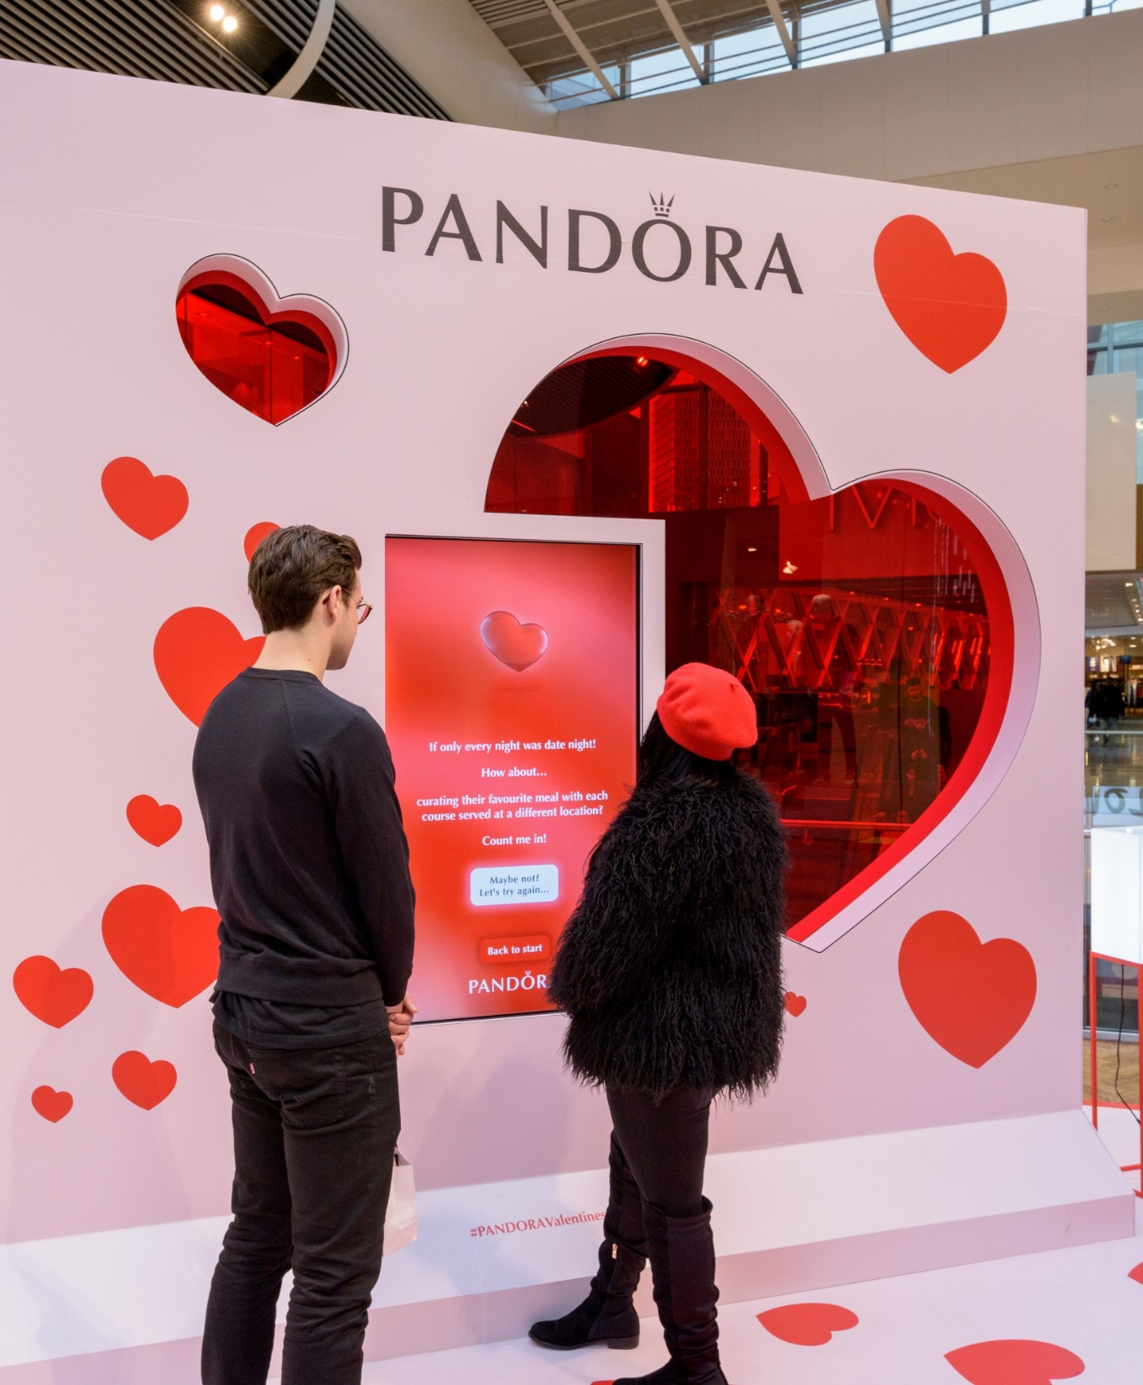
“
JCDecaux’s Foundry and Creative Solutions teams were brilliant collaborators to bring our online Chatbot, Gemma, to life with a physical presence at Westfield Stratford City in the run-up to Valentine’s Day.
“The end result was something extraordinary; a great way for consumers to interact with the Pandora brand in a personal, playful way.
“We were delighted with the positive consumer response, the high levels of interaction with Gemma and the rate of voucher redemption which drove significant additional in-store revenue.
“I’m proud that Pandora was instrumental in spreading a little extra love on Valentine’s Day, thanks to Gemma’s suggestions for romantic activities and our partners in making this happen.”
Rosie Reeves
Brand Manager
Pandora

Slide 15
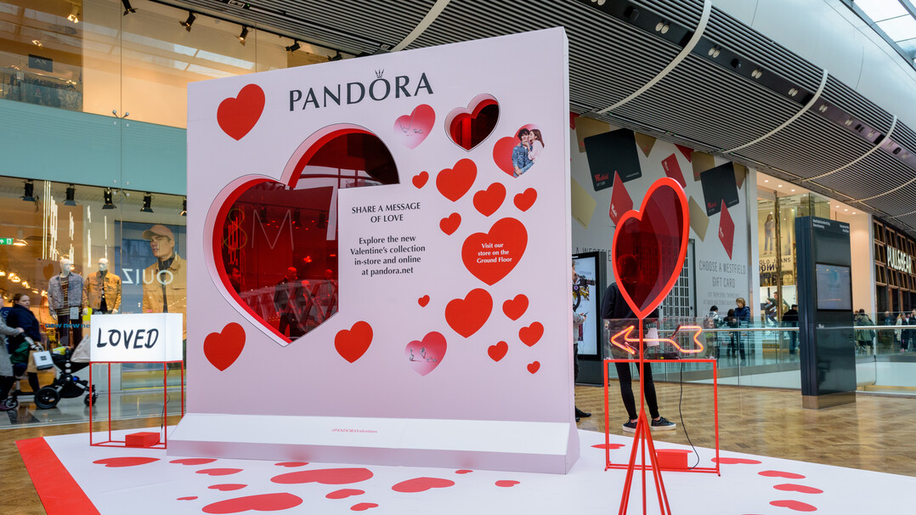
VALENTINE’S DAY 14TH FEBRUARY 2023

