Slide 1
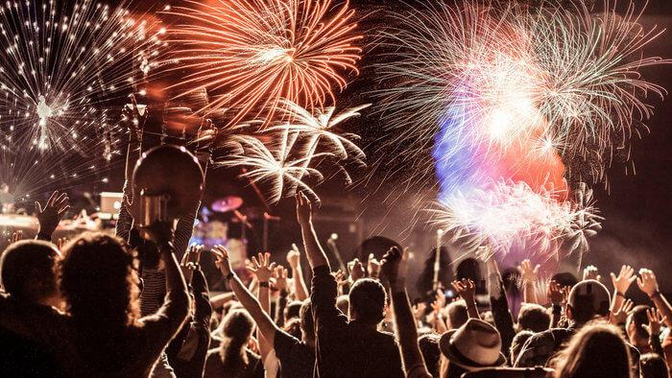
FREEDOM DAY – THE AFTER EFFECTS AUGUST 2021
Notes:
70m vaccine doses given
28.5m fully vaccinated
43% of population fully vaccinated

Slide 2
CELEBRATING FREEDOM DAY
Notes:
Nightclubs opening
Restrictions on large scale events no longer apply
Rule of six on indoor gatherings ended
30 person limit on events e.g. weddings lifted

Slide 3
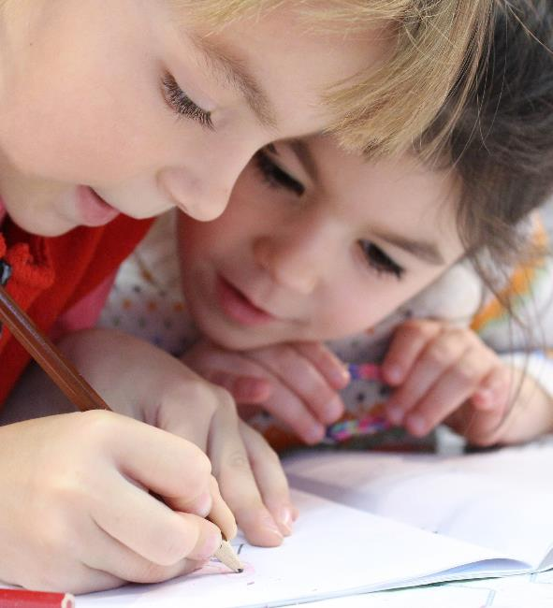
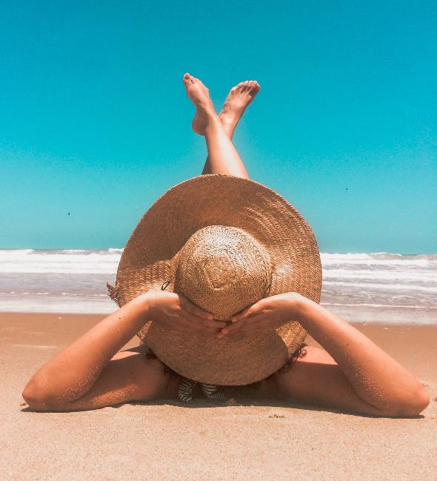
WHAT’S CHANGED?
End of self-isolation
for vaccinated population
16 August
End of ‘school bubbles’
Removal of quarantine
from amber list destinations
Source: inews
Notes:
16 August
no self-isolation for vaccinated population

Slide 4
RETAIL SALES HIGHEST ON RECORD
+10%
increase in total retail sales over 3 months to June – highest on record
+47%
increase for non-food stores vs previous quarter
Source: British Retail Consortium (BRC)

Slide 5
UK JOBS LEAP AS ECONOMY BOUNCES BACK
+365K
jobs in June Vs May
7.3%
rise in weekly earnings March-May vs previous year
Source: Reuters

Slide 6
FREEDOM DAY FOOTFALL UP
16.5%
footfall uplift in UK on 19 July
Source: Retail Gazette

Slide 7
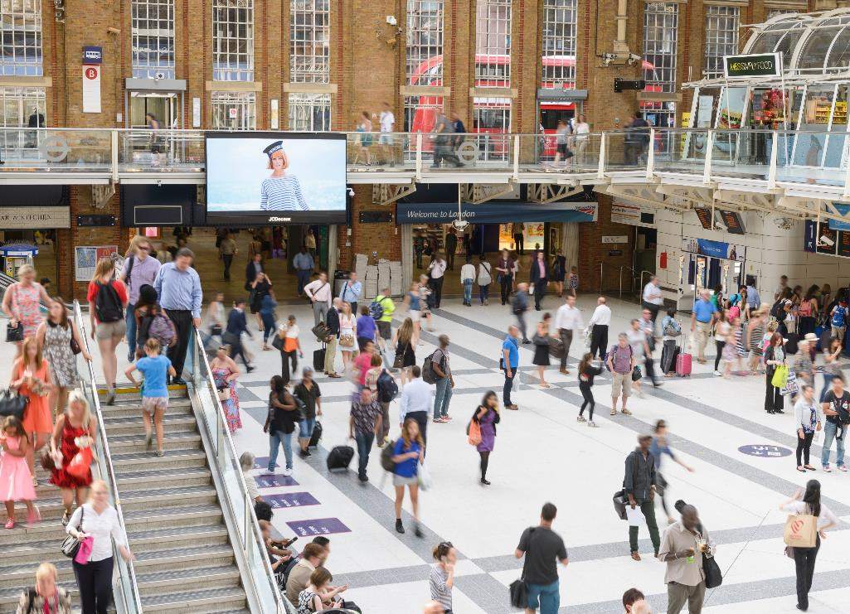
BACK TO WORKPLACE BY SEPTEMBER
+47%
increase in weekly rail use since May
(+1.9 adults)
30%
know their back to work schedule
56%
will be back to workplace by end of Sept
+10%
increase in planned rail use for this year
JCDecaux sentiment tracker 2021
Notes:
Weekly rail use increased from 8% of UK in May, to 11% (5.9m adults) in July. This is an increase of +47%, representing an extra 1.9m adults.
30% have been communicated to back to work schedule
56% will be back to workplace by end of Sept – double check on spreadsheet
Planned rail use for this year has increased by +10% since May.

Slide 8
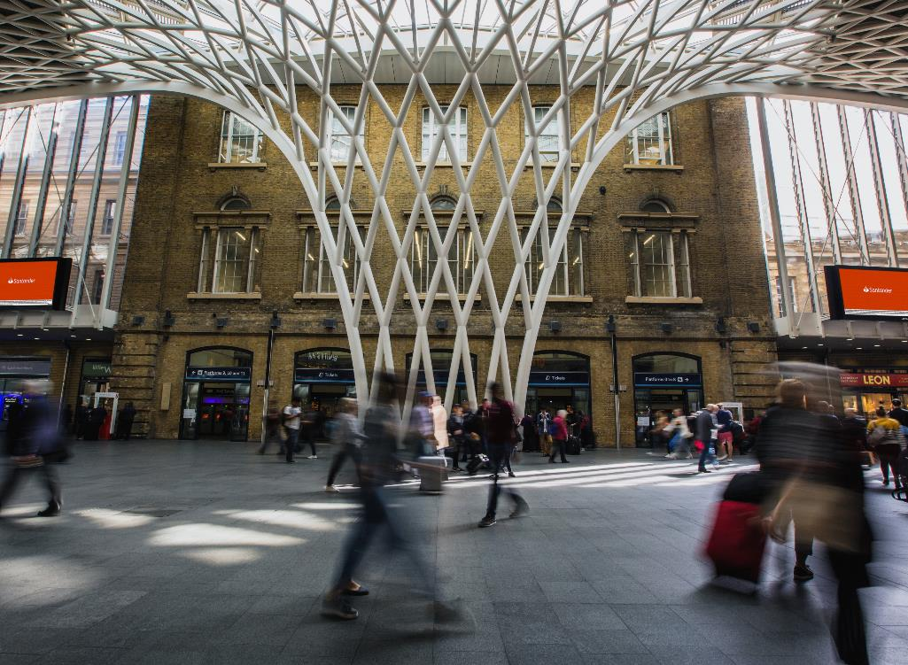
LONDONERS DO MORE IN A WORKDAY
32%
of Londoners are currently working in a workplace 4+ days a week
26%
of Londoners expect to be back at work 5 days a week in the future
+73% buying a coffee in the station
+67% going to the gym
+65% drinking at the pub
JCDecaux sentiment tracker 2021
Notes:
Weekly rail use increased from 8% of UK in May, to 11% (5.9m adults) in July. This is an increase of +47%, representing an extra 1.9m adults.
30% have been communicated to back to work schedule
56% will be back to workplace by end of Sept
Planned rail use for this year has increased by +10% since May.

Slide 9
ACTIVITIES PLANNING BEFORE END OF AUGUST
Source: JCDecaux sentiment tracker 2021

Slide 10
ACTIVITIES PLANNING BEFORE END OF AUGUST
+44%
Source: JCDecaux sentiment tracker 2021
Notes:
Huge increase in confidence of doing activities before end of Aug – these are up since we asked back in May what people were planning to do before the end of the year.

Slide 11
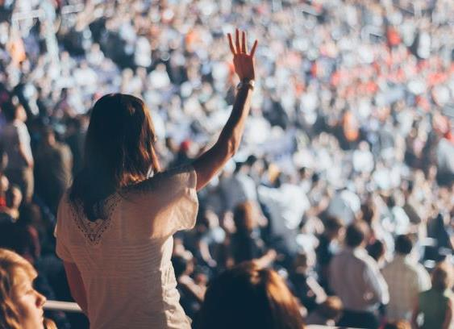
SUMMER OF FUN: PLANS BEFORE END OF SEPT
74%
go to a sports event
70%
go to a festival
68%
go to a nightclub
51%
go to a concert
JCDecaux sentiment tracker 2021

Slide 12
TIME TO SPEND
58%
are planning to spend money saved in lockdown
1 in 4
have saved over £1000
Source: JCDecaux sentiment tracker 2021

Slide 13
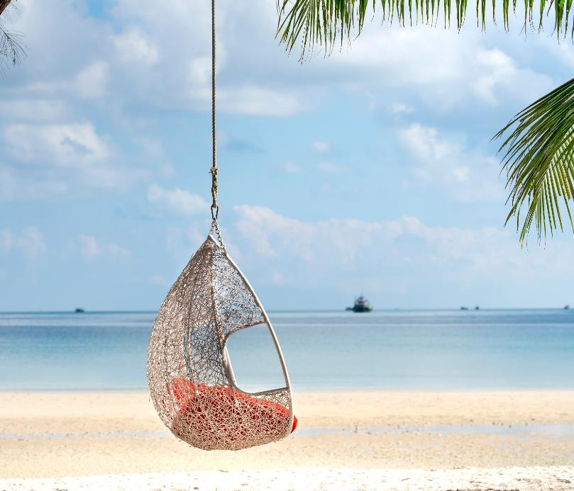
WANT TO HEAR FROM INDUSTRIES WE’VE MISSED
want to hear more from travel companies (24%)
1 in 4
Food and drink
23%
Entertainment
21%
Personal care
20%
Technology
20%
Source: JCDecaux sentiment tracker 2021

Slide 14
TOP 5 CATEGORIES PLANNING TO SPEND ON
Holiday
2.Plan to save until decide
3.Home / garden improvements
4.Clothes / footwear
5.Car
Source: JCDecaux Sentiment Tracker 2021

Slide 15
FREEDOM DAY – THE AFTER EFFECTS AUGUST 2021

